Slide 1
October 2024
Exploration of showing up
Summary of Qualitative Findings

Slide 2

The Ask
BCBSMA has a new mission statement: “Show up for everyone like they’re the only one”. This project explores the meaning of showing up to help the company activate on its mission.
This report
Next Steps
Qualitative Exploration
Illustrate what showing up and not showing up means to members generally and in a BCBSMA context
Explore emotional impacts of showing up and not showing up in these contexts
Uncover how members want BCBSMA to show up for them
Develop input for phase two quant survey module leveraging insights on the above
Potential Follow-up Research
Identify critical moments for members, member needs in the moments, and the possible ways and means for BCBSMA to show up for members in those critical moments
Then, return to the C Space communities to measure scope and scale of interest in proposed actions from BCBSMA

Slide 3



METHODOLOGY
Qualitative Survey: “Tell us all about it”
Fielding dates: Sept 19– Oct 1, 2024
Audience: Commercial and Medicare BCBSMA Members
Respondents: Idea Exchange Communities
AUDIENCE
Commercial | 30 | 61%
Medicare | 19 | 39%
Total | 49
A subset of BCBSMA members from the C Space Communities were invited to participate in the qualitative survey, including a mix of ages, genders, and ethnicities.
See appendix for sample description
Results are qualitative in nature and should be used for directional purposes only.

Slide 4
Key findings
What “showing up” for people means…
Whether in the context of people or companies, “showing up” carries the core idea of being present and providing support when needed.
However, the context changes the expectations and the form that "showing up" takes. For individuals, it's more personal and emotionally driven, while for companies, it involves customer service, support, and corporate policies that go beyond the bare minimum.
…as people
… as companies
Expectations
Intimate and emotional connections
Individualized supports
Actions
Emotional support
Physical presence
Practical assistance
Expectations
Fulfilling obligations
Customer satisfaction
Employee well-being
Actions
Customer service and support that goes above and beyond the bare minimum
Ethical behavior
… as both
Be present and supportive in a moment of need
Results are qualitative in nature and should be used for directional purposes only.

Slide 5
Recommendations for BCBSMA: Bring it all together
Showing up should encompass members’ expectations of companies generally, excellence as a health insurer, and a personalized approach to member support.
Show up as a company
Show up as a health insurer
Show up as a friend / ally
Go beyond duty to:
Demonstrate a sincere and proactive commitment to the interests and needs of members; build trust and value through exceptional service, genuine care, and a culture of support and integrity
Be a leader in the industry:
Offer comprehensive coverage, exceptional customer service, affordability, proactive health and wellness support, patient-centric care, efficient and accessible service, fairness and advocacy in healthcare pricing, operational excellence, and extra benefits for convenience
Make a positive impact on lives of members:
Identify big and small ways to be there and support members in whatever capacity is needed during critical moments of need, especially proactive ways to offer emotional and practical supports for members
Results are qualitative in nature and should be used for directional purposes only.

Slide 6
Recommendations for research
To activate on the company’s mission to show up for everyone like they’re the only one…
Identify critical moments
Understand member needs in those moments
Meet or exceed member expectations for BCBSMA
Strengthen the relationship with personalized supports
Find touchpoints when BCBSMA can anticipate member needs
Engage in active listening to fully comprehend the member view
Go beyond duty to demonstrate genuine care for member satisfaction and wellbeing
Be available, reliable, and offer proactive assistance that is emotional, physical and/or practical
Next Steps:
Confirm and measure scale of interest among members and prioritize ways BCBSMA can show up for members
Results are qualitative in nature and should be used for directional purposes only.

Slide 7

What showing up means to members
Detailed findings for individuals and companies
BLUE CROSS BLUE SHIELD OF MASSACHUSETTS
CONFIDENTIAL – NOT FOR DISTRIBUTION
Blue Cross Blue Shield of Massachusetts is an Independent Licensee of the Blue Cross and Blue Shield Association.

Slide 8
WHAT IT MEANS FOR A PERSON TO SHOW UP FOR YOU
people Showing up is fundamentally about being present and supportive in a time of need, which strengthens the interpersonal bond
Results are qualitative in nature and should be used for directional purposes only.

Slide 9


EXPECTATIONS
showing up for someone as A PERSON means being THERE in a critical moment and offering whatever emotional, physical, or practical support the moment calls for
What it means for a person to show up (unaided, n=49)
Emotional Support: being present for someone emotionally, offering a listening ear, empathy, and understanding. (n=14)
Support in Difficult Times: challenging periods like health issues, loss of a loved one, or emotional distress. (n=6)
Active Listening and Engagement: giving undivided attention, focusing on the person's needs, and engaging with them without distractions. (n=5)
Physical Presence: being there in person, attending events, or being physically close to someone when they need support. (n=11)
Reliability and Dependability: being someone a person can count on, showing consistency in support and follow-through (n=7) and offering unconditional support no matter the circumstances (n=6)
Communication and Check-ins: keeping in touch through calls, messages, or emails, and regularly checking in on the person's well-being. (n=4)
Help with Tasks and Chores: such as cooking, cleaning, or running errands for someone who needs assistance. (n=7)
Assistance and Problem-Solving: offering to help solve problems, providing advice, and assisting with decision-making processes. (n=4)
Being Supportive Without Being Asked: anticipating the needs of the person and taking initiative to provide support. (n=4)
Results are qualitative in nature and should be used for directional purposes only.
Notes:
Q3. First, tell us in your own words what it means for a person to show up for someone? This person could be anyone, including a family, friend, or colleague. What does that mean or look like to you personally? (open end, n=49)

Slide 10



ACTIONS
Ways members have experienced someone showing up for them in the past range from simply listening and being present to helping with chores or tasks
Ways that people show up for each other, from member stories (unaided, n=49)
Listening and Caring: emotional support during tough times, especially when grieving (n=6) and during significant life events, such as moving out, divorce, or transitioning to new phases in life (n=3)
Practical Help: tasks like moving, cooking, or cleaning, especially during illness or recovery from surgery (n=8) or transportation support to appointments (n=3) also unprompted acts of kindness, such as shoveling snow or bringing homemade cookies, to show care and support (n=2)
Physical Presence: the simple act of being physically present as a form of support, such as attending appointments, events such as funerals, or just visiting (n=5) someone in the hospital or being by their side during medical treatments (n=7)
Work-Related Support: stepping in to help with work responsibilities or offering moral support during work-related challenges (n=5)
Thought-starter: How can BCBSMA be present and supportive in a time of need?
Listening and being there: member advocates (across channels) that actively listen and offer genuine empathy to concerned members. Ease access to mental health care and other counseling services.
Practical Help: Consider how BCBSMA can offer or promote respite care for caregivers and other services at hospital discharge that support the transition to home and continued healing.
Physical Presence: provide network hospitals with care packages for members experiencing inpatient stays.
Results are qualitative in nature and should be used for directional purposes only.
Notes:
Q4. Tell us a story from your own real-life experience to illustrate what showing up means for you. It can be any story about any time a family, friend, or coworker showed up for you. (open end, n=49)

Slide 11




ACTIONS
The common thread is the act of being available and supportive to each other, in big and small ways
“I had a hard time moving away for the first time from my family and my girlfriend showed up for me in many ways. She came over and stayed many nights, cooked and cleaned when I couldn't bring myself to, and provided a space where I could feel how I felt without feeling ashamed.” – Commercial,
18-34, Man
“I called two friends to let them know I wasn't well, and they came to the [ER] in the middle of the night to support me. …they took me back to their house, made up a bed for me, and one of them went to the only 24-hour pharmacy in the area to fill the hospital prescription that night.” - Medicare, 65+, Woman
“Several years ago, I had some minor surgery that put me out of my office for a week. One of my coworkers organized the others to make cookies for me and then brought them to my home. 10 dozen homemade cookies went a long way to ease my pain. That is showing up for me!”
- Medicare, 65+, Man
“During a time of poor health having loved ones just send random texts checking in and expressing their love was very meaningful. Often, the messages did not necessitate a response or update (which was relieving) and served as a reminder of the strong support network I have.” - Commercial, 35-49, Man
Results are qualitative in nature and should be used for directional purposes only.
Notes:
Q4. Tell us a story from your own real-life experience to illustrate what showing up means for you. It can be any story about any time a family, friend, or coworker showed up for you. (open end, n=49)

Slide 12
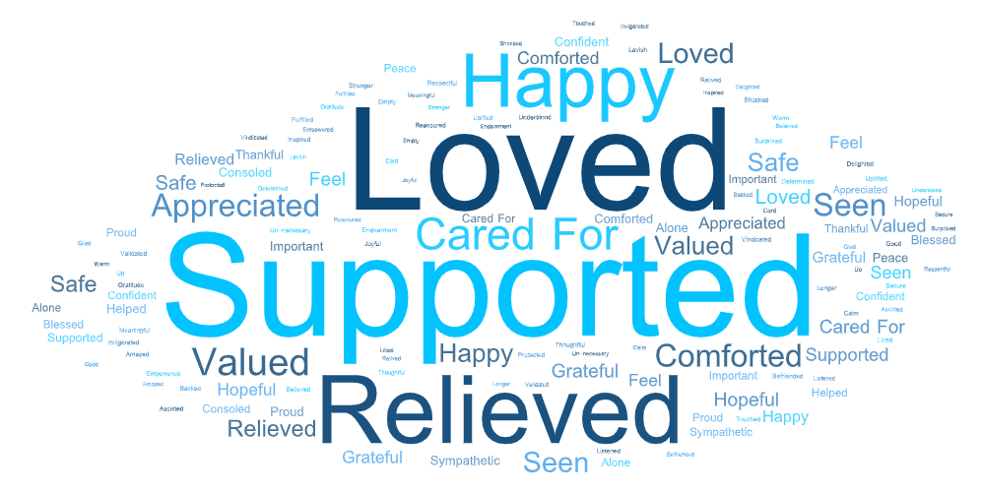
EMOTIONS
When someone shows up for you, it elicits feelings of being supported, loved, relieved and happy
These feelings of love and support likely strengthen the quality of the relationship beyond just this moment of showing up
How it feels when a person shows up
(unaided, up to 3 words, n=49)
Results are qualitative in nature and should be used for directional purposes only.
Notes:
Q5. In the examples of showing up that you just described, tell us up to three words that describe how it made you feel when this person showed up for you. (open text list, n=49)

Slide 13
WHAT IT MEANS FOR A COMPANY TO SHOW UP FOR YOU
Companies Showing up is fundamentally about meeting or exceeding their customer service obligations, which leaves consumers grateful at the end of a transaction
Results are qualitative in nature and should be used for directional purposes only.

Slide 14
EXPECTATIONS
Companies CAN show up for PEOPLE in three distinct ways: AS customers, AS A community, and AS Employees
Members reflected on ways companies and organizations can show up through these lenses… (unaided, n=49)
Showing up for customers
SHOWING UP FOR Community
SHOWING UP FOR employees
Going above and beyond in customer service, offering more value than what is paid for
Responding promptly and thoughtfully to complaints and problems
Standing behind their products and services with guarantees and support
Listening to customers' issues and offering assistance, support, and suggestions
Providing proactive updates, follow-ups, and customized services tailored to individual needs
Being reliable, transparent, and ethical in all actions
Allowing flexibility in policies, such as return policies, to accommodate exceptional circumstances
Taking actions or changing policies to support social causes or disadvantaged groups
Engaging in fundraising or community support activities during important times like heritage months or pride month
Sourcing products in a way that does not harm indigenous groups or the environment
Showing up in support of groups by being present and advocating for their needs
Giving time off for personal matters without penalizing the employee
Providing benefits and support that are not strictly required but enhance the well-being of employees and their families
Acting with understanding, flexibility, and compassion towards employees' lives outside of work
Celebrating employees' milestones and showing genuine care for them as individuals
Supporting personal and professional development through coaching, training, and opportunities
Ensuring that employees feel valued, secure in their employment, and that their career is a priority
Results are qualitative in nature and should be used for directional purposes only.
Notes:
Q6. Now we’d like to think about what it means for a company or organization to show up for someone. What does that mean or look like for you? (open end, n=49)
Note: 3 respondents did not feel the concept of “showing up” was applicable to a company or organization. 10 respondents were unable to recall a story to tell.

Slide 15
ACTIONS
Companies and organizations show up by offering exceptional service, genuine commitment to well-being and satisfaction, and a culture of support and integrity
Ways that companies and organizations show up, from member stories (unaided, n=38)
Exceptional Customer Service that is responsive, timely, and hassle-free (n=10)
  Members shared stories of company representatives making exceptional efforts to resolve issues and companies making exceptions to policy to ensure an individual got what they needed.
Employer Support during Personal Challenges (n=9)
  Companies show up for their employees by responding with compassion and flexibility as the personal circumstances of employees change leaves a powerful and positive impression of the organization with that individual.
Financial and Material Support that offers more value than what is paid for (n=6)
  Members shared stories of gratis services and waived fees, problem resolutions, and adjustments to be sure individual needs were met.
Acts of Kindness and Going Beyond Duty makes customers feel valued and important (n=5)
  Stories describe moments where companies and their representatives honored promises and did what felt right even if it went beyond policy.
Advocacy and Problem Resolution on a person’s behalf (n=3)
  Members describe issues that seemed unresolvable until someone stepped in to clear the path to resolution.
Results are qualitative in nature and should be used for directional purposes only.
Notes:
Q7. Now, please tell us another story from your own real-life experience to illustrate what showing up means for you. This time, please tell a story about a time an organization or company showed up for you. (open end, n=38)
Note: 3 respondents did not feel the concept of “showing up” was applicable to a company or organization. 11 respondents were unable to recall a story to tell.

Slide 16




ACTIONS
Positively impactful moments are often delivered by representatives empowered and encouraged to meet the needs of the moment, not just their obligations
“Once I had an issue with luggage and an employee completely went out of her way to assist, even going to physically get my luggage off the plane once it was checked through and rechecked it in the correct flight.” - Commercial, 50-64, Woman
“We were having a reno done on our newly purchased home… in the middle of all this, I got diagnosed with breast cancer. The [contractor] worked with me to be sure that I had a working home 2 days before my surgery so I could get rid of the construction dust and settle in.” - Commercial, 50-64, Woman
“My gas company, which has been unable to bill my account due to a glitch for almost 6 months [has] a representative who communicates proactively to tell me what to expect in this odd, uncommon scenario. This makes me trust the company a little more.” - Commercial,
35-49, Woman
“I went to the local watering hole and had one too many drinks. One of the bartenders walked me home and got me into my house to make sure I was safe. That was above and beyond what the business needed to do. They could have just thrown me out instead of took me by the hand to my home.”
- Commercial, 35-49, Man
Note: 3 respondents did not feel the concept of “showing up” was applicable to a company or organization. 11 were unable to recall a story to tell.
Results are qualitative in nature and should be used for directional purposes only.
Notes:
Q7. Now, please tell us another story from your own real-life experience to illustrate what showing up means for you. This time, please tell a story about a time an organization or company showed up for you. (open end, n=38)
Note: 3 respondents did not feel the concept of “showing up” was applicable to a company or organization. 11 respondents were unable to recall a story to tell.

Slide 17
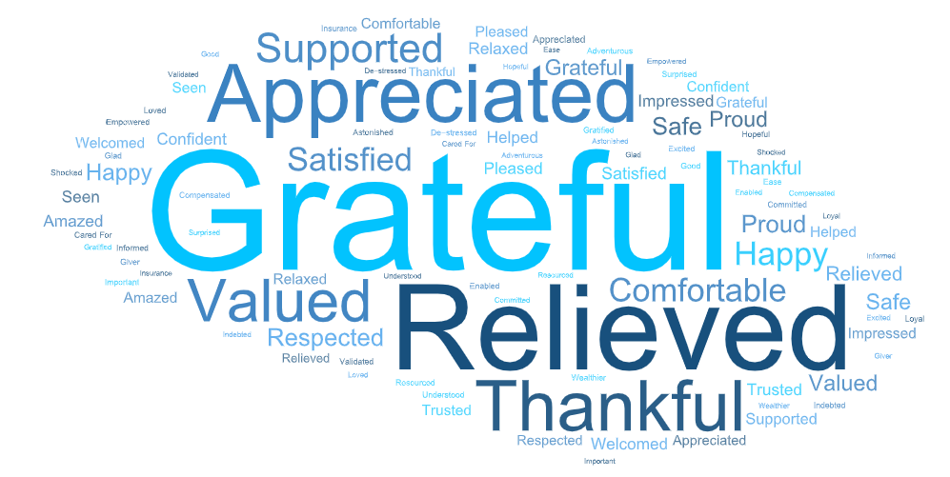
EMOTIONS
These Actions and attitudes that go beyond the minimum required effort leave members feeling grateful, RELIEVED, AND APPRECIATED and more positive about the company
Impacts of showing up on company perception
(5-pt scale, T2B shown, n=38)
How it feels when a company shows up
(unaided, up to 3 words, n=38)
36 of 38
have a more positive perception of a company that showed up for them
Results are qualitative in nature and should be used for directional purposes only.
Notes:
Q8. In the examples of showing up that you just described, tell us up to three words that describe how it made you feel when the company or organization showed up for you. (open end, n=38)
Q9. On a scale of 1 to 5, where 5 is much more positively and 1 is no impact, how did “ showing up" for you impact your perception of the company or organization? (single-select, n=38)
Note: 3 respondents did not feel the concept of “showing up” was applicable to a company or organization. 11 respondents were unable to recall a story to tell.

Slide 18
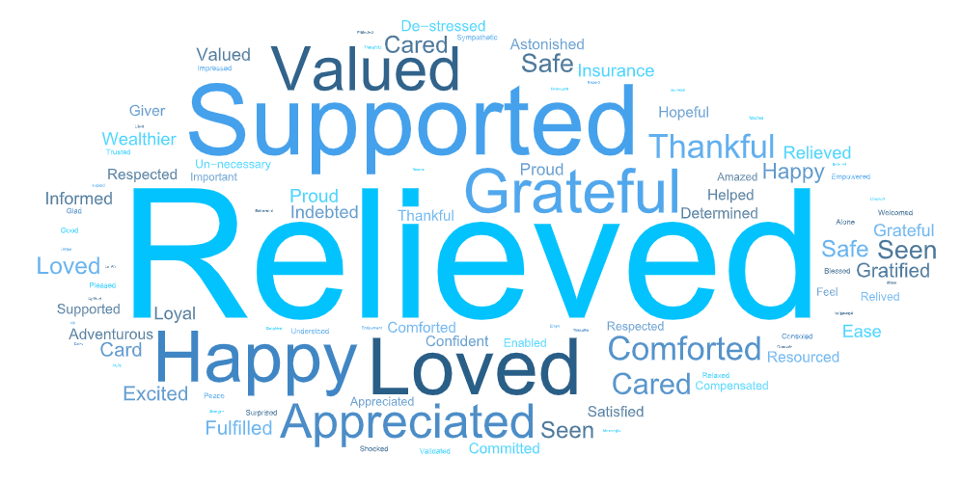
Thought-starter: HOW can BCBSMA move beyond the transactional nature of company expectations and reach toward the emotional impacts of interpersonal relationships?
Can we go beyond gratitude
…toward supported and valued?
How it feels when a company shows up, n=38
Combined how if feels for a person and a company to show up; results speculate deeper emotional response is possible for a company engaging in a personal approach.
Results are qualitative in nature and should be used for directional purposes only.

Slide 19
Perceptions of BCBSMA
BLUE CROSS BLUE SHIELD OF MASSACHUSETTS
CONFIDENTIAL – NOT FOR DISTRIBUTION
Blue Cross Blue Shield of Massachusetts is an Independent Licensee of the Blue Cross and Blue Shield Association.

Slide 20
perception of bcbsma as a company that shows up reflects belief that BCBSMA is making a genuine effort to provide the best care possible
How well would BCBSMA show up for you?
(5-pt scale, n=49)
ABOUT HALF THINK BCBSMA WILL SHOW UP VERY well bECAUSE…
ABOUT one-third FEEL UNSURE ABOUT BCBSMA SHOWING UP BECAUSE…
ABOUT ONE-FIFTH THINK BCBSMA WILL NOT SHOW UP BECAUSE…
(Rated 4 or 5 – Very well, n=25)
(Rated 3, n=15)
(Rated 2 or 1 – not at all, n=9)
members are optimistic the company would show up stemming from a history of effective customer service, reliable coverage, the company's perceived care for their well-being, and the ease of access to information and assistance
members have mixed experience with support and expect the company’s motivation for profit and the regulatory nature of the industry would hamper BCBSMA’s ability to go beyond the basic requirements
members describe moments where they felt left in the lurch and unsupported, sometimes a feeling of powerlessness in the face of rigid or impersonal responses to their need
Results are qualitative in nature and should be used for directional purposes only.
Notes:
Q14. Based on your perception of Blue Cross Blue Shield of Massachusetts, how well do you think they would show up for you when you need them? Please rate the company on a scale of 1 to 5, where 5 is very well, and 1 is not at all. Use the space provided to explain your answer. (Rating with open end, n=49)

Slide 21



members hope that BCBSMA will show UP AS AN industry leader by demonstrating dedication to their health and satisfaction
In order to better serve them and their families, members are looking for… (unaided, n=49)
Coverage and Cost Control (n=19)
  “Provide broad enough coverage for my medical needs without me having to worry about researching what might or might not be covered.” – Medicare, 65+, Man
  “I expect them to do what they can to help bring down the cost of prescription medication (I am on their plan for Part D of Medicare).” - Medicare, 65+, Woman
Customer Service and Support (n=17)
“I would hope that BCBS would truly understand my perspective and position on the matter.” – Commercial, 50-64, Woman
“Providing support beyond the minimal requirements.” - Commercial, 18-34, Man
Transparency and Communication (n=16)
“Better ways to see what you are being charged for. Seeing "medical services" on a bill is not useful.” - Commercial, 50-64, Man
Health and Wellness Support (n=9)
“I would hope that they would support initiatives that promote the health of the larger community. One example is through their work to address inequality in health care.”
- Medicare, 65+, Woman
Simplification and Accessibility (n=8)
“[Make it] easy to get support and expedite approvals when needed, also explaining ways to make it simple (in terms of docs needed, etc.).” - Commercial, 35-49, Man
Innovation and Adaptation (n=5)
“Through research and communication, they will share new innovations in health care to help everyone be better.” - Commercial, 35-49, Man
Results are qualitative in nature and should be used for directional purposes only.
Notes:
Q15. Now thinking of Blue Cross Blue Shield of Massachusetts as a health insurance leader, how would you hope they would show up for you and your family? (open text, n=49)

Slide 22
Potential Follow-up Research
Identify critical moments for members, member needs in the moments, and the possible ways and means for BCBSMA to show up for members in those critical moments
Then, return to the C Space communities to measure scope and scale of interest in proposed actions from BCBSMA
Coming soon!

Slide 23
Appendix

Slide 24
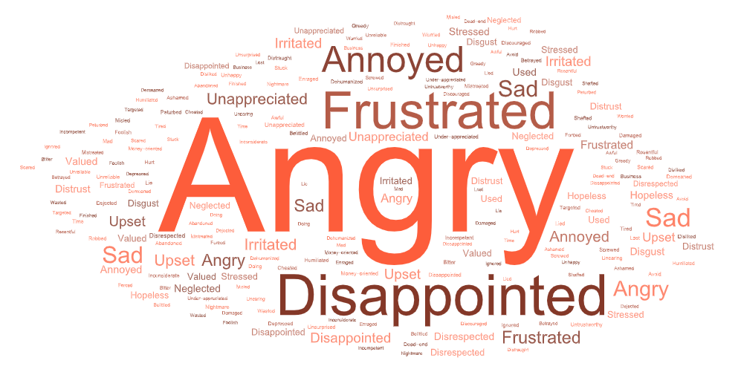
Members feel let down when an organization or company misses an opportunity to show up
EMOTIONS
Failures are disappointing and frustrating, often leading to a loss of trust and consideration to take their business elsewhere in the future. 3-of-4 feel more negatively toward the company.
How it feels when a company does not show up
(unaided, up to 3 words, n=43)
Missed opportunities, from member stories
(unaided, n=43)
Strictly adhered to policies without offering customer-friendly solutions, showing lack of compassion and inflexibility (e.g., refusing to extend a warranty by one day or not canceling a service contract early). (n=15)
Provided poor communication and follow-up (e.g., not returning phone calls or emails, not providing clear information about insurance coverage). (n=6)
Demonstrated a lack of customer appreciation or recognition (e.g., not rewarding loyalty, not accommodating disabilities). (n=6)
Failed to fulfill commitments or promises (e.g., not reimbursing costs as agreed, not completing work on time). (n=10)
Did not take responsibility for mistakes or errors (e.g., not addressing defective products, not crediting interest to an account). (n=3)
Note:. 6 respondents were unable to recall a story to tell.
Results are qualitative in nature and should be used for directional purposes only.
Notes:
Q10. Changing gears, now we’d like you to briefly describe a time when an organization or company missed the opportunity to show up for you. (open end, n=49)
Q11. In the missed opportunity for showing up that you just described, tell us up to three words that describe how it made you feel when the company or organization DID NOT show up for you. (open text list, n=43)
Q12. On a scale of 1 to 5, where 5 is much more negatively and 1 is no impact, how did NOT “ showing up" for you impact your perception of the company or organization? (single-select, n=43)
Note:. 6 respondents were unable to recall a story to tell

Slide 25
Positive member stories about insurance companies
“A life insurance company I had a policy from provided by the company I worked for at the time tried to cancel me for no reason after 10 years. The HR department went to the bat against them and forced reinstatement of the policy and looked for a replacement with a better company keeping the same coverage and premium.” - Medicare, 65+, Man
“My insurance company (USAA) is a great example, whether it was car accident, hurricane or other incident. The first question they ask is am I okay, how am I feeing, I never had any issue with them when making a claim.” - Commercial, 50-64, Woman
“I had a car accident that was not my fault. The insurance adjuster looked at Google maps and concluded that I was driving where there were no legal roads. And so found me at fault. In fact I was on an entirely legal road, as proven by Google Earth. The adjuster refused to acknowledge this. The owner of my insurance company intervened on my behalf and resolved this problem.” - Medicare, 65+, Man
“I probably have more counterexamples but one time I was supported by my company was when I was going through chemo treatments and my boss allowed me to keep my health insurance despite company policy.” - Commercial, 35-49, Man
Positive descriptions of BCBSMA as a company that shows up for members
“They have covered SO much of my expenses out of state. I can't imagine what I would do without this policy.” - Commercial,
50-64, Woman
“I have always been given help when I needed it. It has not mattered if it was a simple question or it was much more complex.”
- Commercial, 50-64, Man
“Every time I needed to contact BC/BS with questions, I received prompt, knowledgeable and accurate information and guidance.” - Medicare, 65+, Man
“They realize that caring for their customers engenders happy and healthy customers. They also have incentives and offered bonuses financially and in other aspects to educate and stay healthy.” - Commercial, 35-49, Man
“I feel that BCBS of MA has gotten better about showing up, sending thoughtful reminders, messages, and updates that are not overwhelming, too frequent, and not based on advertising but rather information and available supports.” - Commercial, 35-49, Man
Results are qualitative in nature and should be used for directional purposes only.
Notes:
Q7. Now, please tell us another story from your own real-life experience to illustrate what showing up means for you. This time, please tell a story about a time an organization or company showed up for you. (open end, n=38)
Q14. Based on your perception of Blue Cross Blue Shield of Massachusetts, how well do you think they would show up for you when you need them? Please rate the company on a scale of 1 to 5, where 5 is very well, and 1 is not at all. Use the space provided to explain your answer. (Rating with open end, n=49)

Slide 26
Negative member stories about insurance companies
“My mother, then in her 80s, was suddenly dropped from Medicare. Neither the Medicare offices nor the supplemental insurance company was helpful. I finally wrote to my senator's office (Ted Kennedy). They called me promptly and got to work sorting it out--which they did successfully.” - Medicare, 65+, Woman
“I was previously insured by Harvard Pilgrim. Their newsletter encouraged members to get the shingles vaccine, which my husband and I did. They then refused to pay for it. I wrote to the president and described the behavior as sleazy. So they hadn't shown up. After the complaint, they paid for it. So eventually they did. As you know, they are no longer my insurer.” - Medicare, 65+, Woman
“Last year, a car insurer (not the one I described earlier) failed to follow through with a non-insured motorist who rear-ended my car. This left me with a $1000 deductible which I deeply resented paying.” - Medicare, 65+, Woman
“When I purchased insurance on an appliance, and the appliance broke after a few months. The company made me jump through hoops to even get a repair.” – Commercial, 35-49, Man
“Some years ago I had a procedure and it was covered (paid) by the insurance. But then the insurance withdrew that payment and I was left holding the bag.” - Medicare, 65+, Man
Moments when BCBSMA missed an opportunity to show up for a member
“When Blue Cross instructed my doctor to send a note to all patients scheduled for any procedure with him that they might not pay for anesthesia. It was alarming and incorrect. The note only applied to a small number of people.”
- Medicare, 65+, Unspecified gender
“Currently Blue Cross Blue Shield is not showing up for me or more importantly my grandson’s follow up care for emergency surgery he received in the winter.” - Commercial, 50-64, Woman
“BC/BS had missed the opportunity several times by not disclosing what the out-of-pocket cost is to me, getting a bill for over $2,000 is one example. As a consumer you cannot make an informed decision.” - Commercial, 50-64, Woman
“When Blue Cross decided to end coverage for covid tests after the mandate ended.” - Commercial, 18-34, Man
Results are qualitative in nature and should be used for directional purposes only.
Notes:
Q10. Changing gears, now we’d like you to briefly describe a time when an organization or company missed the opportunity to show up for you. (open end, n=49)

Slide 27
Sample description
A subset of BCBSMA members from the C Space Communities were invited to participate in the qualitative survey, including a mix of ages, genders, and ethnicities.
Age | N=49
18-34 | 7 | 14%
35-49 | 13 | 27%
50-64 | 10 | 20%
65+ | 19 | 39%
Gender
Woman | 41% | 20
Man | 57% | 28
Non-binary / third gender | 0% | 0
Genderfluid | 0% | 0
I am: | 0% | 0
Prefer not to say | 2% | 1
Plan Type
Commercial | 30 | 61%
Medicare | 19 | 39%
Ethnicity (MS) | N=49
Asian and/or of Pacific Islander origin | 12% | 6
Black and/or of African origin | 10% | 5
Hispanic and/or of Latin origin | 10% | 5
Middle Eastern and/or of North African origin | 4% | 2
Native American / Alaskan Native / Indigenous American origin | 0% | 0
White/Caucasian and/or of European origin | 67% | 33
Multiracial / Multi-ethnic | 2% | 1
Not listed above, I identify as (please share): | 0% | 0
Prefer not to say | 2% | 1
Testimonial Interest
Yes, I am interested | 22 | 45%
Maybe | 10 | 20%
No, thank you | 17 | 35%

