Slide 1
DRAFT: 9/27/2024
Marketing 2025 Budget reassessment
A case for sustaining

Slide 2
2025 marketing budget – a Case for sustaining
With a 5% budget reduction requested for 2025, Marketing will reduce paid media, agency fees, and sponsorship dollars which we believe will hurt our brand in the marketplace.
After deep budget cuts in 2024, and additional market assessment, outlined in the following pages, we propose that Marketing should maintain its 2024 budget levels and pursue no further cuts.
Maintaining our marketing budget, especially during category downturns, ensures that our brand stays visible, competitive, and positioned for growth when the market, and our business, recovers.
While cutting the budget may offer short-term savings, the long-term risks—such as losing market share, damage to brand health, and giving competitors an advantage —far outweigh the benefits.
Instead, a strategic reallocation of our existing budget and focus on more efficient and impactful channels can provide a more sustainable solution and secure our leadership position in the category.

Slide 3
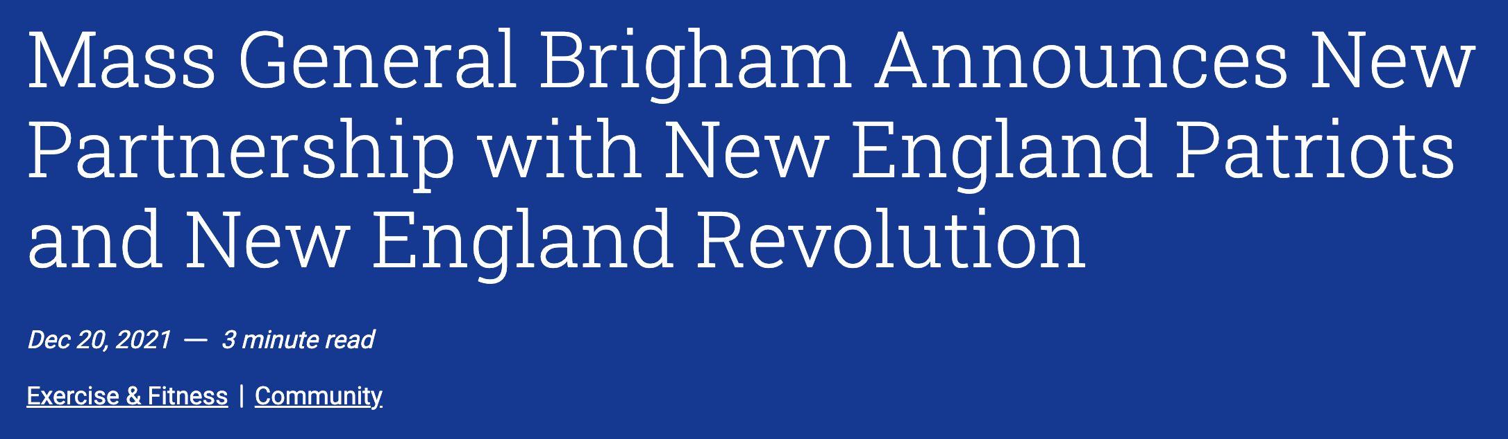
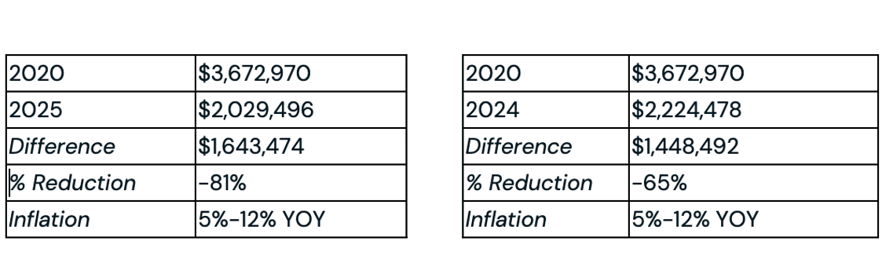


The current landscape
With the exception of Bluebikes, BCBSMA has dramatically reduced in-market spend since 2020, while competitors’ presence has slowly increased, capitalizing on opportunities that could have been ours.
Projected BCBSMA spend
2025 vs 2020
Actual BCBSMA spend
2024 vs 2020
Spend indicated above includes paid media, sponsorships outside of Bluebikes, and integrated content partnerships
Insert graph showing competitive spend increases – may not have accurately from Havas

Slide 4
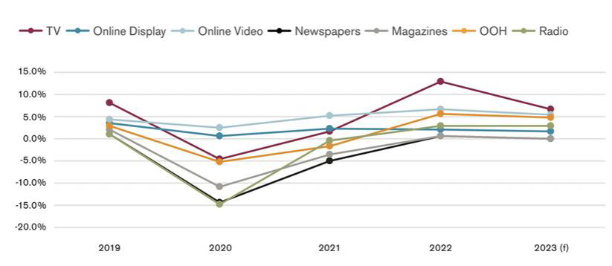
Inflation continues to impact media costs
Even if we were to remain flat YOY, the value of our investment would be significantly reduced.
4.2%
Overall media inflation in North America in 2023
US Media Inflation YOY by channel
6.8%
TV inflation, lower than 2022 levels but higher than any other medium
5.5%
OLV inflation
4.7%
OOH inflation
Near-term reductions result in longer-term spend increases: Regaining lost market share requires a future investment of $1.85 for every $1.00 saved from near-term reductions in brand spending.

Slide 5

Deep cuts in Medicare Marketing Budget directly impact sales performance
Medicare acquisition is a year-round retail-like business—our sales performance has risen and fallen in line w/marketing spend.
2022
2023
2024
Minimal budget during year outside of AEP
Results:
Trailed monthly sales targets
Entered AEP w/out visibility
United gained outsize share at our expense
Increased budget for “Always on” and AEP
Results:
Tracked to monthly sales targets
Entered AEP w/strong momentum
Our best AEP performance—#2 in market, outpaced category growth
Cut budget by $2MM mid-year
Results:
Saw drop vs. monthly targets w/in one month
AEP budget down -40% YoY leaving a big gap btw marketing-generated leads needed to hit sales goals
Against backdrop of election year noise, higher media costs
While our Sales forecast has been adjusted downward, weak acquisition and lower retention risks spiraling into a problematic membership pool. We need to continue to acquire and retain high quality membership, and marketing is necessary to do so.

Slide 6
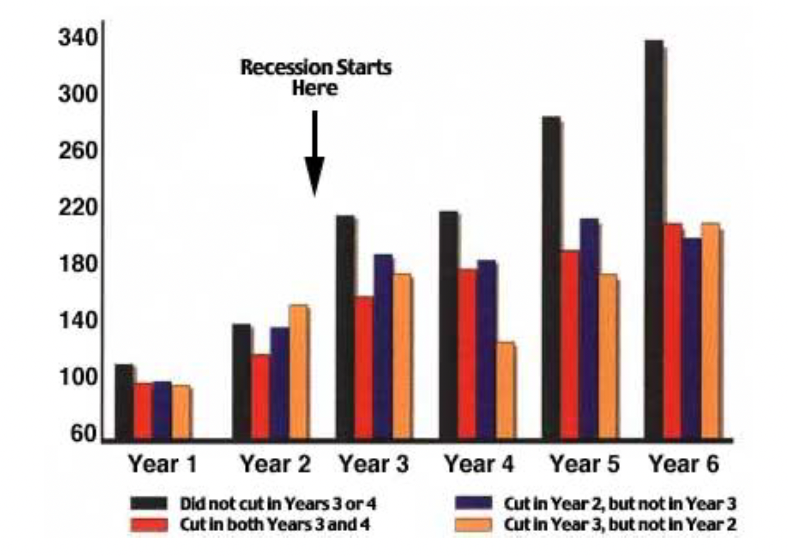



An investor mindset will drive long-term business success
Companies that continue to invest in marketing during economic downturns, or challenging periods for the category typically see stronger business results when the environment shifts.
McGraw-Hill recession study
Capitalizing during COVID
vs
Airbnb halted ad spend with the Pandemic pause in travel. VRBO capitalized, outspending them 10-fold in advertising. Their bookings recovered 61%, while Airbnb’s dipped 15% in the same timeframe.
While many airlines stopped or significantly reduced spend during the pandemic, United airlines launched a massive brand campaign, along with experience enhancements. Over the last two years, United has experienced growth in both passengers and number of miles flown, while many competitors continue to struggle.

Slide 7
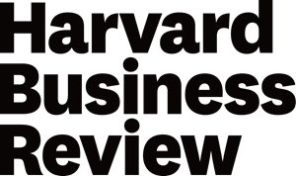

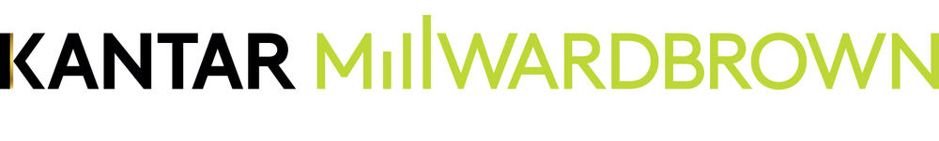
Protect your brand by sustaining budgets
Respected industry reports show that companies that cut during downturns suffer long-term brand health declines.
Millward Brown analyzed the impact of reduced marketing spend on brand consideration and found that companies cutting advertising budgets during recessions saw a decline in brand consideration by up to 28%. This happens as customers turn to visible brands that continue to engage them.
A Harvard Business Review report highlighted that brands that reduced spend saw lower favorability ratings, while those maintaining or increasing investments saw 9% higher favorability ratings.
Brands that go "dark" (completely cut media spending) lost significant momentum, often requiring 3 to 5 years to recover the lost ground in consumer consideration.

Slide 8


Brand Investment cuts have a negative impact on nps and Sales
Customer advocacy declines: Cuts to brand spend results in a 2-3X reduction in perceptions of a company’s ability to meet top consumer needs. Consequently, their likelihood of being recommended was 18 percentage points lower.
This decline is particularly concerning because word-of-mouth recommendations are critical drivers of both new customer acquisition and retention.
Market share drops: Companies that cut brand spending lost 0.8 percentage points of market share relative to those that boosted brand spending.
Sales growth rates underperform: Sales CAGRs for brand spenders in the bottom quartile of our research were 13 percentage points lower than the CAGRs of the top quartile.
Source: BCG, 2023

Slide 9
2025 Budget breakdown – what we stand to lose
2023: $3.6M
At risk with the 2025 cuts:
TV presence with Paid Media
B2B paid marketing campaigns at meaningful levels
Polar Park Stadium presence
Oval Ice Rink Sponsorship
B Fit Sponsorship
Wellness Wednesday Content Partnership with Local News Boston 25
Bluebikes activations (cutting 2-3 promotions in 2025)
Additionally, our A&G Agency Partnership is deeply cut – 60%+ YOY reduced for A&G from 2023
Our total in-market brand budget: paid media, sponsorships (non-Bluebikes), integrated content partnerships
2025: $2M
Our total-in market brand budget

Slide 10


In summary: Recommend No additional brand cuts in 2025
We will sharpen our strategies around channel investment, partnership decisions, and our messaging mix (between Brand and B2B) in order to maximize our budget impact.
We will achieve greater market visibility, prevent competitive encroachment in our priority lanes, and protect our brand health and leadership positioning.
We will sustain healthier levels of strategic agency partnership, which is crucial for future planning and campaign/content production.

