Slide 1
BCBS MA Consumer Experience Strategy – Final update
June 30, 2023

Slide 2
Key goals for today
Share refined CX vision and strategy
Review near-term and medium-term roadmaps for prioritized CX episodes and key enablers
Discuss operationalization and immediate next steps

Slide 3
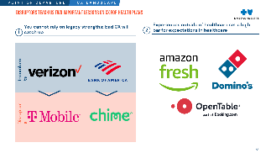
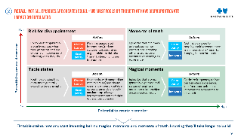
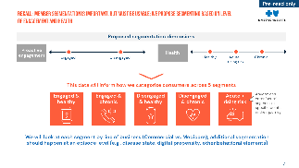
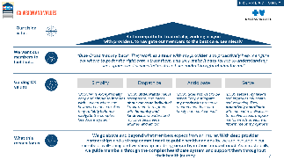
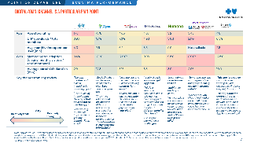
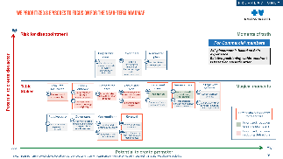
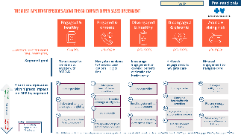
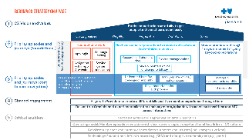
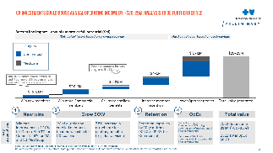
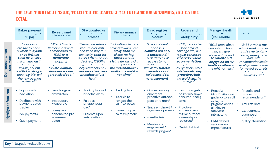
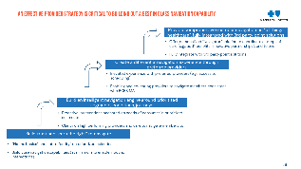
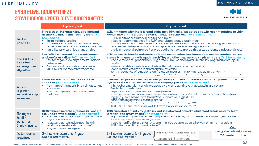
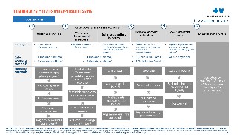
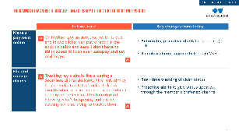
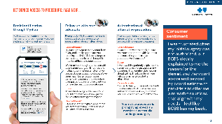
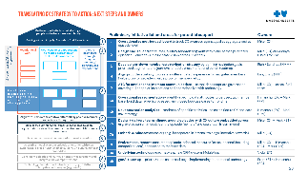
Key deliverables from Our cx strategy work
Established case for change based on competitive positioning & disruptor inspiration
Prioritized episodes based on impact and need for improvement
Developed member segmentation schematic and proposed metrics
Built strategy on a page with vision, values, strategic pillars, and enablers
Built business case for CX
Aligned on episode-level ambition; defined what good looks like and what we need to achieve
Shared POV on best-in-class navigation strategy and identified opportunities to navigate
Developed roadmap for near term & medium term with identified owners

Slide 4
BCBSMA CX Strategy on a page
1
CX Vision and values
Draft
Be the empathetic trusted ally, working in sync with providers, to navigate our members to the best care, seamlessly
Guiding values:
Simplify
Empathize
Anticipate
Serve
2
Priority episodes and journeys (foundational)
By segment (LOB, health, engagement)
Foundational work
Meet consumer expectations to reduce detractors on table-stakes moments
Create promoters through “magical moments” going beyond expectations
App login
Webpage loading
Research and choose a plan
File and manage claims
Navigation within app & website
Service center optimization
Make a payment online or change to bill pay
3
Priority episodes and journeys (core to care navigation)
Navigate members to the right care at the right time/place
Understand benefits, coverage or eligibility
Enroll, register online / set up account
Manage a health/chronic condition
Stay updated on prior auth process
Find a provider
4
Channel engagement
Align with Providers to create a differentially positive member experience through them
Deliver true Omnichannel experience tailored to each segments/episode with seamless transitions and ATC across interactions
5
Critical enablers
Next best action and segmentation data & analytics
Operating model: Member episode orientation with clear owners, rapid cross-functional test & learn, CX culture
Consistent episode and journey oriented measurement and insights (incl. competitive lens)
Technology: Foundational infrastructure (e.g., CRM) and disruptive technologies (e.g., GenAI)

Slide 5
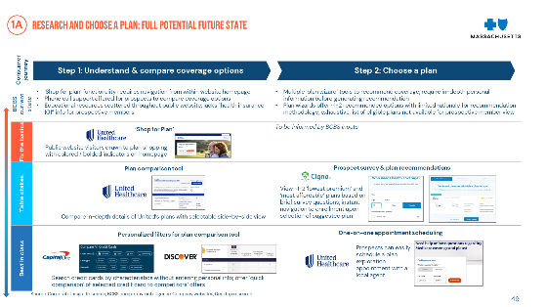
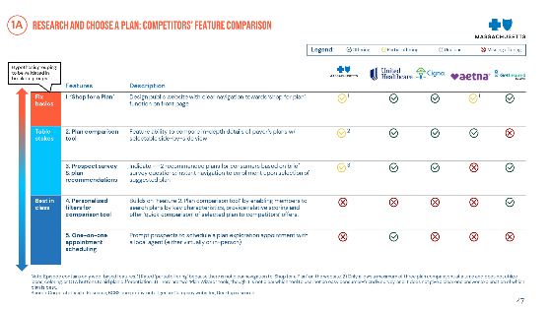
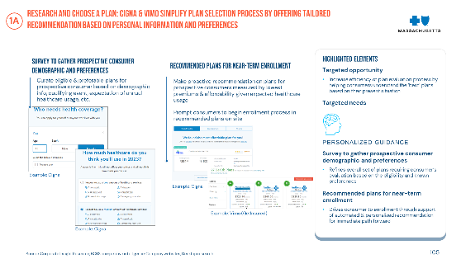
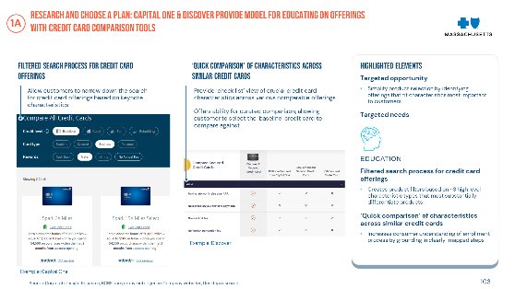
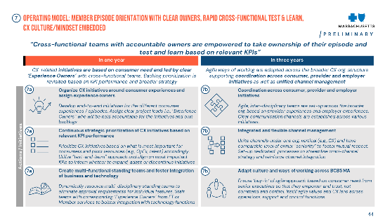
To achieve our vision, we defined both Where to play & how to win
Where to play
How to win
What episodes / experiences do we have with consumers, and which should we prioritize in the next 1-3 yeas?
How do we drive differentiation vs. competitors? What does “good” look like for each episode, and what core enablers are needed?
Prioritized top 8 episodes across Commercial and Medicare that will move the needle, based on impact (frequency, emotiveness) and need for improvement
Defined ambition levels and “what good looks like” for each prioritized episode + core enablers, based on outside-in research on players in and outside healthcare
Reducing detractors
Creating promoters
Research and choose a plan
Enroll, register online / set up account
Find a provider
Manage a health condition (incl. chronic)
Understand benefits, coverage, or eligibility
Stay updated on prior authorization process
Make a payment online or change to bill pay
File and manage claims

Slide 6
Where to play
we are focusing on Episodes with a disproportionate impact on consumers, by both reducing detractors on table stakes, and creating promoters through magical moments
Reducing detractors
Creating promoters
High
Risk for disappointment
Moments of truth
Episodes that generally are only noticed when they go wrong, and are extremely inconvenient/ irritating when they do
Action:
Episodes that can make or break consumer perceptions, creating either a promoter or detractor depending on experience; key opportunities to serve
Action:
Fix the basics
Minimize associated interactions (reduce occurrence); neutralize anger; minimize risk of a “miss” by keeping human interaction and treating with empathy
Be at parity
Optimize episode to amplify positive experience; minimize risk of a “miss” by keeping human interaction
Be at parity
Innovate
Deny a claim
Resolve coverage or claim question
Potential to create detractor
Table stakes
Magical moments
Routine, simple episodes that consumers generally expect to be done right
Action:
Episodes that are not generally expected and so can strengthen consumer relationships if executed correctly; necessitate active anticipation of needs
Action:
Fix the basics
Be at parity with competition (at a minimum) and ensure experience is easy; digitalize episodes amenable to self-service; step-change improvements can shift right (at least temporarily)
Be at parity
Optimize frequency; deliver best-in-class experience; look for opportunities to innovate the experience to elevate it
Make a payment online
Be at parity
Innovate
File/manage claims
Find a provider
Manage a health condition
Low
High
Potential to create promoter
Fix table stakes now and start investing behind magical moments, knowing they’ll take longer to build

Slide 7
Where to play
We prioritized 8 episodes to focus on for the near-term roadmap based on their potential impact on consumers and BCBSMA performance
High
Risk for disappointment
Moments of truth
2x2 placement is based on Bain experience.
Relative positioning within quadrant is based on episode order.
Prepare for care
Cover care
Administer plan
5b
7b
9a
Get denied or reduced access to provider, procedure, or treatment
Receive unexpected medical or pharmacy charge / claim reimbursement
Resolve claim or coverage question
Potential to create detractor
Find & seek care
Engage with benefits
Table Stakes
Evaluate insurance
Enroll & onboard
Prepare for care
Administer plan
Receive care
Magical moments
2a
9b
4a
6b
3a
1a
Enroll, register online / set up account
5a
Make a payment online or change to bill pay
Find a provider
Manage a health condition (incl. chronic)
Access wellness benefits
Research and choose a plan
Stay updated on prior authorization process
2b
Understand benefits, coverage, or eligibility
9c
File and manage claims
4b
Schedule & view appointments
6c
Use support services during/after an acute event
3b
Use ancillary/other benefits (e.g., food, transport, rebates)
Receive care
Cover care
Get medicine
Renewal
Differentially important for Medicare
6a
7a
Receive expected medical or pharmacy charge / claim reimbursement
8a
10a
Prioritized; focus on creating promoters
Visit a provider (in person or virtual)
Understand pharmacy coverage
Renew or change coverage
8b
Request & fulfill prescriptions
10b
Make changes to plan (add spouse, dependents)
Prioritized; focus on reducing detractors
Low
High
Potential to create promoter
Note: *BCBS performance calculated based on 4Q21 competitor NPS panel, 4Q21 member NPS survey, Medallia touchpoint NPS and Medallia text analytics

Slide 8
Where to play
The Importance of each episode differs by segment; we have prioritized A balanced portfolio of episodes that will improve the experience of each of our five segments
Engaged & healthy
Engaged & chronic
Disengaged & healthy
Disengaged & chronic
Acute + rising risk
Directional % of members (avg. health plan)
5-10%
10-20%
25-35%
25-35%
10-20%
Segment goal
Make it easy for members to engage with BCBSMA
Navigate members to the best care options – digital first
Encourage engagement on covered benefits and make the basics easy
Hi-touch engagement to navigate care
Hi-touch engagement to navigate care
Prioritized episodes with highest impact on NPS by segment
4a
6b
Manage a health/chronic condition
4a
4a
Find a provider
6b
Manage a health/chronic condition
Find a provider
Find a provider
Create promoters
2b
Understand benefits, coverage, or eligibility
6b
Manage a health condition (incl. chronic)
2b
2a
9c
Potential to…
Understand benefits, coverage, or eligibility
Enroll, register online / set up account
File and manage claims
4a
5a
Stay updated on prior authorization process
Find a provider
2a
2b
9b
Enroll, register online / set up account
Understand benefits, coverage, or eligibility
Make a payment online or change to bill pay
Key
5a
Stay updated on prior authorization process
9c
File and manage claims
Neutralize detractors
Differentially impactful for Medicare
Note: High level totals of distribution by segment for an averagee health plan based on Bain experience: healthy 30-40%, chronic 40-50%, acute 10-20%; engaged 25-35%, disengaged 65-75%

Slide 9
How to win
For each prioritized episode, We defined the desired 3-year outcome for consumers, and feature detail
Make a payment online or change to bill pay
Research and choose a plan
Stay updated on prior authorization process
File and manage claims
Enroll, register online / set up account
Understand benefits, coverage, or eligibility
Manage a health condition (incl. chronic)
Find a provider
“I can easily navigate to make a payment in MyBlue or via IVR, can track my status / history and easily make changes in MyBlue, and I’m notified of changes, upcoming bills, and when my payment is cleared.”
“When I Google Medicare insurance, I am directed to BCBS for a memorable shopping experience with tools to compare plans and receive personalized recs”
“Fewer procedures require prior auth., and when they do, I can easily track the status. When they get declined, BCBSMA goes above and beyond to help me I understand why and what alternatives I have”
“Submitting claims is straightforward. I can easily track my claims, get help understanding claims details, and if rejected, BCBS helps me understand why and how to avoid it next time”
“The enrollment process is seamless and easy to understand. I have immediate access to my MyBlue account with all my benefits in one place, and I feel rewarded for my engagement”
“BCBS predicts the benefits and coverage info, with regular reminders and personalized recommendations. I can get answers to my questions with a quick search. They proactively help me avoid surprise charges”
“BCBS cares about and puts my health first, and goes above and beyond to educate and engage me on my health condition at the right moments”
“BCBS reminds me when I need care and guides me to high-value, appropriate care, with recommendations for which provider is best for me and accurate data on costs, availability, etc.”
Desired consumer sentiment
Pop-up with navigation
Dashboard with payment status tracker
IVR payments
Guest payment
Search engine optimization
Introductory Medicare 101
Survey and personalized plan recommen-dation
Tracking tool and proactive alerts
Fast pass provider ‘gold card’
Outreach upon auth. decline*
Tracking tool
Tutorials to navigate the claims process
Outreach upon claims rejection*
Guidance during enrollment, proactive outreach post-enrollment*
Single enrollment / registration process
Benefits hub
Membership engagement / rewards program*
Easy to navigate pages with simple, consumer-facing terms
Proactive education and regular outreach connecting to resources*
GenAI chat bot
Proactive identification and guidance to enroll in eligible programs across all relevant consumer interactions
HMM defined specific care mgmt. features
Proactive and personalized recommendation*
Accurate data
Cost estimator, guaranteed availability and quality information
Highlighted features
Key: * Navigation-related initiative

Slide 10
How to win
Translating cx strategy to action: next steps and owners
Preliminary
Be the empathetic trusted ally to get people to the best care, seamlessly
Summary of initiative list and areas for potential support |  | Sponsors
1 | Operationalize metrics dashboard to track CX progress against goal at aggregate and at episode level | Mike (CX)
2a | Foundational work to redesign Mobile App, streamline website / MyBlue navigation, implement GenAI live chat, and improve call center performance | Mike (CX)
2b | Design end-to-end consumer journey for each segment within and across prioritized episodes (current vs. future state vision across-channels), fix the basics and implement promoter-creating features for 8 priority episodes | Mike (CX) or Sandhya (HMM) for CM (+ owners for each episode)
3 | Define north star ambition for care navigation, determine how to weigh/prioritize across the 3 pillars (TMC, account retention, equity), build cross-functional action roadmap, and develop intelligent navigation engine | Rich / Sandhya (HMM)
4 | Align provider strategy to create a differentiated experience for navigated members (value prop for providers, value prop for members, etc.) | Lisa, Emily (PFH)
5 | Develop omnichannel member engagement strategy and system for air traffic control (appropriate governance covering full scope of interactions, operationalize with tech) | Mike (CX) + cross-fxn’l team
6 | Segmentation & analytics: Align on segmentation and roll out across the organization, operationalize (tag member base, build real-time refresh processes, AI-driven analytics, next best action recommendations, closed-loop use cases to front line) and evolve over time | Himanshu (EA) + Mark (PMI)
7 | Agile operating model: Design / delivery teams aligned around episodes with clear “owners”, scale test & learn model, embed CX culture across org (e.g., incorporate in internal trainings, incentive, rewards) | Mike (CX) + Vicki (ET)
8 | Measurement & insights: consistent episode-oriented measures (cross-channel. Including competitor lens), connected to member data | Mike (CX) + Himanshu (EA) + Mark (PMI)
9a | Data infrastructure, tech tools & platform (e.g., new CRM system, streamline digital asset management, Analytics Data Hub with 360 member data) | Vicki (ET)
9b | GenAI roadmap: prioritize use cases and begin implementing foundational technology | Prem (ET) + Himanshu (EA)
Guiding values: Simplify Empathize Anticipate Serve
1
By segment (LOB, health, engagement)
Foundational work
Meet consumer expectations to reduce detractors on table-stakes moments
Create promoters through “magical moments” going beyond expectations
2
Navigate members to the right care at the right time/place
3
Align with Providers to create a differentially positive member experience through them
4
Deliver true Omnichannel experience tailored to each segments/episode with seamless transitions and ATC across interactions
5
Next best action and segmentation data & analytics
6
Operating model: Member episode orientation with clear owners, rapid cross-functional test & learn, CX culture/mindset embedded
7
Consistent episode and journey oriented measurement and insights (incl. competitive lens)
8
Technology: Foundational infrastructure (e.g., CRM) and disruptive technologies (e.g., GenAI)
9

Slide 11
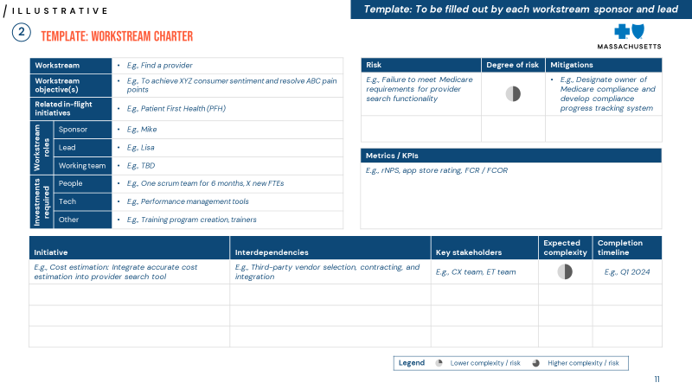
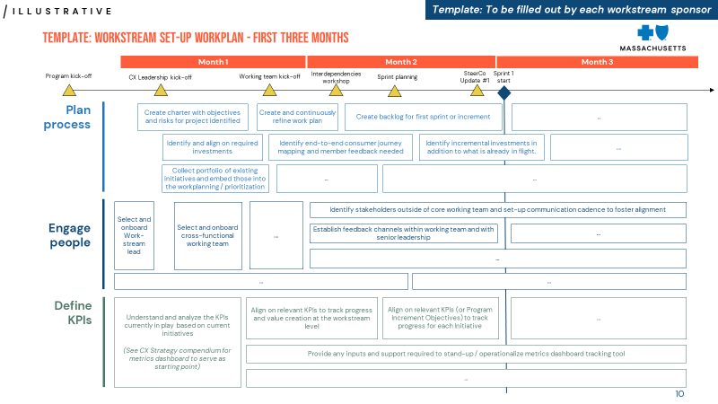
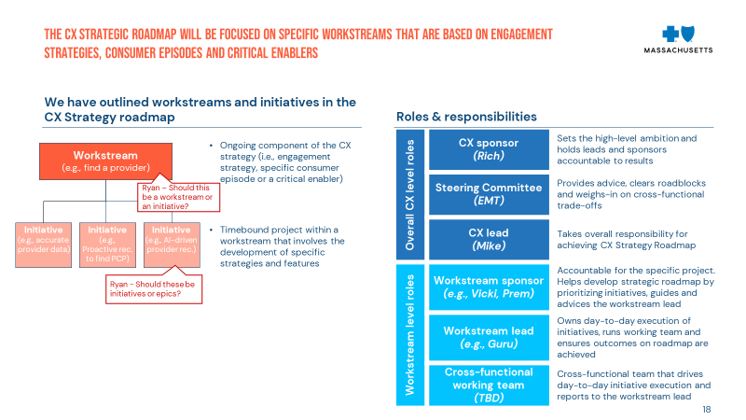
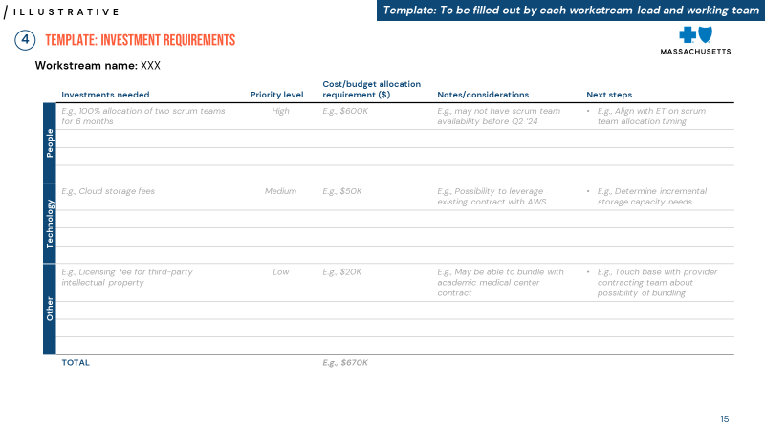
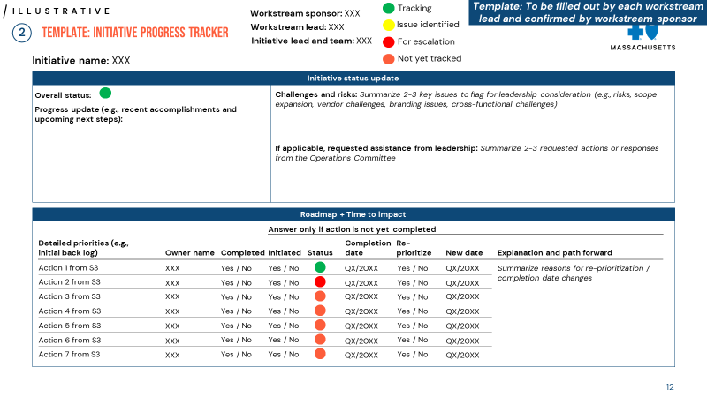
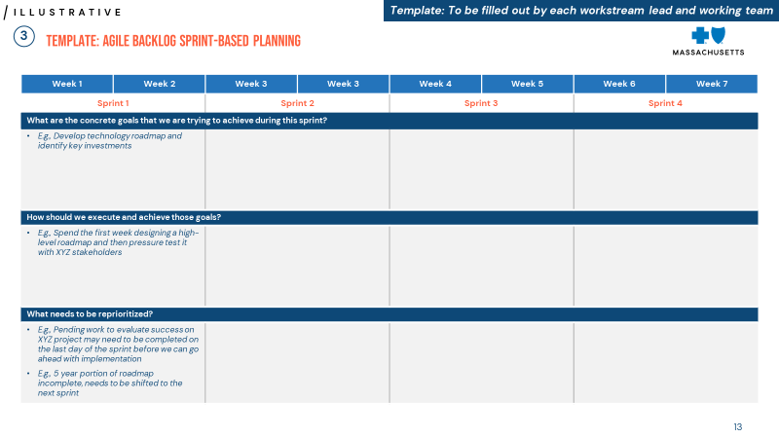
Workstream detail: critical Next steps to complete by September 1
Next two months
1
2
3
4
Assign workstream sponsors and leads
Create charters for each workstream
Create work plan for each workstream and backlog for first sprint
Quantify detailed investment requirements for each workstream
At the end of two months, output/ deliverables should include:
Detailed workstream roadmaps
Clear understanding of tradeoffs, detailed investments, interdependencies, and risks
Deliverables will serve as inputs for enterprise-wide decisions on:
Sequencing
Relative investments
Additional hiring
Buy vs. build
Completion timelines
Workstream charter template*
Agile work plan template*
Workstream roles and responsibilities framework*
Investment requirement template*
Initiative progress tracker template*
Agile backlog by sprint template*
Critical steps to complete in next two months will lay foundation for successful workstream execution
Note: *Slides can be found in the compendium

Slide 12
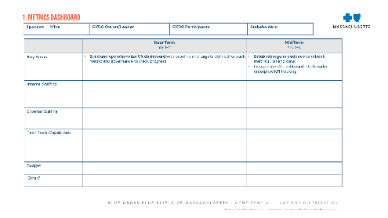
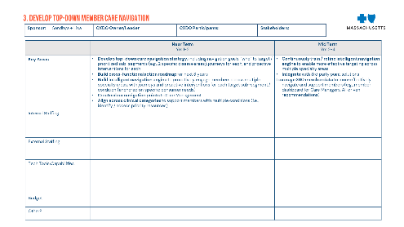
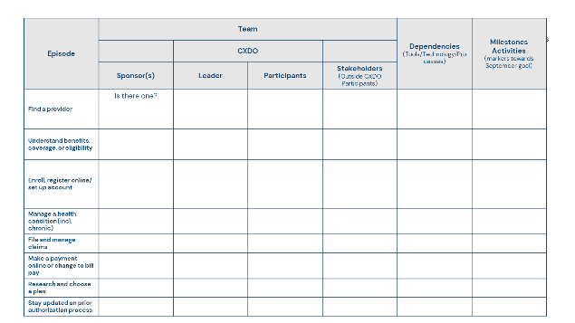
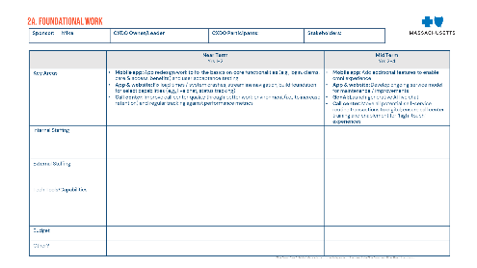
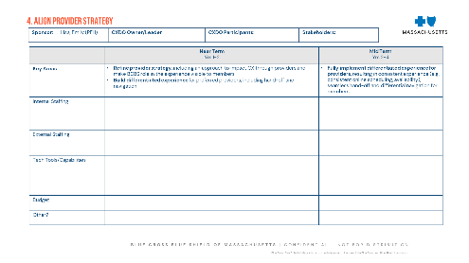
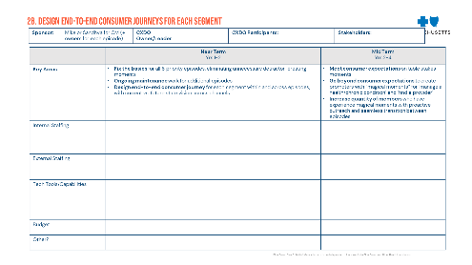
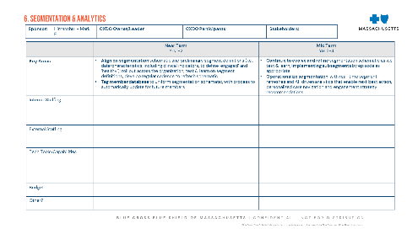
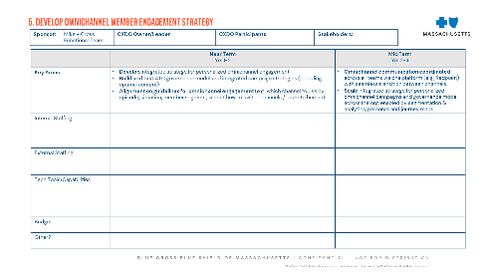
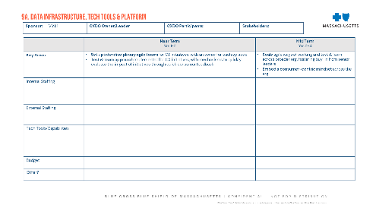
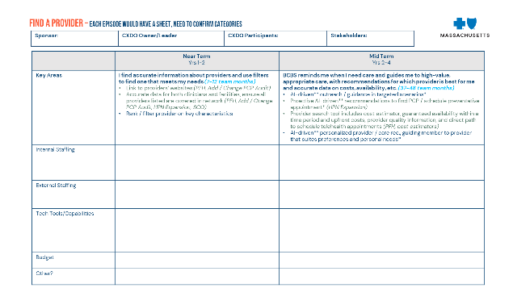
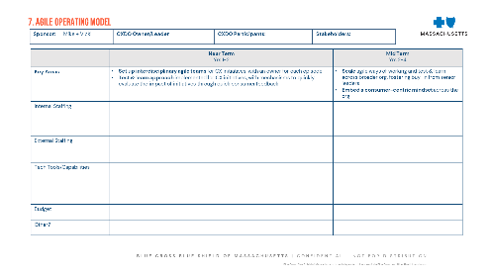
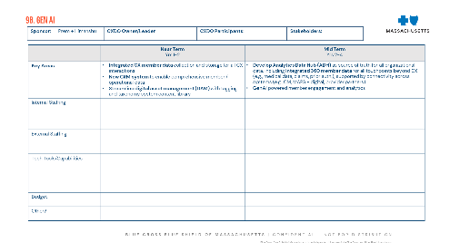
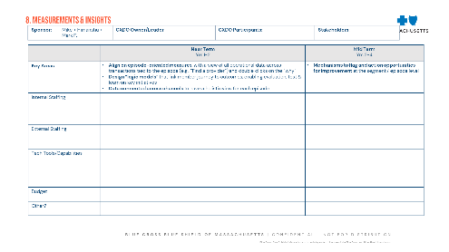
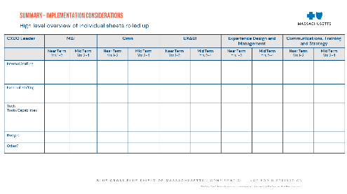
To get started, We have implementation plan templates for each workstream and episode
Implementation plan templates at workstream level
Implementation plan templates at episode level
Lays out sponsor, CXDO owner/leader, CXDO participants, stakeholders, key areas, internal staffing, external staffing, tech tools/capabilities, budget, and other considerations for near term vs. mid-term
Each owner should complete templates by 8/1; we will reconvene to integrate into an implementation roadmap, identifying required investments and trade-offs to work through in August ahead of the fall board meeting

Slide 13
Preliminary list of Investments identified to support CX strategy
Potential to consider buy/partner options to accelerate roadmap
Internal capacity & capability
CX research and marketing
Technology and data
Workstream leads on CX team to own episodes, run cross-functional teams, and backlog dev / prioritization
Human-centered design ownership
Campaign management & content strategy/dev on marketing team
Analytics capabilities / ownership to support predictive analytics and AI implementation
Reporting & dashboard design and metrics development capabilities / ownership, ensuring improvements in member journeys are tied to specific outcomes
Training & enablement across org to implement test & learn and embed quick response to dashboard results
Additional ET resourcing TBD depending on desired timing/phasing of initiatives
UX work for detailed episode journey mappings
Consumer research to inform episode redesigns and proactive omnichannel approach
CRM reboot to enable air traffic control
Analytics Data Hub and other infrastructure to support comprehensive member / provider data
Mobile app enhancements to simplify and enhance digital experience
Generative AI for analytics and member engagement recommendations
As a next step, initiative owners should quantify investments needed ($ value and/or team resourcing required)

Slide 14
What we are doing differently going forward
Establishing a multi-year strategy and roadmap with clear tie to enterprise strategy and a business case, allowing us to create a path to sustained leadership vs. being purely reactive to annual surveys
Re-orienting CX approach with analytics-driven end-to-end consumer journeys vs. touchpoints/ feature fixes
Driving hyper focus – we can’t outspend our biggest competitors; need to ruthlessly prioritize based on consumer desirability, impact and feasibility; make trade-offs on where to be good-enough vs. creating magical moments, while recognizing that the bar for parity and consumer expectations are a moving target
Building a robust navigation engine, proactively embedding navigation into priority CX touchpoints and more explicitly incorporating provider and care management into broader strategy given direct impact on CX
Evolving our operating model – Early steps in motion; more to come in setting up for executing against the CX strategy, with a focus on driving an enterprise wide CX mindset/culture and test and learn at scale to break down silos

Slide 15
we will share a compendium which includes all our cx strategy work
CX strategy compendium – key content:
Point of departure / Case for change: where we are and why CX investment matters
Strategy house and supporting elements: where to play and how to win with CX
CX vision and values: guiding vision, values, and what they mean
Priority episodes: prioritized episodes and detail on what good looks like for each
Care navigation: POV on best-in class care navigation
Channel engagement: provider alignment and seamless omnichannel experience
Critical enablers: what good looks like for foundational elements needed to drive best-in-class CX
Governance: organizational design and data driven decision-making to drive success
Business case overview: order of magnitude of potential benefit from CX investments

Slide 16
Immediate next steps
Confirm initiative owners and assign episode owners
Each episode owner to develop charter, identify required cross-functional input and involvement, build detailed workplan / backlog, and quantify required investments
Discuss trade-offs and any required re-prioritization of work in flight
Schedule regular touchpoints to ensure progress at both EMT and at working group level (share updates, escalate roadblocks)

Slide 17
overall_0_131600703282246985 columns_1_131600694444874709
Detailed roadmaps

Slide 18
Translating cx strategy to action: next steps and owners
Be the empathetic trusted ally to get people to the best care, seamlessly
Summary of initiative list and areas for potential support |  | Sponsors
1 | Operationalize metrics dashboard to track CX progress against goal at aggregate and at episode level | Mike (CX)
2a | Foundational work to redesign Mobile App, streamline website / MyBlue navigation, implement GenAI live chat, and improve call center performance | Mike (CX)
2b | Design end-to-end consumer journey for each segment within and across prioritized episodes (current vs. future state vision across-channels), fix the basics and implement promoter-creating features for 8 priority episodes | Mike (CX) or Sandhya (HMM) for CM (+ owners for each episode)
3 | Define north star ambition for care navigation, determine how to weigh/prioritize across the 3 pillars (TMC, account retention, equity), build cross-functional action roadmap, and develop intelligent navigation engine | Rich / Sandhya (HMM)
4 | Align provider strategy to create a differentiated experience for navigated members (value prop for providers, value prop for members, etc.) | Lisa, Emily (PFH)
5 | Develop omnichannel member engagement strategy and system for air traffic control (appropriate governance covering full scope of interactions, operationalize with tech) | Mike (CX) + cross-fxn’l team
6 | Segmentation & analytics: Align on segmentation and roll out across the organization, operationalize (tag member base, build real-time refresh processes, AI-driven analytics, next best action recommendations, closed-loop use cases to front line) and evolve over time | Himanshu (EA) + Mark (PMI)
7 | Agile operating model: Design / delivery teams aligned around episodes with clear “owners”, scale test & learn model, embed CX culture across org (e.g., incorporate in internal trainings, incentive, rewards) | Mike (CX) + Vicki (ET)
8 | Measurement & insights: consistent episode-oriented measures (cross-channel. Including competitor lens), connected to member data | Mike (CX) + Himanshu (EA) + Mark (PMI)
9a | Data infrastructure, tech tools & platform (e.g., new CRM system, streamline digital asset management, Analytics Data Hub with 360 member data) | Vicki (ET)
9b | GenAI roadmap: prioritize use cases and begin implementing foundational technology | Prem (ET) + Himanshu (EA)
Guiding values: Simplify Empathize Anticipate Serve
1
By segment (LOB, health, engagement)
Foundational work
Meet consumer expectations to reduce detractors on table-stakes moments
Create promoters through “magical moments” going beyond expectations
2
Navigate members to the right care at the right time/place
3
Align with Providers to create a differentially positive member experience through them
4
Deliver true Omnichannel experience tailored to each segments/episode with seamless transitions and ATC across interactions
5
Next best action and segmentation data & analytics
6
Operating model: Member episode orientation with clear owners, rapid cross-functional test & learn, CX culture/mindset embedded
7
Consistent episode and journey oriented measurement and insights (incl. competitive lens)
8
Technology: Foundational infrastructure (e.g., CRM) and disruptive technologies (e.g., GenAI)
9

Slide 19
CX strategy roadmap: Vision & Episodes - What we need to achieve in near vs. medium term
 |  | Near term (1-2 years) | Medium term (2-4 years) | Sponsors
CX Vision and values | (1) Metrics dashboard | Build and operationalize CX dashboard with baseline and targets defined for each metric and governance to track progress | Establish regular cadence to refresh metrics (list and data) Incorporate CX dashboard into broader enterprise KPI tracking | Mike (CX)
Priority episodes and journeys | (2a) Foundational work | Mobile app: App redesign work to fix the basics on core functionalities (e.g., login, claims, care & access, benefits) and user acceptance testing App & website: Fix load times / system crashes, streamline navigation, build foundation for select capabilities (e.g., live chat, status tracking) Call center: Improve call center quality through better work environment (i.e., to increase retention) and regular tracking against performance metrics | Mobile app: Add additional features to enable omni experience App & website: Develop ongoing service model for maintenance / improvements GenAI: Launch generative AI live chat Call center: Move all potential self-service routine transactions to digital; ensure call center training and enablement for ‘high-touch’ experiences | Mike (CX)
 | (2b) Priority episodes and journeys | Fix the basics for all 8 priority episodes, eliminating unnecessary detractor-creating moments Ongoing maintenance work for additional episodes Design end-to-end consumer journey for each segment within and across episodes, with current vs. future state vision across channels | Meet consumer expectations on table stakes moments Go beyond consumer expectations to create promoters with “magical moments” for ‘manage a health/chronic condition’ and ‘find a provider’ Increase quantity of members who have experience magical moments with proactive outreach and seamless transition between episodes | Mike (CX) or Sandhya (HMM) for CM
 | (3) Care navigation strategy | Define north star ambition for care navigation, determine how to weigh and prioritize across pillars (TMC, account retention, equity), and define key metrics for success Build cross-functional action roadmap for next 3 years Build intelligent navigation engine to proactively engage members across multiple specialty areas, with journeys and proactive interventions for each target sub-segment / condition (anchored on specific consumer needs) Create clear navigation points to Care Management (team and digital platform) for relevant populations Align across clinical categories to support members with multiple conditions (i.e., identify / access priority resources) | Continuously train / refine intelligent navigation engine to enable more effective targeting across multiple specialty areas Integrate with 3rd party point solutions Leverage 360 member data to more effectively navigate and support members (e.g., member dashboard for Care Managers, AI-driven recommendations) | Rich / Sandhya (HMM)

Slide 20
CX strategy roadmap: Channels and enablers - What we need to achieve in near vs. medium term
 |  | Near term (1-2 years) | Medium term (2-4 years) | Sponsors
Channel engagement | (4) Provider strategy | Refine provider strategy, including an approach to impact CX through providers and make BCBS role in the experience visible to members Build differentiated experience for preferred providers, including hand-off and navigation | Fully implement differentiated experience for providers, resulting in consistent experience (e.g., consistent online scheduling, availability), seamless hand-off and differential navigation for members | Lisa, Emily (PFH)
 | (5) Omnichannel member eng. strategy (incl. air traffic control) | Develop integrated strategy for personalized omnichannel engagement Build and test ATC governance model and integrated campaign strategies (including optimal content) Alignment on guidelines for omnichannel engagement (e.g., which channel to use by episode, situation, member segment; when / how to switch channels / route to human) | Omnichannel communication coordinated across all teams via one platform (e.g., Redpoint) with seamless transition between channels Scale integrated strategy for personalized omnichannel campaigns and governance model across the org, enabled by segmentation & analytics, personas and journey maps | Mike (CX) + cross-fxn’l team
Critical enablers | (6) Segmentation & analytics | Align on segmentation schematic and preliminary segment definitions (i.e., data/characteristics, including clinical indicators, to define ‘engaged’ and ‘healthy’); roll out across the organization; test & learn on segment definitions; develop regular cadence to refresh schematic Tag member database to uniform segmentation schematic, with process to automatically update for future members | Continue to evolve and refine segmentation schematic as we test & learn, implementing subsegments by episode as appropriate Operationalize segmentation, with real-time segment refreshes and AI-driven analytics that enable next best action, personalized care navigation and engagement strategy recommendations | Himanshu (EA) + Mark (PMI)
 | (7) Agile operating model | Set up interdisciplinary agile teams for CX initiatives, with an owner for each episode Test & learn approach implemented for CX initiatives, with mechanisms to quickly evaluate the impact of initiatives through quick consumer feedback | Scale agile ways of working and test & learn across broader org, fostering buy-in from senior leaders Embed a consumer-centric mindset across the org | Mike (CX) + Vicki (ET)
 | (8) Measurement & insights | Align on episode-oriented measures, with a view of all operational data across transactions tied to the episode (e.g., “Find a provider”) and double clicks on the “why” Design “logic models” that link member journey to outcomes, enabling evaluation, test & learn on key initiatives Data connected across channels to have a holistic view for each episode | Mechanisms to flag and action opportunities for improvement at the segment / episode level | Mike (CX) + Himanshu (EA) + Mark (PMI)
 | (9) Data infrastructure, tech tools & platforms | Integrated CX member data collection and storage for all CX interactions New CRM system to enable comprehensive member / operational data Streamline digital asset management (DAM) with tagging and taxonomy system content library | Develop Analytics Data Hub (ADH) as source of truth for all organizational data, including integrated 360 member data for all touchpoints beyond CX (e.g., medical data, claims, prior auth.), supported by connectivity across systems (e.g., CM, MAPS + digital, provider partners) GenAI powered member engagement and analytics | Vicki (ET) Prem (ET) + Himanshu (EA)
Note: Enablers that do not affect CX are omitted (e.g., account portal)

Slide 21
Metrics dashboard: Proposed metrics across and within episodes
All metrics should be gathered for BCBS and competitors to understand relative performance
Cross-episode metrics: NPS, brand trust, app star rating, call center wait time
High
Reducing detractors
Creating promoters
Risk for disappointment
Key metrics
Moments of truth
Incidence - % calls with issues / disputes for benefits/ claims
% who feel empowered to avoid an issue next time
% who were confident in the process
Episodes that can make or break consumer perceptions, creating either a promoter or detractor depending on experience; key opportunities to serve
Episodes that generally are only noticed when they go wrong, and are extremely inconvenient/ irritating when they do
Key metrics
Incidence - % who received care navigation services or CM services
% who thought BCBS empathized with their issues and challenges
% who believe BCBS went above and beyond to serve their needs
% who felt payer was “on their side” and an advocate during experience
Potential to create detractor
Magical moments
Table stakes
Key metrics
Routine, simple episodes that consumers generally expect to be done right
FCOR
% routine interactions that are digital
% who thought process was clear and easy
# interactions required to complete a task
Individual time to complete
Episodes that are not generally expected and so can strengthen consumer relationships if executed correctly; necessitate active anticipation of needs
Low
High
Potential to create promoter
Final dashboard should include progress tracker of in-flight initiatives and incorporate current CX team dashboard work

Slide 22
Episode-level roadmap [1 of 2]
 |  | Near term (1-2 years) | Medium term (2-4 years)
Actions / Initiatives at an episode-level | Find a provider | I find accurate information about providers and use filters to find one that meets my needs (7-12 team months) Link to providers’ websites (PFH, Add / Change PCP Audit) Accurate data for both clinicians and facilities, ensure all providers listed are covered in network (PFH, Add / Change PCP Audit, HPN Expansion, SCO) Rank / filter provider on key characteristics | BCBS reminds me when I need care and guides me to high-value, appropriate care, with recommendations for which provider is best for me and accurate data on costs, availability, etc. (37-48 team months) AI-driven** outreach / guidance in targeted scenarios* Proactive AI-driven** recommendations to find PCP / schedule preventative appointment* (HPN Expansion) Provider search tool includes cost estimator, guaranteed availability within a time period and upfront costs, provider quality information, and direct path to schedule telehealth appointments (PFH, cost estimators) AI-driven** personalized provider / care rec., guiding member to provider that suites preferences and personal needs*
 | Understand benefits, coverage, or eligibility | I easily find, navigate and understand coverage and benefits on MyBlue (7-12 team months) Easy to navigate to coverage, benefits, and cost estimator tool (Medicare shopping enrollment) Clear and visual pages with simple language Quick links for common benefits searched | BCBS predicts the benefits and coverage info, with regular reminders and personalized recommendations. I can get answers to my questions with a quick search. They proactively help me avoid surprise charges (37-48 team months) Proactive education upon enrollment / registration¹; Enroll members in add-on / ancillary programs upfront (e.g., OTC benefits)* Improved benefits hub interface with buttons that help members use their benefits² Search bar enables targeted search through benefits portal GenAI chatbot gives personalized recommendations based on member data (e.g., eligibility checks)** Regular outreach via preferred channel (e.g., push notifications, text) to proactively connect members to resources* (Personal Msg Orchestrate hub)
 | Enroll, register online/ set up account | I know how to enroll and my next steps after enrollment (7-12 team months) Clear instructional material for enrollment options & processes (Medicare shopping enrollment) Clear next steps and welcome packet after enrollment (Medicare shopping enrollment) | The enrollment process is seamless and easy to understand. I have immediate access to my MyBlue account with all my benefits in one place, and I feel rewarded for my engagement (25-36 team months) Enhanced guidance during enrollment process with clear steps, time estimates, nudging and rewards (Medicare shopping enrollment, HPN expansion, Modernize Medicare enrollment) On-file identity verification Single enrollment & MyBlue account creation process Proactive outreach to welcome members, confirm enrollment, assist with registration, and educate / incentivize to engage (e.g., access benefit info through MyBlue, proactively suggest PCP)^{1*} Membership engagement / rewards programs* (BlueFit, SmartShopper) Centralized benefits hub integrates with other benefit providers through SSO² Flag OON PCPs and info on in-network PCPs with availability; connect to CM*
 | Manage a health condition (incl. chronic) | BCBS connects me with a care manager, tools and resources for my condition (3-6 team months) Direct a subset of members to care mgmt. program with new diagnosis / condition* (relates to BlueScout - part of PFH) Education resources on MyBlue and partnerships with benefits providers for select conditions* Navigate members to support tools outside of care management* Proactive guidance using member insights and predictive analytics* | BCBS cares about and puts my health first, and goes above and beyond to educate and engage me on my health condition at the right moments (37-48 team months) AI-driven** system to identify and navigate highest value members to care management, and navigate other members to additional support tools* Automated, AI-driven** proactive identification and guidance to enroll in eligible programs across all relevant consumer interactions* Digital tools (in addition to care management) to help members find / manage care team, implement their care plan, track / manage their symptoms, manage their medications, and implement healthy habits* HMM defined specific care management features*
 | Total teams required | 2-4 scrum teams for 1 year (24-42 team-months) | 6-8 scrum teams for 2 years (136-180 team-months)
Key:
Total of 136-180 months required for 1 scrum team; to achieve in 2 years, translates to 6-8 scrum teams
*Navigation-related initiative
**AI-related initiative
Related BCBS ongoing initiative³
Note: 1. These initiatives, both related to proactive outreach upon enrollment, can likely be combined across episodes. 2. These initiatives both build on a centralized benefits hub.
3. More details regarding ongoing BCBS initiatives are in the compendium

Slide 23
Episode-level roadmap (2 of 2)
 |  | Near term (1-2 years) | Medium term (2-4 years)
Actions / Initiatives at an episode level | File and manage claims | Submitting claims is straightforward, and I can easily view and download prior claims (7-12 team months) Simple, consistent language on claims descriptions (Claims experience research, SCO) Sort, filter, and download claims (Claims experience research, SCO) Simplify submission process for member-submitted claims (Claims experience research) | Submitting claims is straightforward. I can easily track my claims, get help understanding claims details, and if rejected, BCBS helps me understand why and how to avoid it next time (7-12 team months) Credit-card style consolidated monthly statements Tutorials to navigate the claim process Tracker for member-submitted claims with financial visualizers¹ (Claims experience research, SCO) Claim submission process is tailored to claim type (SCO) Proactive outreach on next steps when claims are rejected*
 | Make a payment online or change to bill pay | I can effectively navigate to payment scheduling / information, make changes and get notified once my payment has cleared (7-12 team months) Pop-up helps with navigation and alerts members of ~48 wait time (ongoing initiative) Notifications of cleared payment via email, text, MyBlue; confirmation over phone if required One-time guest payment (SCO) | I can easily navigate to make a payment in MyBlue or via IVR, can track my status / history and easily make changes in MyBlue, and I’m notified of changes, upcoming bills, and when my payment is cleared. (13-18 team months) Additional payment methods such as IVR (high prio.) Glossary of terms and instructional video Payment dashboard in MyBlue with status tracker for pending payments and notification of upcoming bills via preferred channel¹ Synced-up payment timings for spouses, different benefits, auto-draft disabled once plan is cancelled
 | Research and choose a plan | I easily find the tool that helps me decide which plan works for me (4-6 team months) Easy to navigate to ‘Shop for a Plan’ tool, with clear checklist outlining differences in plans | When I Google Medicare insurance, I am directed to BCBS for a memorable shopping experience with tools to compare plans and receive personalized recs (7-12 team months) Search engine optimization Introductory Medicare 101 content with answers to basic questions Memorable shopping experience with plan comparison tool that compares in-depth details with side-by-side view (Medicare shopping enrollment) Survey and existing member data for personalized plan recommendation (Medicare shopping enrollment)
 | Stay updated on prior authorization process | I can easily track the status of my prior authorization (4-6 team months) Website clearly explains prior authorization process Automated messages when authorization is approved, denied or stalled Status tracker for in process prior authorizations (ongoing initiative to create hub for authorizations and referrals)¹ | I only wait for prior auth. when it is required, and when procedures require it, I can easily track the status. When they get declined, BCBSMA goes above and beyond to help me I understand why and what alternatives I have (4-6 team months) Automated message sent when prior authorization is submitted to explain process Fast pass waiving prior authorization requirements for providers with demonstrated efficiency records Members receive phone outreach about alternative providers when authorization is declined* Proactively flag when prior auth is needed for chronic members*
 | Total teams required | 2-3 scrum teams for 1 year (22–32 team months) | 1-2 scrum teams for 2 years (31–48 team months)
Note: Each bullet point represents an initiative
Key:
*Navigation-related initiative
**AI-related initiative
Related BCBS ongoing initiative²
Note: 1. All require the development of a status tracker tool 2. More details regarding ongoing BCBS initiatives are in the compendium

Slide 24
Engagement strategy roadmap: Air traffic control for omnichannel member communications
“Deliver a personalized and omnichannel consumer experience via the optimal channel(s) for each individual member across all interactions, making it easy to navigate within and across channels”
 | Near term (1-2 years) |  | Medium term (2-4 years)
 | We strive to orchestrate an omnichannel experience tailored to situations and segments, with coordination across episodes and teams |  | We strive to orchestrate an omnichannel experience tailored to individual member needs, with one platform to centralize and deliver communications across the entire consumer journey
Actions / Initiatives |  | Develop high-level engagement goals and strategy Align on engagement goals and strategic approach by channel for each episode and member segment. Communicate goals/strategy across organization to build alignment. |  | Predictive analytics selects optimal channel and enables seamless transition between channels Based on member’s segment, episode, situation, and preferences, system automatically selects the optimal channel for communication (e.g., SMS, email, live phone call, etc.)
 |  | Create guidelines for channel selection by episode, situation, and member segment Decide which situations require higher-touch interactions (e.g., explaining prior authorization rejection), when to switch channels / route to human, and how to do so; streamline and utilize members’ communication preferences |  | Scale integrated strategy for personalized omnichannel campaigns and governance model Implement organization-wide omnichannel strategy and governance approach; integrate data for personas, journey maps and interactions at the member level in DAL/CAR and customize campaigns accordingly
 |  | Test integrated strategy for personalized omnichannel campaigns and governance model For select episodes, create a personalized campaign (i.e., optimal content, channels), select a governance approach (e.g., coordinated, collaborative, controlled) and establishes feedback mechanisms to test-and-learn; ensure tech and cross-function integration is in place for A/B testing |  | Scale a single platform for complete orchestration and predictive analytics of omnichannel communication Build on CCA and CIM work to centralize omnichannel communications into one platform for all teams across the organization; implement predictive AI, next best action, and other analytics to determine the optimal channel, message and time to communicate with members

Slide 25
Air traffic control: There are FOUR levels to governing member communications across teams & channels
overall_1_131635901969492522 columns_1_131635901969492522
1
2
3
4
Clarified
Coordinated
Collaborative
Controlled
Visibility into all planned communications to consumers
E.g., planned communications tagged to the consumer ID in CRM
Coordinate timing and format of communications across teams
E.g., pre-arranged schedule
Share and integrate resources / tools across teams
E.g., integrated messaging systems
Centralized governance and plan agreed upon by all teams
E.g., designated roles to coordinate, approve, and track success of comms
Degree of governance
BCBS today
Low
High
Source: Bain IP

Slide 26
ENABLER ROADMAP: SEGMENTATION & ANALYTICS
“Designing and executing CX episodes, tailored to each member segment and their needs”
 | Near term (1-2 years) |  | Medium term (2-4 years)
 | All existing and incoming member data is tagged according to high-level segmentation, with ongoing test and learn to refine; care navigation and episode strategy tailored to each segment |  | Refined and granular segments backed by advanced data management and AI-driven analytics allowing for highly customized care navigation and experiences across episodes
Actions / Initiatives |  | Align on consistent, organization-wide segmentation schematic and preliminary definitions Align with key stakeholders on segmentation schematic, key metrics, and definitions for each segment leveraging learnings from member data and ongoing initiatives. Regular touchpoints to assess efficacy of segmentation and potential refinements |  | Establish real-time segment refresh process and predict member movement between segments Stand up low-touch, real-time refresh processes for key segmentation data inputs; track and predict movement between segments (e.g., disengaged to engaged pipeline, rising risk)
 |  | Develop segment-specific CX/care navigation POV Develop high-level CX engagement approach by segment and determine key care navigation needs and intervention points by segment |  | Refine segmentation and introduce sub-segments Use real-world learnings to refine segments and define sub-segments, updating data processes accordingly. Sub-segmentation may vary by episode
 |  | Tag existing member data and incorporate segmentation into data ingestion Tag segments across member databases, align on refresh rates, and stand-up processes to ensure new database additions are automatically segmented |  | Leverage AI for personalized care navigation and engagement strategy recommendations Use AI to identify optimal engagement by segment to enable next best action and give real-time, personalized, engagement advice to service reps and care navigators
Investments in data and partnerships will be important to ensure that the segmentation is based on the key metrics that matter.

Slide 27
ENABLER ROADMAP: agile OPERATING MODEL
“Cross-functional teams with accountable owners are empowered to take ownership of their episodes and test and learn based on relevant KPIs”
 | Near term (1-2 years) |  | Medium term (2-4 years)
 | CX-related initiatives are based on consumer need and led by clear ‘Workstream Sponsors’ with cross-functional teams. Backlog prioritization is revisited based on KPI performance and broader strategy |  | Agile ways of working are adopted across the broader CX org. structure supporting coordination across consumer, provider and employer initiatives as well as unified channel management
Actions / Initiatives |  | Organize CX initiatives around consumer experiences and assign experience owners Develop end-to-end initiatives for the different consumer experiences / episodes. Assign clear project leads i.e., “Workstream Sponsors” who will be held accountable for the initiatives and own backlogs |  | Coordination across consumer, provider, and employer initiatives Agile, interdisciplinary teams are set-up across the broader org. based on provider experiences and employer experiences. Clear communication channels are established across various initiatives.
 |  | Continuous strategic prioritization of CX initiatives based on relevant KPI performance Prioritize CX initiatives based on what is most important for consumers and pivot resources (e.g., OpEx, talent) accordingly. Utilize “test-and-learn” approach and align on most important KPIs to inform whether to expand, adapt or discontinue initiatives |  | Integrated and flexible channel management Unite channels under one org. vertical (e.g., CX) and have comparable level of owner “seniority” to foster mutual respect. Set up dedicated processes to streamline omnichannel strategy and reinforce channel integration
 |  | Create multi-functional standing teams and foster integration of business and technology Dynamically resource multi-disciplinary standing teams to eliminate approval requirements for individual features. Staff teams with corresponding ‘Experience Owners’ from ET or Member Services to bolster integration with technology functions |  | Adapt culture and ways of working across BCBS MA, embedding a consumer-centric mindset Ensure ‘buy-in’ of agile approach based on consumer need from senior executives so that they empower and trust, not command and control. Instill agile values and CX lens across org (e.g., trainings, incentives) and across operations, support and control functions.

Slide 28
ENABLER ROADMAP: measurement & insights
“Each episode has clear, frequently refreshed success measures that are monitored and incorporated into future actions”
 | Near term (1-2 years) |  | Medium term (2-4 years)
 | Draw on integrated member data to assign cross-episode KPIs and success measures for each episode |  | Actively monitor and respond to episode measures to improve CX with clear episode owners who are held accountable
Actions / Initiatives |  | Align on member data-backed success measures for each episode Function- specific KPIs are replaced with episode-specific and cross-episode measures of success with corresponding acceptability thresholds |  | Implement alert system to flag changes in episode measures Introduce database functions that notify organization when episode measures decline below acceptability threshold
 |  | Integrate episode measure data sources across channels and functions Remove channel and function siloes across episode data sources (e.g., contact center, portal engagement, claims, benefits etc.) and elevate transaction-level data to episode-level data |  | Regular meeting cadence to discuss episode measures with project owners Schedule touchpoints to discuss episode measure implications and response strategy with relevant episode and initiative owners
 |  | Set refresh rate for episode measures Develop refresh cadence for episode measures and work towards minimizing cadences where possible through automation |  | Identify key KPI drivers for each episode Implement data collection and analytics capabilities to reach “why” insights on KPI levels and changes

Slide 29
ENABLER ROADMAP: data infrastructure, tech tools & platforms
“Centralize and integrate all sources of member data to drive seamless, omni-channel engagement”
 | Near term (1-2 years) |  | Medium term (2-4 years)
 | We strive to have comprehensive, centralized CX-related data collection and sharing across BUs and to accelerate cross-initiative tech capabilities (e.g., CRM) |  | We strive to have a single unified source of truth for all member data with GenAI enabling best-in-class, omni-channel consumer engagement across all member journeys
Actions / Initiatives |  | Integrated CX data collection and storage BlueView call center data integrated with Adobe web analytics and Medallia data |  | Unified 360-degree member data collection and visualization of member journey Track member interactions across all silos with tools to visualize end-to-end member “story” across channels
 |  | Cross-function alignment and ownership of CX-related data initiatives Create a single tracker for experience data, research, and testing asks and assign clear owners for all initiatives. Foster cross-function alignment on data privacy, accuracy etc. |  | Develop Analytics Data Hub into centralized data governance platform Analytics Data Hub becomes organization-wide source of truth for data access and analytics with clear protocols for initiating new forms of data collection
 |  | Technological capabilities to enable cross-episode CX initiatives Heavy investment in mobile app and CRM to deliver personalized experiences; develop common status tracker for claims, payment and prior auth. |  | GenAI powered member engagement and analytics tools Stand up AI tools that give real-time engagement guidance to help service reps and care navigators identify and assist members in need of specialized care

