Slide 1
Quick turnaround deck shared in 11:30am May 3, 2024 meeting
CUSTOMER RESEARCH, Experience & Advocacy (crea)
2024 brand campaign TESTING
Insights from the BCBSMA/C Space Idea Exchange Community and additional out-of-community sample

Slide 2

THE ASK
The brand team has engaged their agency (A&G) to develop a new campaign. The existing campaign has been in market for over two years and has performed well, but BCBSMA has new opportunity from an internal perspective and external perspective.
This test serves as a check to:
Confirm that the brand-level messages are coming through clearly
Confirm the messages are received positively by audiences
Measure performance against brand benchmarks
Confirm communications are relevant to diverse audiences
Findings will be used to validate the campaign direction and suggest minor tweaks.

Slide 3
THE APPROACH – 2024 brand campaign testing
To ensure results were comparable to the prior ad tests, two sample sources were used:
BCBSMA Community: Respondents from BCBSMA/C Space Idea Exchange online community (Commercial and Medicare)
Out of Community (OOC): Respondents recruited by C Space from supplemental panel sources, age 18+, Massachusetts residents
Fielding dates: 4/22/24 to 4/29/24 | Total | BCBSMA Community | OOC Sample
BCBSMA Member | 242 | 189 | 53
Non-member | 201 | 52 | 149
Total | 443 | 241 | 202
NOTES: Statistically significant differences highlighted are (p < .05).
Survey results are qualitative in nature and should be used for directional purposes only

Slide 4
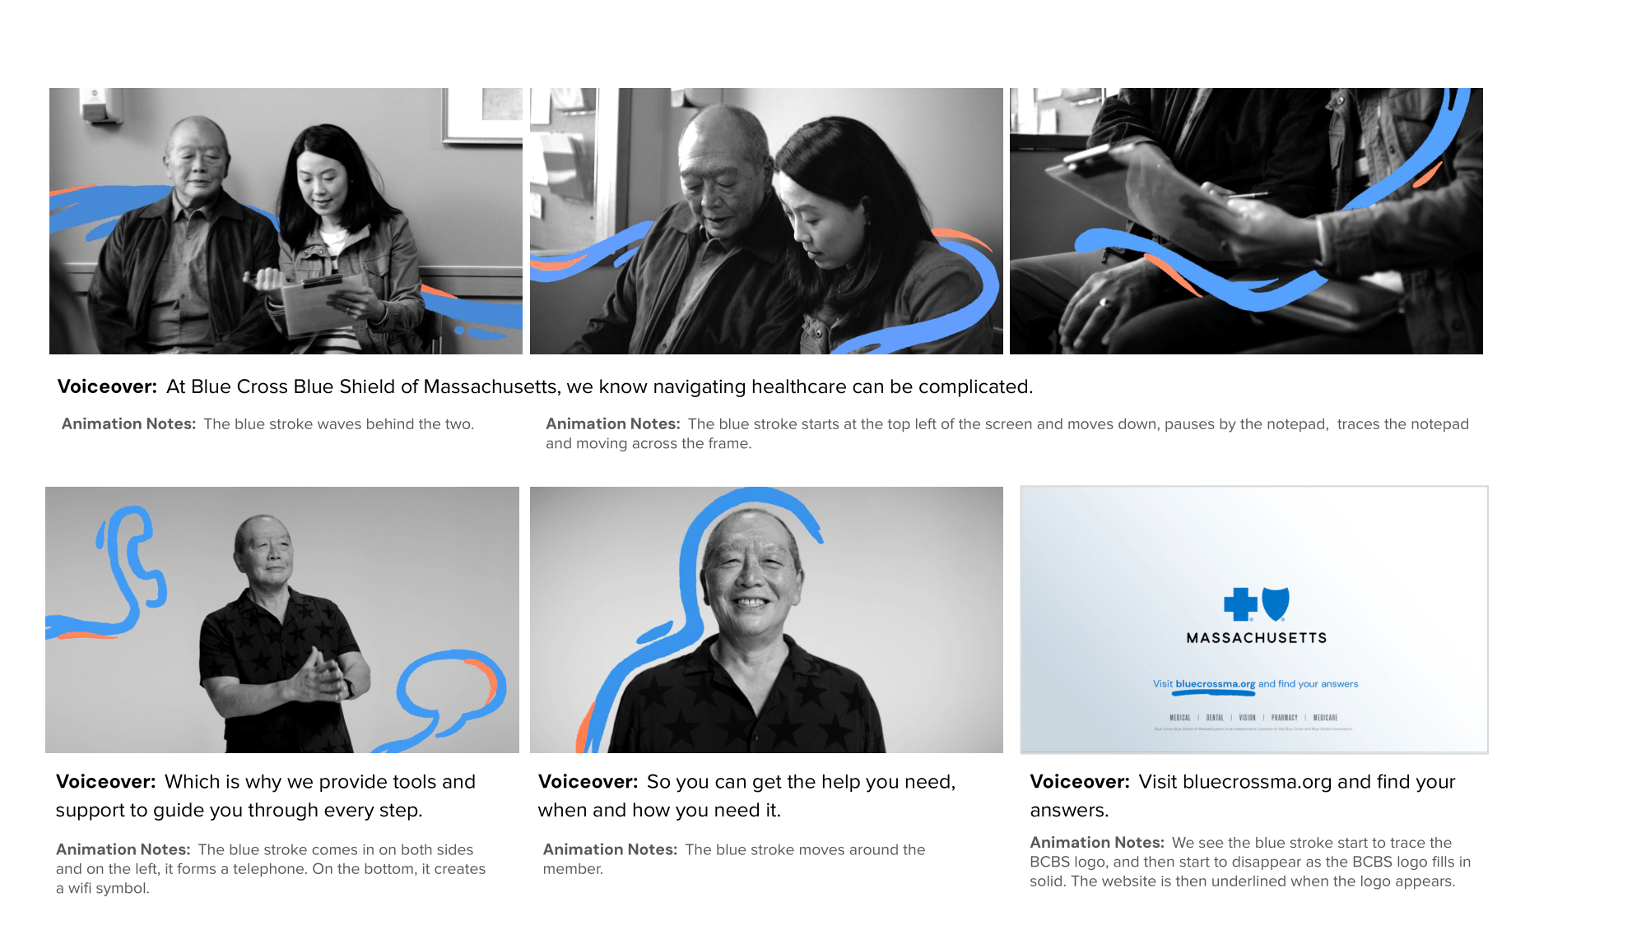
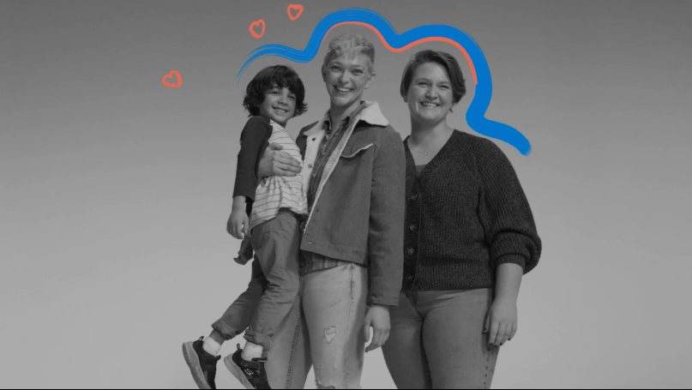

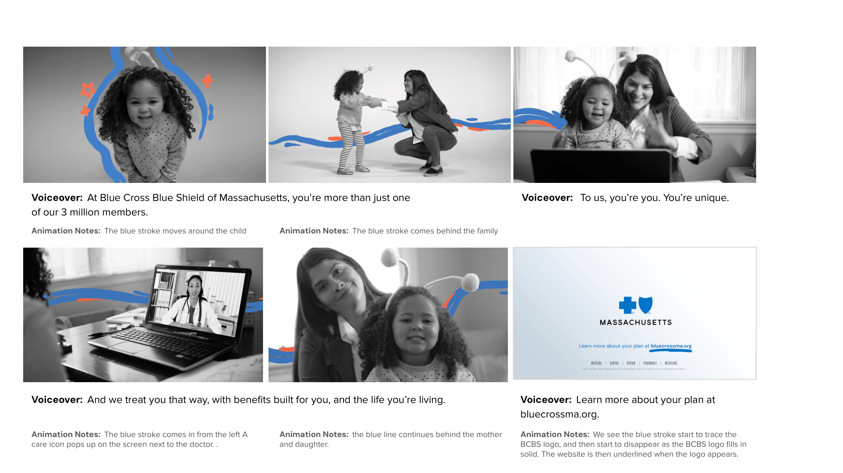
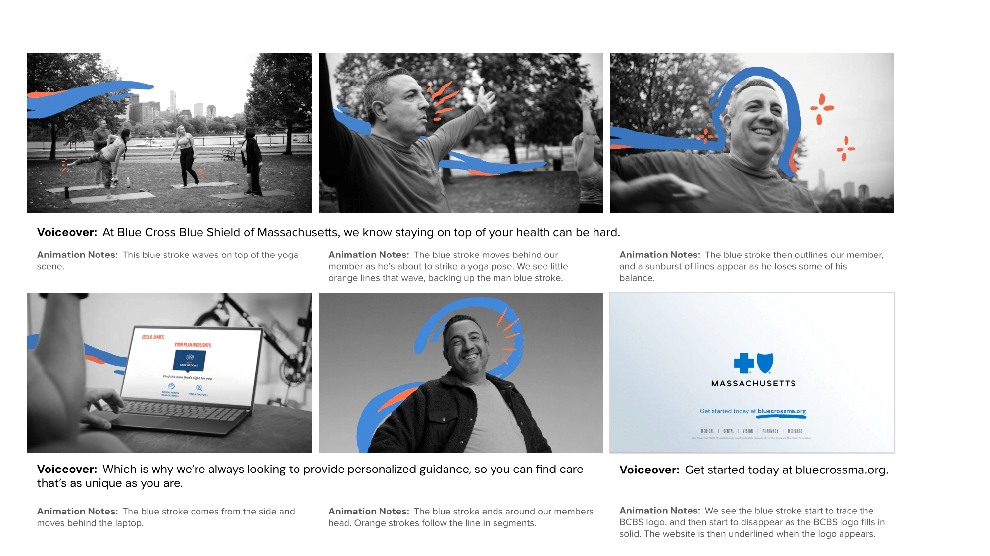
Stimuli tested
Respondents saw the :30 video and provided detailed feedback; respondents were asked about possible actions expected to take after seeing the advertisement. Then participants viewed each of three :15 storyboards (viewing order varied) and answered feedback questions to collect further insight on the cut-down versions.
:15 storyboards
:30 Video
Support
AND
Benefits & Resources
AND
Care Navigation

Slide 5

EXECUTIVE SUMMARY: key findings
consistent themes emerge across the video and storyboards
:30 Video
:15 Support
:15 Benefits & Resources
:15 Care Navigation
Across all content the following stood out: | Positive tone and message BCBSMA cares about their consumers’ unique needs and is here to support them Generic content missing the how and what (e.g., confusion on what the actual offerings are, wanting clarity on how offerings will be customized) The blue and orange animated line was distracting to a small minority*; others were unclear on its purpose
Key Takeaways Unique to Each Ad | Diversity makes people feel seen & represented | BCBSMA guides consumers through a complex system | Highlights online access to support | Viewers see their health needs reflected through relatable elements (e.g., man doing yoga)
Initial Reactions (T2B; very/somewhat positive) | 75% | 68% | 67% | 63%
Relevancy (T3B; extremely/very/somewhat relevant) | 75% | 70% | 68% | 69%
% who identify areas of confusion | 12% | 15% | 12% | 14%
 | 3-in-4 think BCBSMA is doing more for them after viewing the campaign
* 10% of Total Sample inclusive of mentions across all 4 content pieces; majority of commenters are aged 65+

Slide 6



EXECUTIVE SUMMARY: key takeaways
Visuals
Content
Impact
Diverse representation of family types, ages, races, etc. is well received. It makes viewers feel heard and seen while creating an authentic and supportive tone. The diversity also underscores BCBSMA’s overall goal of demonstrating the personalization of offerings and treating customers as individuals with unique needs.
The blue and orange animation is distracting or unclear in purpose for a small minority.
However, viewers want more information on the specifics i.e., what is actually being personalized and what customized offerings could look like.
Without examples, the campaign feels somewhat vague and doesn’t succeed in standing out from other ads.
The campaign confirms for viewers that
BCBSMA exhibits many positive attributes and can do more than they previously thought.
After viewing, roughly 1-in-4 would visit the BCBSMA website, but half felt no call to action from the campaign.
Despite positive reactions on par with past BCBSMA ads, viewers report lower impact on their perception of BCBSMA.
Build trust and believability with viewers by demonstrating how BCBSMA will meet their consumers’ unique needs with examples of customized benefits and tools.
Maintain the inclusive feel to highlight key brand perception goals of customized offerings and treating customers as individuals.
Strengthen the call to action by offering the specific information they can expect to find by visiting the website.

Slide 7
EXECUTIVE SUMMARY: ad performance benchmarks
2024 Brand Campaign :30 Video aligns with other BCBSMA ads for viewer reaction and excels for clarity yet has lower positive impact on BCBSMA perception.
Positive
Negative
Overall Avg.
75%
Overall Reaction (T2B)
2024 Brand Campaign in April 2024 is in the middle of the pack for overall reactions
Mighty Mass
(2020)
On to Better
(2023)
2024 Brand Campaign
Back to Better: Concept Y
(2021)
Impact on Perception of BCBSMA (T2B)
Overall Avg.
57%
2024 Brand Campaign in April 2024 has lower positive impact (less change) on BCBSMA perceptions compared to most BCBSMA ads.
Removing Barriers: Bret (2020)
On to Better
(2023)
2024 Brand Campaign
MH Ad: Leadership in Community
(2020)
Confusing (Yes)
Overall Avg.
17%
2024 Brand Campaign in April 2024 has lower levels of confusion compared to most BCBSMA ads.
On to Better
(2023)
Plant the Flag
re-test (2020)
MH Ad: RTB
(2020)
2024 Brand Campaign

Slide 8
DETAILED FINDINGS:
:30 video

Slide 9
By acknowledging and appreciating everyone’s unique needs, viewers feel seen and heard
:30 Video
And viewers see BCBSMA as an inclusive, supportive, and authentic healthcare provider
Main Messages
(Unaided OE, N=443)
“Just as each individual has unique traits, they have unique health needs as well. BCBSMA provides personalized care plans for individual needs.” – Man, Nonmember, Commercial, Asian/PI, 40-54
BCBSMA is for everyone (e.g., all ages, all health statuses) and has tailored healthcare options to cater to people’s unique needs
BCBSMA values their customers – they see their customers as real human beings with unique needs and not just as a number
BCBSMA is here to help people achieve their health goals so they can live their best, most fulfilled life
“We value you as more than just a customer.” – Woman, Member, Commercial, Asian/PI, 25-39
“The overall message is that BCBS supports your needs so you can live a fulfilling life.” – Woman, Nonmember, Commercial, Black/AA, 25-29
SOURCE: 2024 Brand Campaign Test (April 2024)
Blue idea exchange/Medicare idea exchange + OOC Sample Boost (N=443)
Notes:
Q – What do you think the main message of this ad is? Unaided (n=443)

Slide 10

The video’s welcoming, inclusive tone and visuals make viewers feel like BCBSMA is there to acknowledge and support their unique needs
:30 Video
Reasons why
(Unaided, N=443).
Overall Reaction to Video
(5-pt scale, N=443)
75% very / somewhat positive
Overall tone (including the music) is upbeat, supportive, and encouraging Diversity makes people feel seen and represented – inclusive representation of individuals and families also indicates BCBSMA would personalize offerings for their specific needs People feel like BCBSMA is genuine – they really care about their customers
“I liked the message of tailored care to individual needs. I liked the tone of the ad; upbeat music and the blue line moving around the people.” – Man, Member, Medicare, White/Caucasian, 65+ “I appreciated that it acknowledged that subscribers will have different healthcare needs from one another. I appreciated that it showed a diversity of families and individuals.” – Man, Member Commercial, White/Caucasian, 25-39
Though top box scores have very slightly retracted, top 2 box scores have slightly increased for the ad.
75%
T2B
On par with benchmarks
4% very / somewhat negative
A few find the blue graphic distracting and people are unsure of its purpose A couple thought the video was too vague, generic, and boring – it lacks specificity on the benefits and how it differs from other plans A couple feel ads in general are too focused on diversity
“I found the wavy blue line throughout the ad very distracting, and it took away from the message because my eye kept going to the line hoping it would stop.” – Woman, Nonmember, Medicare, White/Caucasian, 65+ “It doesn't list concrete reasons to use BCBS. It took 15 seconds to mention tools to select a doctor and that was the only benefit listed.” – Man, Member, Commercial, White/Caucasian, 55-64
4% B2B
Overall Reaction | Benchmarks
 | Overall Ave T2B | 2023 Campaign
 | 75% | 80%
See Appendix for details
SOURCE: 2024 Brand Campaign Test (April 2024)
Blue idea exchange/Medicare idea exchange + OOC Sample Boost (N=443)
High Health Status and Highly Healthcare Engaged audiences are significantly more positive. See Appendix for details.
Notes:
Q – How do you feel about the ad overall? Please use the space provided to explain your reasoning (n=443)

Slide 11
the video leaves a positive to neutral impression Of BCBSMA
:30 Video
Impact on BCBSMA Perception
(5-pt scale, N=443)
Relevance
(5-pt scale, N=443)
BCBSMA Attributes after viewing video
(%Somewhat/Strongly Agree, 5-pt scale, N=443)
 | :30 Video
 | T2B
… treats members as individuals with unique needs | 79%
… designs benefits and resources around member needs | 77%
… is a resource members can turn to in helping navigate their healthcare journey | 76%
… takes care of members and their families when they need it most | 73%
… helps members to get the most from their plan | 71%
… empowers members to make better decisions about their health and wellbeing | 71%
… is a trustworthy company | 70%
… proactively makes suggestions to members that improve their health care | 61%
- below benchmarks
T2B 53%
T3B 75%
BCBSMA Perception | Benchmarks
 | Overall Ave T2B | 2023 Campaign
 | 57% | 62%
See Appendix for details
SOURCE: 2024 Brand Campaign Test (April 2024)
Blue idea exchange/Medicare idea exchange + OOC Sample Boost (N=443)
Viewers aged 25-54 report significantly more positive impact on BCBSMA perception, and 25-54 & Black/AA audience feels higher (T2B) relevance. See Appendix for details.
Notes:
Q – How would seeing this advertisement impact your perception of Blue Cross Blue Shield of Massachusetts? (n=443)
Q - How relevant is the message in this ad to you personally? (n=443)
Q - After viewing this ad, how much do you agree or disagree with the following statements? Blue Cross Blue Shield of Massachusetts … Single-select (n=443)

Slide 12

The video prompts about 1 in 4 viewers to review and re-evaluate their insurance; more specificity on offerings could spur further action
:30 Video
Anticipated Actions Upon Seeing Video
(multi-select, N=443)
On par with benchmarks
Viewers aged 25-54 are more likely to take action (See Appendix for details).
Hispanic viewers are more likely to review their health benefits (51%).
Asian viewers are more likely to go to the BCBSMA website (36%).
Viewers with B3B Health Status are more likely to do nothing (54%).
Consider switching to BCBSMA
Feel confident in current BCBSMA decision
Learn more about the benefits (e.g., talk to HR department)
Recommend to family / friends
Watch the video again
Make a doctor appointment
On par with benchmarks
SOURCE: 2024 Brand Campaign Test (April 2024)
Blue idea exchange/Medicare idea exchange + OOC Sample Boost (N=443)
Overall Avg. Benchmarks: Go to website – 30%, Would not do anything – 50%
Notes:
Q9.1-9.8 – What actions (if any) would you take after seeing this ad? Multi-select (n=443)

Slide 13
While MOST viewers find the video clear, a small minority wants more specificity about what BCBSMA can do for them
:30 Video
Some are also unclear on what the blue animation is meant to represent.
What are the actual offerings?
Viewers are left wondering what the benefits of BCBSMA would actually be? They’re unclear on the tools, costs, and generally what the service would look like in their life.
What’s the purpose of the animation?
Some viewers wonder what the blue and orange line was meant to symbolize. Others saw it as distracting – something that took away from the message rather than added to it.
How will benefits be customized?
Others heard the promise of personalization but found details on how and what would be customized lacking.
“I'm not sure what the actual services are - it's all very generic like, ‘your insurance plan is doing more for YOU’ but unclear what exactly they're doing that's different/new/novel compared to others or what they previously offered.” – Woman, Nonmember, Commercial, Asian/PI, 25-39
12% found something confusing
“The blue line that travels across all images was distracting. Health insurance isn't a whimsical or arty topic, not sure to what end you hope […] to trick folks into thinking the company is something other than a business that makes huge profits?” – Woman, Member, Commercial, White/Caucasian, 40-54
+ exceeds benchmarks
“What kinds of help BCBS could provide me. Is it online support, articles, someone to help me? It wasn't totally clear how my care could be personalized and what tools are available.” – Man, Member, Commercial, Asian/PI, 25-39
Confusing | Benchmarks
 | Overall Ave | 2023 Campaign
 | 17% | 24%
SOURCE: 2024 Brand Campaign Test (April 2024)
Blue idea exchange/Medicare idea exchange + OOC Sample Boost (N=443)
BCBSMA Members report significantly higher rates of confusion compared to non-members.
Notes:
Q – What, if anything, do you find confusing or unclear about this ad? (n=443)

Slide 14
DETAILED FINDINGS:
:15 Storyboards

Slide 15
Across all 3 storyboards, reactions are generally positive, and the messages are relevant and clear
:15 Support
Confusion
(Yes/No, N=443)
Overall Reaction
(5-pt scale, N=443)
Relevance
(5-pt scale, N=443)
85%
:15 Benefits & Resources
found this storyboard clear
T2B 68%
T2B 67%
T2B 63%
T3B 70%
T3B 66%
T3B 69%
:15 Support
:15 Care Navigation
88%
found this storyboard clear
:15 Benefits & Resources
86%
found this storyboard clear
:15 Support
:15 Benefits & Resources
:15 Care Navigation
:15 Support
:15 Benefits & Resources
:15 Care Navigation
:15 Care Navigation
*Chart totals over 100% due to rounding
SOURCE: 2024 Brand Campaign Test (April 2024)
Blue idea exchange/Medicare idea exchange + OOC Sample Boost (N=443)
Notes:
Q – How do you feel about the ad storyboard overall? Please use the space provided to explain your reasoning. (n=443)
Q - How relevant is the message in this ad to you personally? (n=443)

Slide 16
Storyboards successfully broadcasts a Positive View of BCBSMA supporting members and offering personalized support
Most room for optimization lies in adding specifics
Storyboard Positives (majority of viewers)
Positive messaging shows that BCBSMA cares and is here to help BCBSMA prioritizes personalized member experience BCBSMA can help with a complicated healthcare system Highlighting online access to care and support The focus on the individual and customized tools is appealing
Call-outs from viewers with less positive reaction (small number of viewers)
Message about unique and personalized service is not believable & lacks specifics Ad feels generic with no stand-out qualities or insurance offerings highlighted Generic information without specifics – viewers are hooked by claims of support and individualized care, but the promise seems empty without details Blue streak is not appealing to a small number across each
:15 Support
:15 Benefits & Resources
:15 Care Navigation

Slide 17
The support storyboard demonstrates BCBSMA as a guiding force for navigating through healthcare system complexities
:15 Support
Similar to the video, viewers want more of the ‘how’
Main Messages
(Unaided OE, N=443)
85%
Healthcare is complex. BCBSMA is here to help me, with tools to make navigating healthcare easier.
Clarity & Confusion
(Yes/No with OE, N=443)
found this storyboard clear
15% found something confusing
Lacks specificity about the tools and benefits offered The purpose of the blue streak The relationship between the people in the storyboard and how they relate to BCBSMA tools and supports is unclear
“None of the ads really tell you exactly what services set them apart. I wish there was a screen shot of a few examples to intrigue you into going to the website.” – Woman, Member, Commercial, Asian/PI, 35-54 “What does BCBSMA actually offer — is it anything I wouldn't normally expect from any other health insurance company?” – Man, Member, Commercial, White/Caucasian, 25-34
“BCBS is here to help me with my family's unique healthcare needs and situations. Navigating the healthcare system is not easy, but they are here to help..” – Man, Member, Commercial, Asian/PI, 25-34
“Blue Cross can help you with your health care questions.” – Man, Nonmember, Medicare, White/Caucasian, 65+
BCBSMA is ready to meet the unique needs of individuals.
“You get wrap around service from the company.” – Woman, Nonmember, Medicare, Black/AA, 65+
“Assistance and guidance on every step of your healthcare journey.” – Woman, Nonmember, Commercial, White, 35-54
SOURCE: 2024 Brand Campaign Test (April 2024)
Blue idea exchange/Medicare idea exchange + OOC Sample Boost (N=443)
BCBSMA Members and Older Audience report significantly higher rates of confusion.
Notes:
Q – What do you think the main message of this ad is? (n=443)
Q – What, if anything, do you find confusing or unclear about this ad? (n=443)

Slide 18
majority feel positive toward the Support storyboard, as BCBSMA is acknowledging their reality of struggling through a complex system
:15 Support
But recognition only goes so far – viewers want concrete examples of support
Overall Reaction
(5-pt scale, N=443)
Reasons why
(Unaided OE, N=443)
Relevance
(5-pt scale, N=443)
68% very / somewhat positive
Overall positive message and imagery BCBSMA can help with a complicated healthcare system BCBSMA cares about individual needs Image of aging parent resonates for some
“I like that this company helps you navigate healthcare which can be complicated.” – Woman, Nonmember, Medicare, White/Caucasian, 65+
T2B 68%
T3B 70%
5% very / somewhat negative
Message is not believable or confusing Content is too generic, not informative Blue streak is not appealing A few feel negatively about implication an older person needs help from younger
“Seems super generic & unbelievable - doesn't actually provide any detail on what they can actually do, just directs you to website. Feels like a very pointless ad.” – Woman, Nonmember, Asian/PI, Commercial, 35-54
*Chart totals over 100% due to rounding
SOURCE: 2024 Brand Campaign Test (April 2024)
Blue idea exchange/Medicare idea exchange + OOC Sample Boost (N=443)
Older Audience reports significantly less positive reaction; Hispanic viewers are significantly more positive. 25-54 & Hispanic audiences feels higher (T2B) relevance See Appendix for details.
Notes:
Q – How do you feel about the ad storyboard overall? Please use the space provided to explain your reasoning. (n=443)
Q - How relevant is the message in this ad to you personally? (n=443)

Slide 19
BCBSMA treats patients as unique individuals rather than a number
:15 Benefits & Resources
They help members find the unique support they and their families need
Main Messages
(Unaided OE, N=443)
Members have unique needs and are more than just a number. BCBSMA is there for members, providing specialized care and support.
Clarity & Confusion
(Yes/No with OE, N=443)
88%
12% found something confusing
Specifics behind how BCBSMA will personalize experiences & services Goal and key message of ad Purpose of blue & orange designs
“What reason do I have to take any action after viewing this ad? Is this supposed to make me buy BCBSMA? What does it offer?.” – Man, Member, Commercial, White/Caucasian/Middle Eastern/North African, 25-34 “It doesn't tell me about anything new or any new tools. When I pick a BCBS benefits plan through my employer, I choose from a menu of 3 plans. I don't feel very unique, so this message seems to contradict reality.” – Woman, Member, Commercial, Multiracial/Multi-ethnic, 35-54
found this storyboard clear
“You are unique, and we treat you as such with the range of products we offer.”
– Woman, Non-member, Commercial, White/Caucasian, 35-54
“BCBS is here to help take care of my and my family's unique health needs. I am more than 1 in however many people they serve.”
– Man, Member, Commercial, Asian/PI, 25-34
BCBSMA can support the needs of you AND your family.
“BCBS has many ways to meet your family's heath care needs whether in person or online.”
– Woman, Member, Commercial, Black/AA, 55-64
“Help you to find the best plan for you and your family.”
– Woman, Non-member, Medicare, White/Caucasian, 65+
SOURCE: 2024 Brand Campaign Test (April 2024)
Blue idea exchange/Medicare idea exchange + OOC Sample Boost (N=443)
BCBSMA Members report significantly higher rates of confusion compared to non-members.
Notes:
Q – What do you think the main message of this ad is? (n=443)
Q – What, if anything, do you find confusing or unclear about this ad? (n=443)

Slide 20
majority feel positive toward the Benefits & resources story board, as A personalized healthcare experience translates to ‘BCBSMA cares’
:15 Benefits & Resources
Reasons why
(Unaided OE, N=443)
Overall Reaction
(5-pt scale, N=443)
67% very / somewhat positive
BCBSMA prioritizes personalized member experience Family-oriented visual is heartwarming and shows diversity of care services Positive messaging shows that BCBSMA cares Highlighting online access to care and support
“Mother and child being able to visit a physician online/Telehealth. This gives families options whereas before you needed to drive to the doctor's office to see your health care provider.” – Woman, Member, Commercial, Black/AA, 55-64 “I like the way BC/BSMA is being depicted as a company that cares about each of its individual members.” - Man, Member, Medicare, White/Caucasian, 65+
Relevance
(5-pt scale, N=443)
T2B 67%
T3B 66%
4% very / somewhat negative
Message about unique and personalized service is not believable & lacks specifics Ad feels generic with no stand-out qualities or insurance offerings highlighted
“I think it's deceptive. BCBSMA has a limited range of plans. Nothing is tailored for the individual. At all. Neither prices, nor benefits, nor policies. Everything is standardized. How, then, does it treat me as an individual?” - Woman, Member, Medicare, Multiracial/Multi-ethnic, 65+ “This feels disingenuous - is my plan really designed "for me" or just what my company decides to offer in their corporate plan. Don't like this - feels very generic insurance nonsense.” - Woman, Nonmember, Commercial, Asian/PI, 35-54
SOURCE: 2024 Brand Campaign Test (April 2024)
Blue idea exchange/Medicare idea exchange + OOC Sample Boost (N=443)
Older Audience are significantly less positive; Black/AA, High Health Status and High Healthcare Engaged viewers are significantly more positive. 25-54, Black/AA & Hispanic audiences feel higher (T2B) relevance See Appendix
Notes:
Q – How do you feel about the ad storyboard overall? Please use the space provided to explain your reasoning. (n=443)
Q - How relevant is the message in this ad to you personally? (n=443)

Slide 21
Personalized guidance comes through loud and clear
:15 Care Navigation
But some members are confused what the personalized guidance includes and how BCBSMA will deliver it
Main Messages
(Unaided OE, N=443)
BCBSMA offers personalized guidance for members’ unique healthcare needs.
Clarity & Confusion
(Yes/No with OE, N=443)
86%
14% found something confusing
Not enough details on what personalized guidance entails and how BCBSMA provides it Purpose of blue/orange lines
“What personalized guidance does BCBS provide? I can tell that I need to go to my online account to figure it out, but it's not clear from the commercial.” – Man, Member, Commercial, White/Caucasian, 25-34 “BCBSMA can help us online, but how can you help us as a unique customer?” – Woman, Member, Commercial, Asian/PI, 35-54 “The blue and orange graphics are distracting, purposeless.” – Man, Nonmember, Commercial,, White/Caucasian, 55-64
found this storyboard clear
“You are unique and BCBS cares about your health and offers personal guidance for your healthcare needs.” – Female, Member, Commercial, White, 35-44
“BCBS provides personalized assistance to ensure you get individualized and specialized care.” – Female, Member, Commercial, Black/AA, 35-54
BCBSMA is there to help members stay healthy.
“BCBS is there to help members stay healthy in a variety of ways.” – Female, Member, Commercial, Asian, 55-64
“BC will help you identify ways to keep healthy. The inference is that you will have coverage for that.” – Female, Nonmember, Medicare, White, 65+
SOURCE: 2024 Brand Campaign Test (April 2024)
Blue idea exchange/Medicare idea exchange + OOC Sample Boost (N=443)
BCBSMA Members and Older Audience report significantly higher rates of confusion.
Notes:
Q – What do you think the main message of this ad is? (n=443)
Q – What, if anything, do you find confusing or unclear about this ad? (n=443)

Slide 22
Majority feel positive toward the Care navigation storyboard
:15 Care Navigation
It feels relatable and motivates them to take control of their health with BCBSMA’s personalized guidance
Reasons why
(Unaided OE, N=443)
Overall Reaction
(5-pt scale, N=443)
Relevance
(5-pt scale, N=443)
63% very / somewhat positive
Viewers relate to the man in the campaign as they see their interests (e.g., being active, yoga) and health needs reflected They feel motivated to take control of caring for their health especially with BCBSMA providing guidance The focus on the individual and customized tools is appealing Overall light, welcoming, and wholesome tone
“That Blue Cross and Blue Shield always provides guidance for personalized care unique as every individual.” – Man, Member, Commercial, White/Caucasian, 55-64 “The way the blue stroke is incorporated signifies BCBS is there to help navigate the journey.” – Woman, Member, Commercial, White/Caucasian, 55-64
T2B 63%
T3B 69%
6% very / somewhat negative
Generic information without specifics – viewers are hooked by claims of support and individualized care, but the promise seems empty without details
“Once again, there's no content. Things are hard - we'll guide you. What does that mean? How? And it doesn't get me interested enough to even want to find out.” – Woman, Member, Commercial, White/Caucasian, 25-39
SOURCE: 2024 Brand Campaign Test (April 2024)
Blue idea exchange/Medicare idea exchange + OOC Sample Boost (N=443)
Older Audience are significantly less positive; Black/AA, Hispanic and High Health Status viewers are significantly more positive. 25-54 & Hispanic audiences feels higher (T2B) relevance See Appendix
Notes:
Q – How do you feel about the ad storyboard overall? Please use the space provided to explain your reasoning. (n=443)
Q - How relevant is the message in this ad to you personally? (n=443)

Slide 23
Wrapping it up

Slide 24

After viewing the entire campaign (video + 3 storyboards), 3-in-4 think BCBSMA is doing more for them
After Brand Campaign Exposure – Overall Impression
(Single-select, N=443)
SOURCE: 2024 Brand Campaign Test (April 2024)
Blue idea exchange/Medicare idea exchange + OOC Sample Boost (N=443)
Notes:
Q - Thinking about what you have seen in all four of these ads combined, please fill in the blank in the statement below. After seeing these ads, I think Blue Cross Blue Shield of Massachusetts can do _______ than I previously thought. Single-select (n=443)

Slide 25
Appendix

Slide 26

EXECUTIVE SUMMARY: KEY AUDIENCES
The campaign performs particularly well with target age, lower health status and some non-white subgroups. No key audiences expressed concern or offense. The campaign underperforms for the older audience on a few metrics.
How did the campaign perform among target audiences?
Views campaign more positively (compared to others in category) | Views campaign similarly (compared to others in category) | Views campaign less positively (compared to others in category)
Aged 25-54 (compared to older audience) A highly receptive audience that resonates with the entire campaign: More positive reaction, higher rates of positive brand impact, higher rates of relevance and most likely to take action after viewing the ad (i.e., review health benefits, visit website) | Less Engaged in Healthcare (0-7, 10-pt scale) (compared to High Healthcare Engagers) A passive audience: Responds positively to the content, yet less likely to take action after viewing the video | Senior audience (Aged 65+) (compared to younger audience) Less receptive audience: Lower rates of relevance and most were not inspired to take action after the video
Lower Health Status (B3B, 5-pt scale) (compared to Higher Health Status audience) A highly receptive audience that resonates with most content: Reacts positively and feels higher rates of relevance | Prospective/Nonmembers (compared to BCBSMA Members) Not a unique audience: mostly mirrors the members, except for clarity. Nonmembers are less likely to report confusion.
Black/AA & Hispanic (compared to White/Caucasian audience) A highly receptive audience that resonates with most content: Reacts positively and feels higher rates of relevance

Slide 27
Viewers aged 25-54 react more positively for the :15 storyboards and feel all content has greater relevance
[pOv | Overall Reaction (5-pt scale, T2B shown) |  |  | Relevance (5-pt scale, T2B shown)
 | Total Aggregate | Age 25-54 | All Others | Total Aggregate | Age 25-54 | All Others
N= | 443 | 217 | 226 | 443 | 217 | 226
:30 Video | 75 % | 78 % | 72 % | 48 % | 55 % | 41 %
:15 Support | 68 % | 75 % | 61 % | 43 % | 50 % | 35 %
:15 Benefits & Resources | 67 % | 75 % | 60 % | 42 % | 53 % | 31 %
:15 Care Navigation | 62 % | 68 % | 57 % | 40 % | 47 % | 32 %
Significantly higher than age groups combined
SOURCE: 2024 Brand Campaign Test (April 2024)
Blue idea exchange/Medicare idea exchange + OOC Sample Boost (N=443)
Notes:
Q - What actions (if any) would you take after seeing this ad? (n=443)

Slide 28
Viewers aged 25-54 are more likely to act after seeing the video
[p | By Target Age
 | Total Aggregate | Age 25-54 | All Others
N= | 443 | 217 | 226
Review my health insurance plan benefits | 26 % | 38 % | 15 %
Go to the Blue Cross Blue Shield of Massachusetts website | 26 % | 35 % | 18 %
I would not do anything after seeing this ad | 49 % | 34 % | 63 %
Log into my Blue Cross Blue Shield of Massachusetts account | 16 % | 26 % | 6 %
Comment or share about the ad via social media (Twitter, Facebook, Instagram) | 5 % | 8 % | 1 %
Call Blue Cross Blue Shield of Massachusetts | 4 % | 7 % | 2 %
Email Blue Cross Blue Shield of Massachusetts | 3 % | 4 % | 1 %
Search online for (please specify): | 2 % | 1 % | 2 %
I would do something else not listed above after seeing this ad (please specify): | 4 % | 1 % | 6 %
Anticipated Actions Upon Seeing :30 Video
(Multi-select)
Significantly higher than age groups combined
SOURCE: 2024 Brand Campaign Test (April 2024)
Blue idea exchange/Medicare idea exchange + OOC Sample Boost (N=443)
Notes:
Q - What actions (if any) would you take after seeing this ad? (n=443)

Slide 29
BCBSMA Attributes after viewing :30 Video
Total Sample
(5-pt scale, N=443)
Blue Cross Blue Shield of Massachusetts… | Strongly agree | Somewhat agree | Neither agree nor disagree | Somewhat disagree | Strongly disagree | T2B | B2B
… treats members as individuals with unique needs | 43 % | 36 % | 17 % | 3 % | 1 % | 79 % | 4 %
… is a trustworthy company | 33 % | 37 % | 26 % | 2 % | 1 % | 70 % | 3 %
… takes care of members and their families when they need it most | 33 % | 40 % | 22 % | 4 % | 1 % | 73 % | 5 %
… helps members to get the most from their plan | 35 % | 36 % | 24 % | 4 % | 1 % | 71 % | 5 %
… empowers members to make better decisions about their health and wellbeing | 32 % | 39 % | 25 % | 4 % | 1 % | 71 % | 5 %
… proactively makes suggestions to members that improve their health care | 25 % | 37 % | 31 % | 6 % | 1 % | 62 % | 7 %
… designs benefits and resources around member needs | 33 % | 44 % | 19 % | 3 % | 1 % | 77 % | 4 %
… is a resource members can turn to in helping navigate their healthcare journey | 35 % | 41 % | 20 % | 3 % | 1 % | 76 % | 4 %
SOURCE: 2024 Brand Campaign Test (April 2024)
Blue idea exchange/Medicare idea exchange + OOC Sample Boost (N=443)
Notes:
Q - After viewing this ad, how much do you agree or disagree with the following statements? Blue Cross Blue Shield of Massachusetts … (n=443)

Slide 30
Respondent profile
Total Sample
Age | N=443
18-24 | 12 | 3 %
25-34 | 75 | 17 %
35-54 | 142 | 32 %
55-64 | 76 | 17 %
65+ | 138 | 31 %
Gender
Men | 182 | 41 %
Women | 257 | 58 %
Gender Fluid | 1 | <1 %
I am: (please specify) | 1 | <1 %
Prefer not to say | 2 | <1 %
Ethnicity (MS)
Native American / Alaskan Native / Indigenous American origin | 2 | <1 %
Asian and/or of Pacific Islander | 55 | 12 %
Black and/or of African origin | 40 | 9 %
Hispanic and/or of Latin origin | 39 | 9 %
Middle Eastern and/or of North African origin | 4 | 1 %
White/Caucasian and/or of European origin | 303 | 68 %
Multiracial / Multi-ethnic | 6 | 1 %
Prefer not to say | 2 | <1 %
Not listed, I identify as: (please share) | 5 | 1 %
Health Insurance Provider
BCBMA Member | 242 | 55 %
Nonmember | 201 | 45 %
Health Status (5-pt Scale)
Excellent/Very Good Health | 241 | 54 %
Good/Fair/Poor Health | 202 | 46 %
Health Engagement (10-pt Scale)
Highly Engaged – T3B | 290 | 65 %
All Others | 153 | 35 %

Slide 31
Overall reaction
Overall Reaction by Member vs. Non-Member
Content | BCBSMA Member (n=242) |  | Nonmember (n=201)
 | T2B (Positive) | B2B (Negative) | T2B (Positive) | B2B (Negative)
:30 Video | 74 % | 5 % | 76 % | 3 %
:15 Support | 66 % | 7 % | 71 % | 5 %
:15 Benefits & Resources | 67 % | 6 % | 68 % | 3 %
:15 Care Navigation | 61 % | 6 % | 64 % | 5 %
Overall Reaction by Ethnicity
Content | White/Caucasian (n=303) |  | Asian/PI (n=55) |  | Black/AA (n=40) |  | Hispanic/Latino (n=39)
 | T2B | B2B | T2B | B2B | T2B | B2B | T2B | B2B
:30 Video | 74 % | 4 % | 73 % | 2 % | 80 % | 3 % | 72 % | 5 %
:15 Support | 64 % | 7 % | 71 % | 4 % | 75 % | 3 % | 82 % | 0 %
:15 Benefits & Resources | 63 % | 6 % | 66 % | 4 % | 83 % | 3 % | 77 % | 3 %
:15 Care Navigation | 59 % | 6 % | 62 % | 4 % | 75 % | 3 % | 80 % | 5%
Significantly higher than White / Caucasian sample group
Overall Reaction by Age
Content | 18-24 (n=12) * |  | 25-34 (n=75) |  | 35-54 (n=142) |  | 55-64 (n=76) |  | 65+ (n=138)
 | T2B | B2B | T2B | B2B | T2B | B2B | T2B | B2B | T2B | B2B
:30 Video | 58 % | 0 % | 76 % | 4 % | 79 % | 4 % | 71 % | 3 % | 74 % | 7 %
:15 Support | 75 % | 0 % | 75 % | 1 % | 75 % | 5 % | 67 % | 1 % | 57 % | 12 %
:15 Benefits & Resources | 42 % | 8 % | 69 % | 5 % | 78 % | 3 % | 63 % | 3 % | 60 % | 7 %
:15 Care Navigation | 67 % | 0 % | 65 % | 1 % | 69 % | 5 % | 66 % | 4 % | 51 % | 9 %
Significantly higher than 65+
sample group
* Small sample size
NOTE: Statistically significant differences highlighted are (p < .05).
Notes:
Q - How do you feel about the ad overall? (n=443)

Slide 32
Overall reaction
Overall Reaction by Health Status (5-pt. Scale)
Content | High Health Status -Excellent/Very Good (n=241) |  | Lower Health Status - Good/Fair/Poor (n=202)
 | T2B (Positive) | B2B (Negative) | T2B (Positive) | B2B (Negative)
:30 Video | 81 % | 3 % | 68 % | 6 %
:15 Support | 71 % | 6 % | 64 % | 5 %
:15 Benefits & Resources | 72 % | 3 % | 61 % | 7 %
:15 Care Navigation | 67 % | 4 % | 56 % | 7 %
Significantly higher than Lower Health Status sample group
Overall Reaction by Healthcare Engagement (10-pt Scale)
Content | Highly Engaged – T3B (n=290) |  | Lower Healthcare Engagers – B7B (n=153)
 | T2B (Positive) | B2B (Negative) | T2B (Positive) | B2B (Negative)
:30 Video | 78 % | 5 % | 69 % | 3 %
:15 Support | 69 % | 7 % | 67 % | 4 %
:15 Benefits & Resources | 71 % | 5 % | 60 % | 3 %
:15 Care Navigation | 65 % | 6 % | 57 % | 5 %
Significantly higher than Lower Healthcare Engagement sample group
* Small sample size
NOTE: Statistically significant differences highlighted are (p < .05).
Notes:
Q - How do you feel about the ad overall? (n=443)

Slide 33
Perception of BCBSMA
Perception of BCBSMA by Member vs. Non-Member
Content | BCBSMA Member (n=242) |  | Nonmember (n=201)
 | T2B (Positively) | B2B (Negatively) | T2B (Positively) | B2B (Negatively)
:30 Video | 51 % | 3 % | 55 % | 1 %
Perception of BCBSMA by Ethnicity
Content | White/Caucasian (n=303) |  | Asian (n=55) |  | Black/AA (n=40) |  | Hispanic/Latino (n=39)
 | T2B | B2B | T2B | B2B | T2B | B2B | T2B | B2B
:30 Video | 49 % | 2 % | 56 % | 2 % | 70 % | 3 % | 59 % | 3 %
Significantly higher than White / Caucasian sample group
Perception of BCBSMA by Age
Content | 18-24 (n=12) * |  | 25-34 (n=75) |  | 35-54 (n=142) |  | 55-64 (n=76) |  | 65+ (n=138)
 | T2B | B2B | T2B | B2B | T2B | B2B | T2B | B2B | T2B | B2B
:30 Video | 58 % | 8 % | 56 % | 1 % | 63 % | 2 % | 55 % | 3 % | 38 % | 1 %
Significantly higher than 65+
sample group
Perception of BCBSMA by Health Status (5-pt. Scale)
Content | High Health Status -Excellent/Very Good (n=241) |  | Lower Health Status - Good/Fair/Poor (n=202)
 | T2B (Positively) | B2B (Negatively) | T2B (Positively) | B2B (Negatively)
:30 Video | 58 % | 2 % | 47 % | 3 %
Significantly higher than B3B Health Status sample group
Perception of BCBSMA by Healthcare Engagement (10-pt Scale)
Content | Highly Engaged – T3B (n=290) |  | Lower Healthcare Engagers – B7B (n=153)
 | T2B (Positively) | B2B (Negatively) | T2B (Positively) | B2B (Negatively)
:30 Video | 56 % | 3 % | 47 % | 1 %
* Small sample size
NOTE: Statistically significant differences highlighted are (p < .05).
Notes:
Q - How would seeing this advertisement impact your perception of Blue Cross Blue Shield of Massachusetts? (n=443)

Slide 34
Ad performance against benchmarks
2024 Brand Campaign :30 Video aligns with T2B overall reactions scores for recent ads and has a lower confusion rating than most other tested ads. Yet the ad doesn’t move the needle for BCBSMA perceptions as well as other recent ads.
Metrics | Overall Average* | Back to Better Ad (July 2021) Concept Y | Affordable (Nov 2021) | VIP (Nov 2021) | On to Better (Feb 2022) | On to Better (May 2023) | 2024 Brand Campaign (April 2024)
Overall Reaction (T2B) | 75% | 63% | 79% | 76% | 77% | 80% | 75%
Perceptions of BCBSMA (T2B) | 57% | - | 61% | 64% | 55% | 62% | 53%
Actions
Go to the Blue Cross Blue Shield Website | 30% | 30% | 52% | 50% | 32% | 40% | 26%
Call Blue Cross Blue Shield | 5% | 2% | 15% | 17% | 4% | 6% | 4%
Email Blue Cross Blue Shield | 1% | 0% | 0% | 1% | 3% | 2% | 3%
Search online for (please specify): | 5% | 3% | 5% | 6% | 4% | 7% | 2%
Comment or share via social media (Twitter, Facebook, Instagram) | 4% | 2% | 0% | 1% | 4% | 5% | 5%
I would do something else not listed above after seeing this video (please specify): | 7% | 5% | 12% | 11% | 3% | 4% | 4%
I would not do anything after seeing this video | 50% | 60% | 30% | 26% | 45% | 39% | 49%
Confusing | 17% | 26% | 16% | 16% | 16% | 24% | 12%
*Includes ads tested 2020 to present
Benchmarks provided by Blue Cross Blue Shield of Massachusetts

