Slide 1
My Blue Mobile App Design
Survey Insights
March 21, 2024

Slide 2
01
Project Background
02
Executive Summary
Contents
03
Methodology
04
Benefits Survey
05
Claims Survey
06
Find a Provider Survey
07
Channel Comparisons
08
Next Steps
09
Appendix

Slide 3
Project Background
01

Slide 4
Project Background | Overview
BCBSMA engaged with Blink to reimagine the MyBlue mobile app.
Project Goals
Improve the mobile experience of BCBSMA members
Establish a framework for measuring CX
Design for increased self-service capabilities and provide features that decrease the need for members to call
Desired Outcomes
Improve MyBlue KPIs (NPS, FCoR, App Store ratings, MAPS call volume)
Understand best in class practices for both other “Blues” and other insurance providers

Slide 5

Project Background
Our process for developing the CX framework
Phase 1
Define customer success
Gain a foundational understanding of customer needs resulting in Customer Success Outcome (CSO) frameworks for the five focus areas:
Find a Provider
Understanding Benefits/Coverage
Claims
Prescription coverage
Costs
Phase 2
Baseline the experience
Perform a quantitative assessment of the current experience and benchmark against competitors to evaluate and prioritize future CX improvements.
Phase 3
Measure over time
Develop a dashboard of CSO performance to align the team and continually monitor to measure the impact of CX design improvements.

Slide 6
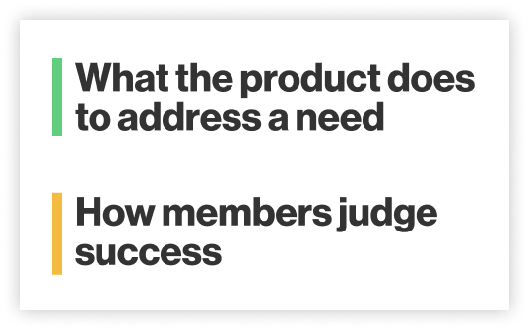

Project Background
What are Customer Success Outcomes?
Job statement
Customer Success Outcomes (CSOs) are a rigorous approach to CX strategy that align all levels of the business on member needs within a specific customer journey. This approach is modeled from the Jobs To Be Done theory.
CSOs are derived from deep qualitative research and grounded in customers’ needs. We used insights from BCBSMA past research and 22 in-depth interviews with members of both BCBSMA and competitor health insurance companies to develop the CSOs.
The goal of identifying CSOs is to align teams, guide product strategy decisions, and evaluate designs to track progress over time.
Success criteria
Job statement
Success criteria

Slide 7
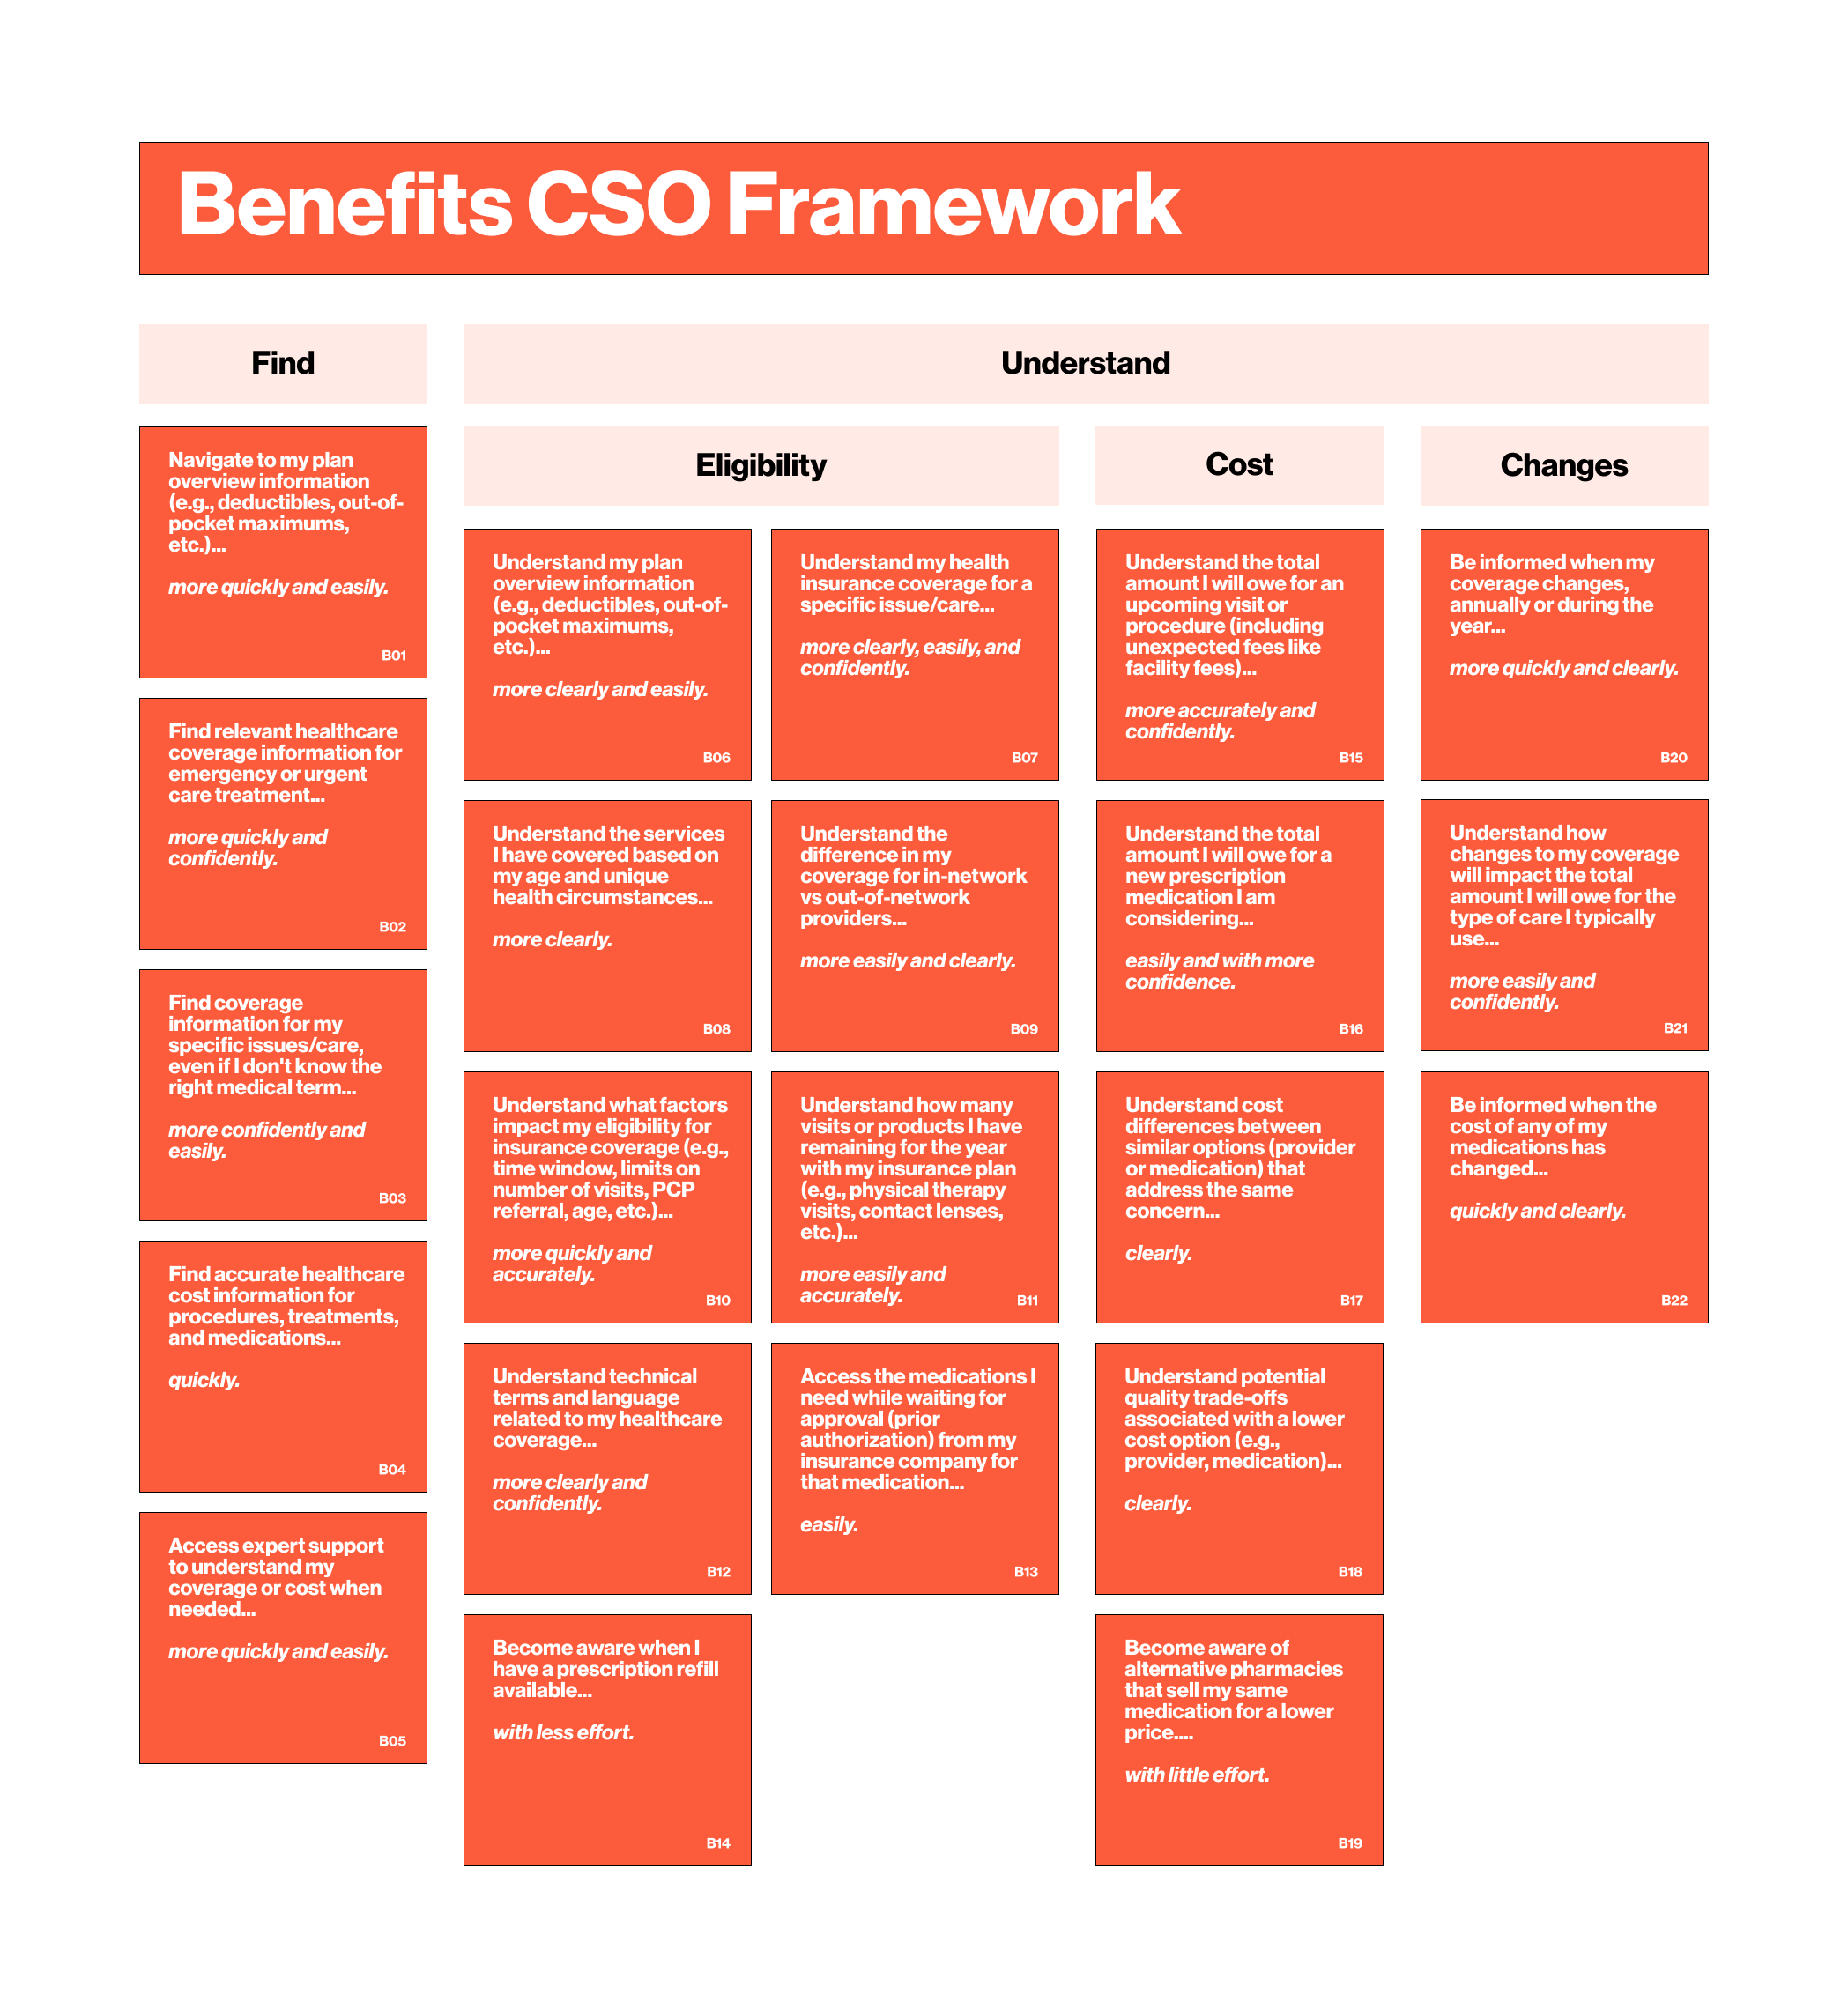
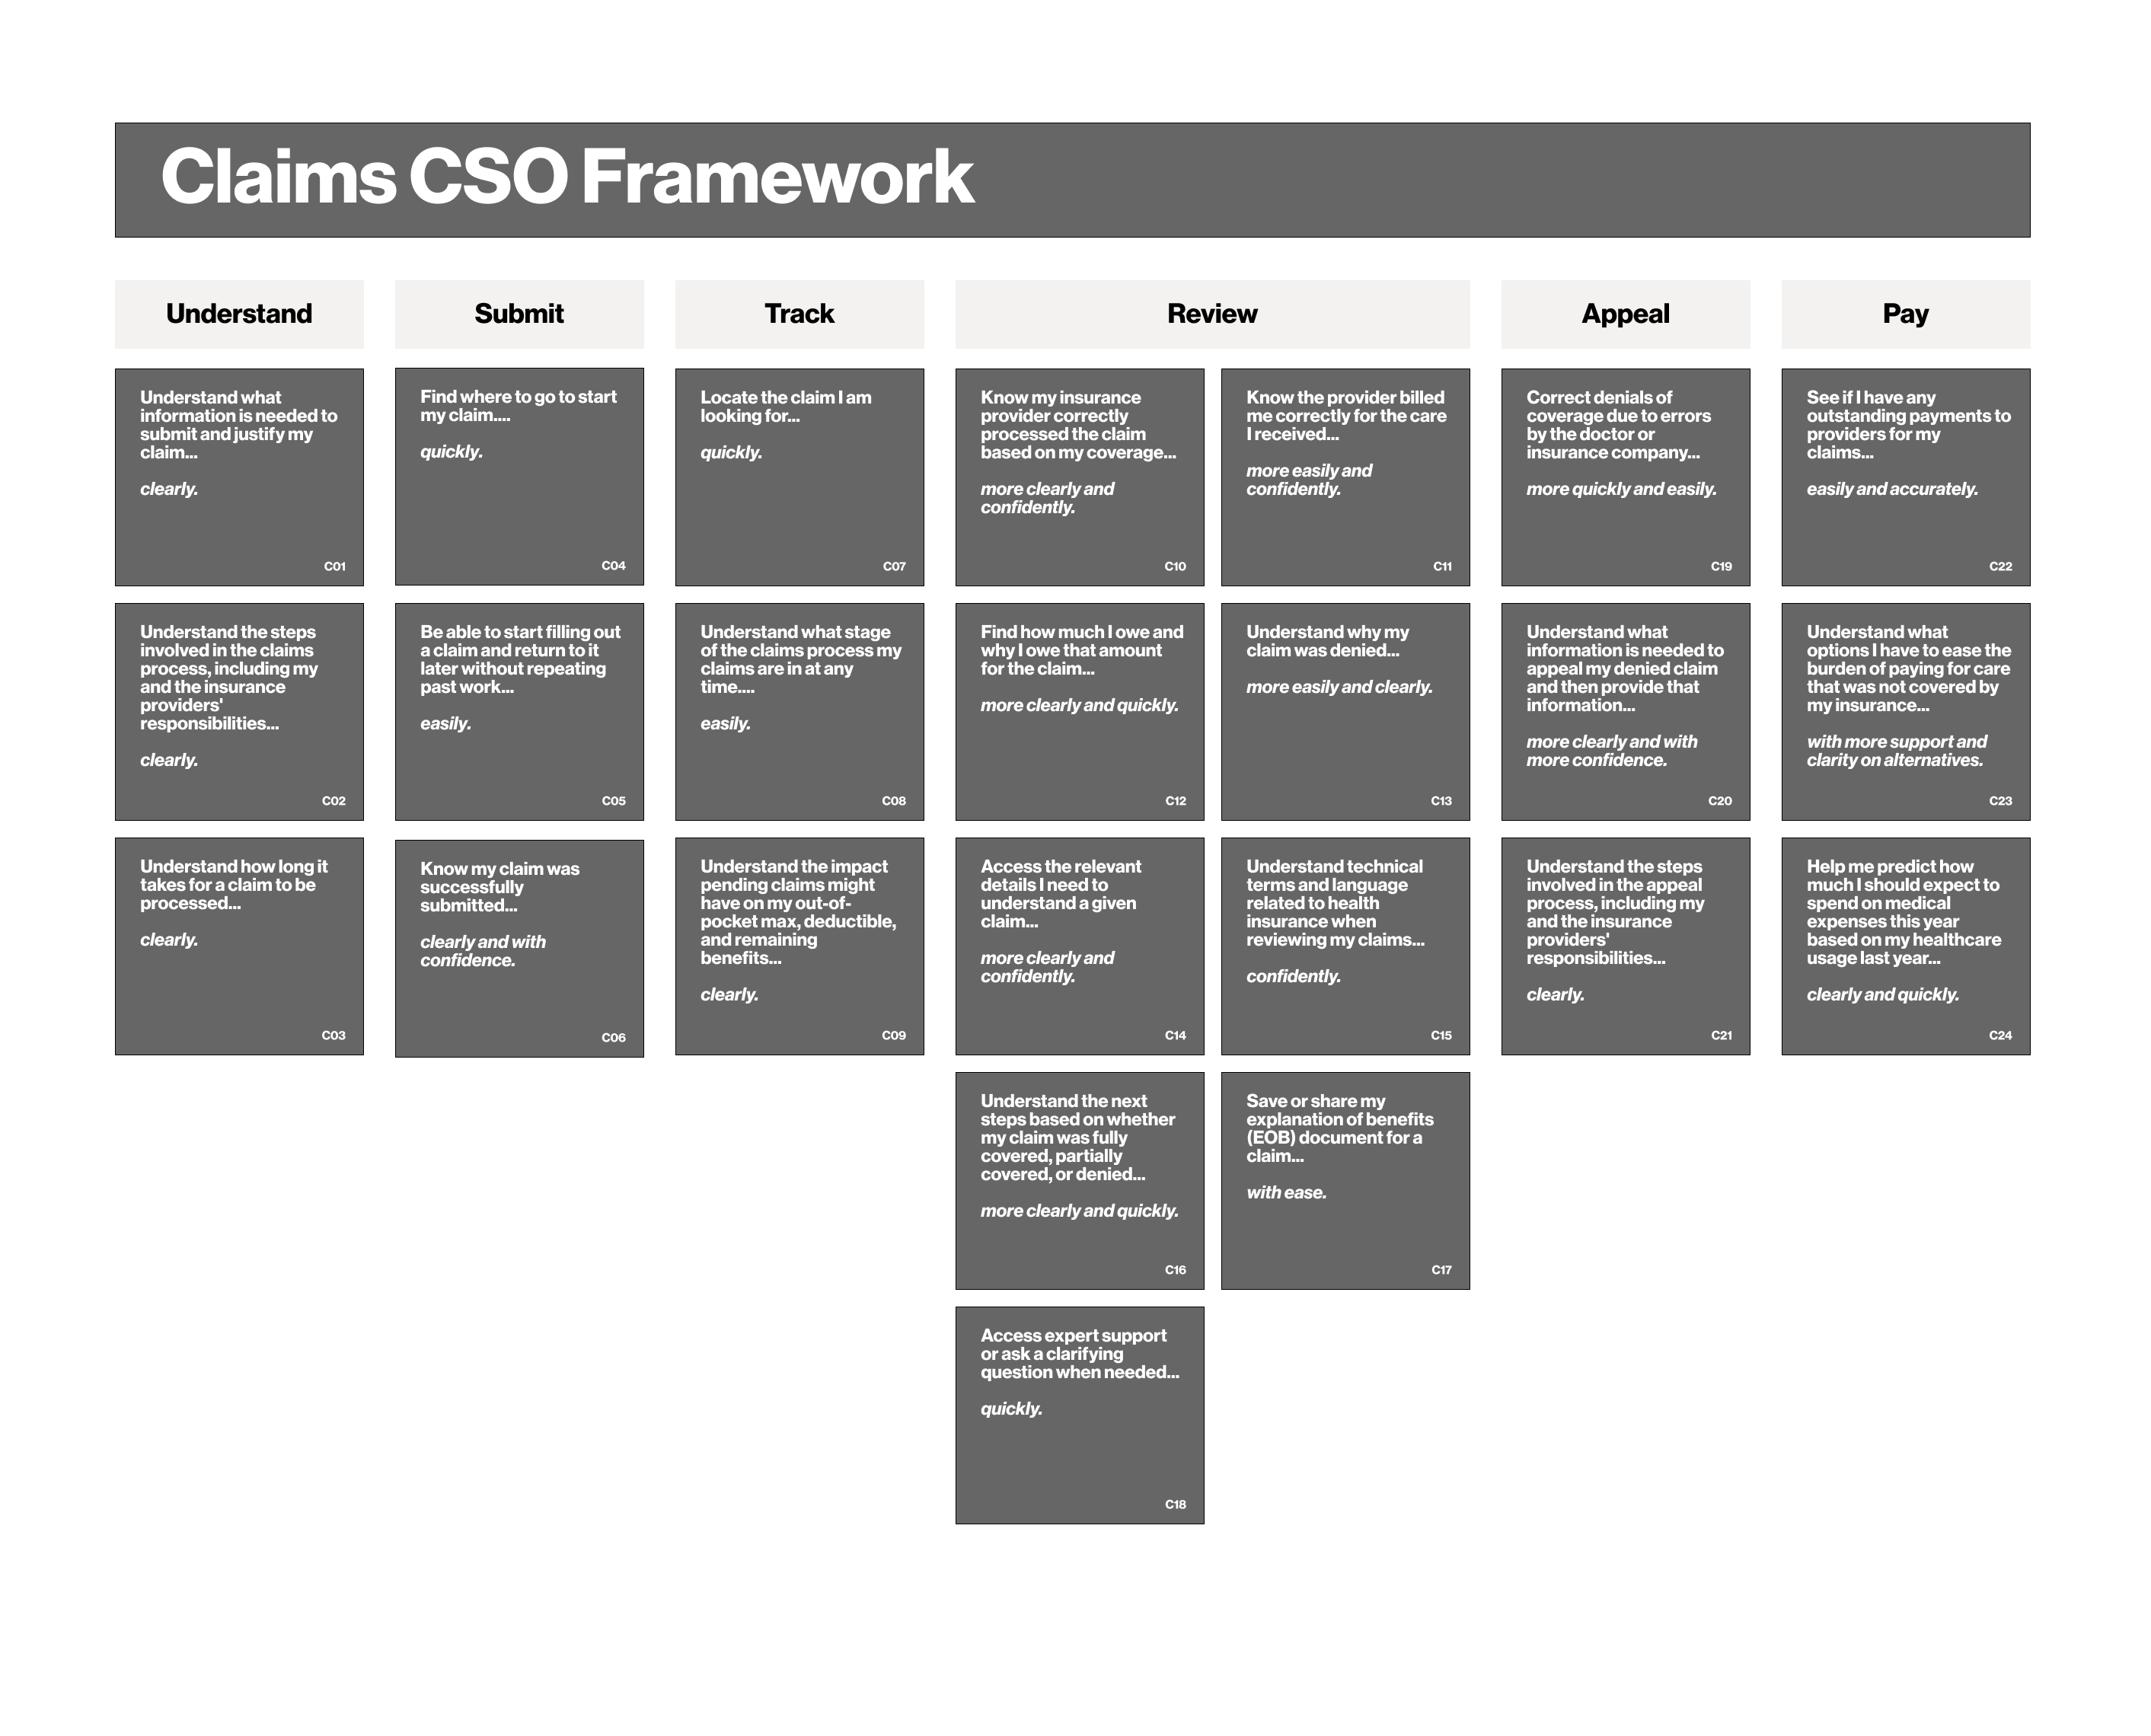
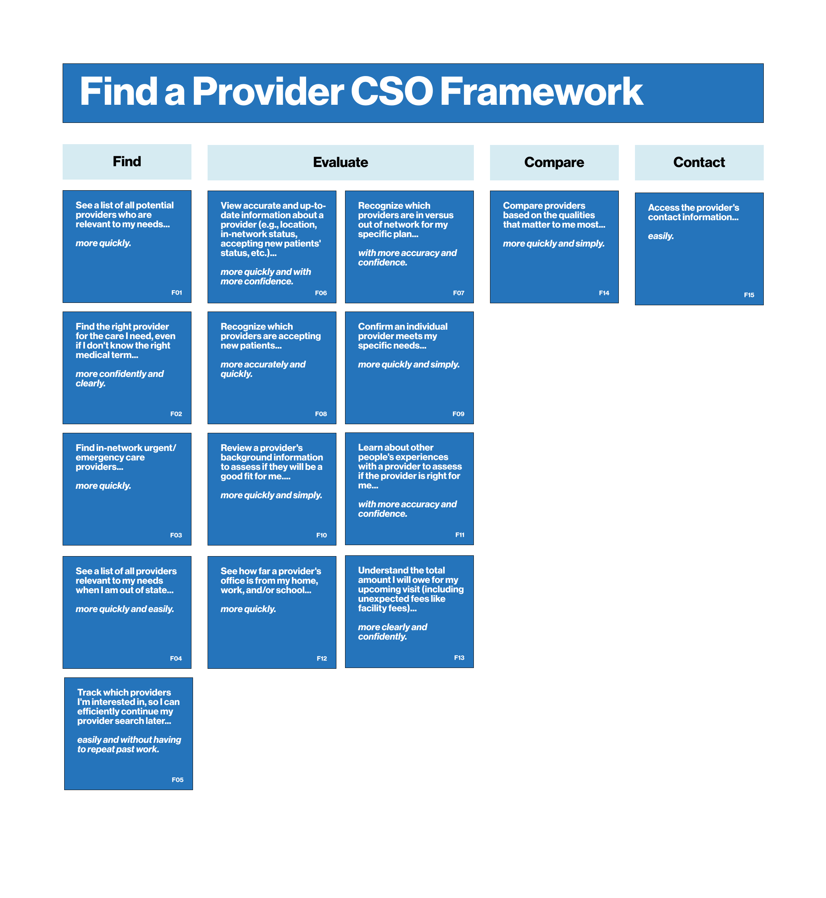
Project Background
BCBSMA CSO Frameworks

Slide 8
Project Background
Survey Objectives
01
Establish Baseline
Assess how important individual CSOs are to healthcare insurance members to find high-value areas
Evaluate how well BCBSMA is currently fulfilling member needs.
02
Benchmark Competitors
Compare how BCBSMA stacks up to two key competitors.
03
Identify Opportunities
Surface high-value areas to address and prioritize where to invest in CX improvements.
Notes:
All of the CSOs identified and tested are important to members
The CSOs are all elements of various health insurance journeys that members experience and this study focused on prioritizing which CSOs will have the biggest impact on the most members.
Some of the CSO tasks may not exist currently (i.e. correct denials of coverage due to errors) but were included as part of the member’s journey in the full Claims process.

Slide 9
Project Background
What this report is and is not
This data represents:
A snapshot in time
A reflection of past experiences
Importance of CSOs, regardless of channel
Respondents who have self-selected which channels they prefer based on their experiences
What this data is not:
Comparable to the immediate journey-based feedback following an experience on specific channels
Touchpoint feedback via web, app, or phone
How this data will be used:
As part of the BCBSMA app’s digital CX measurement strategy the CX team is currently defining
To inform where to prioritize digital CX investments in the short term
As a baseline for continued measurement of how well BCBSMA digital properties are serving members’ needs

Slide 10
Executive Summary
02

Slide 11
Executive Summary
Key Insights
01
Key words for top CSOs are “understand,” “find,” and “be confident”
This stresses the importance of focusing on content and navigation that make it easy for members to find information and complete their tasks.
02
One in three members are less than satisfied with their BCBSMA web and/or app experience
The average satisfaction score for all CSOs among BCBSMA members is 65%.
B15
Understand total cost associated with upcoming care
C10
Be confident the claim was processed correctly
F06
View accurate/ updated info about a provider

Slide 12
Executive Summary
Key Insights
03
BCBSMA satisfaction trails competitors for nearly every CSO across journeys
Additionally, BCBSMA satisfaction shows significantly lower scores for:
15/24 Claims CSOs
10/15 Find a Provider CSOs
4/22 Benefits CSOs
04
Improving transparency in costs is a valuable opportunity to support members’ top needs
All the CSOs are important as they represent critical steps in a member’s process.
The highest-value areas for BCBSMA members are costs associated with care and providers (understanding their total out-of-pocket costs prior to visits) and transparency (instilling confidence that claims are processed correctly and providers are represented accurately).

Slide 13
Executive Summary
Benefits Insights
Top 5 most important CSOs:
B15
Understand total cost associated with upcoming care
B06
Understand plan overview info (deductibles, etc.)
B04
Find accurate cost info for procedures, treatments, and meds
B07
Understand coverage for a specific issue/care
B21
Understand how changes to coverage will impact annual usage
Where to focus first:
Who to use as an example:
Qual identified:
B15
Understand total cost associated with upcoming care
B04
Find accurate cost info for procedures, treatments, and meds
B21
Understand how changes to coverage will impact annual usage
B03
Find coverage information for a specific issue/care
BCBSMA trails both Anthem and United in satisfaction of key CSOs.
However, neither competitor scored well in this survey for Benefits. BCBSMA should look for another competitor that communicates benefits better to aspire to.
Satisfaction: 68%
Satisfaction: 69%
Satisfaction: 65%
Satisfaction: 67%
Note: CSO numbering is based on the order of the CSOs as a member moves through the journey (e.g., B1 indicates the first step, B22 is the last step).

Slide 14

Executive Summary
Claims Insights
Top 5 most important CSOs:
C10
Be confident the claim was processed correctly
C11
Be confident I was billed correctly for the care received
C12
Find how much is owed and why it is owed for a claim
C16
Understand next steps based on outcome of a claim
C06
Be confident a claim was successfully submitted
Where to focus first:
Who to use as an example:
C10
Be confident the claim was processed correctly
C11
Be confident I was billed correctly for the care received
C12
Find how much is owed and why it is owed for a claim
C16
Understand next steps based on outcome of a claim
BCBSMA satisfaction scores were significantly below both competitors, but United generally performed best.
Satisfaction: 67%
Satisfaction: 64%
Satisfaction: 72%
Satisfaction: 66%
Note: CSO numbering is based on the order of the CSOs as a member moves through the journey (e.g., C1 indicates the first step, C24 is the last step).

Slide 15

Executive Summary
Find a Provider Insights
Top 5 most important CSOs:
F06
View accurate/ updated info about a provider
F07
Identify which doctors are in vs. out of network
F01
See a list of providers relevant to needs
F13
Understand my total cost for an upcoming visit
F09
Confirm a provider meets my specific needs
Where to focus first:
Who to use as an example:
F01
See a list of providers relevant to needs
F13
Understand my total cost for an upcoming visit
F09
Confirm a provider meets my specific needs
BCBSMA satisfaction scores were significantly below both competitors, but Anthem performed best for key CSOs.
Satisfaction: 72%
Satisfaction: 49%
Satisfaction: 69%
Note: CSO numbering is based on the order of the CSOs as a member moves through the journey (e.g., F1 indicates the first step, F15 is the last step).

Slide 16
Methodology
03

Slide 17
Methodology
Survey Design
Three nationwide surveys were deployed online, one for each journey (Benefits, Claims, and Find a Provider), from February 12 to March 4, 2024.
On average, respondents were able to complete the survey in 15 minutes.
All respondents were required to:
Be 18 years old or older
Not work in the healthcare or health insurance industry
Manage their own healthcare
Either be the decision-maker or share the responsibility in making health insurance decisions
Have a commercial, individual, or Medicare plan
Receive healthcare insurance through BCBSMA, Anthem BCBS, or United
Use either the insurer’s website or app to engage with their healthcare insurance company
Take one of the qualifying actions in the past year
Respondent demographics include:
 |  | Design | Actual
Insurer | BCBSMA | 1000 | 425
 | Anthem | 1000 | 625
 | United | 1000 | 738
Track | Benefits | 1000 | 751
 | Claims | 1000 | 570
 | Find a Provider | 1000 | 467
Primary channel | Website | <50% | 65%
 | App | >50% | 35%
Gender | Male | 50% | 45%
 | Female | 50% | 54%
Ages | 18-34 | 32% | 22%
 | 35-54 | 36% | 43%
 | 55+ | 32% | 36%
1788 total completes

Slide 18
Methodology
How competitors were chosen
When determining which competitors to measure against (and limited to choosing two for this study), the following factors were considered:
Footprint of competitors (national or regional)
Membership size
Number of ratings in the app store
Overall app ratings in the app store
Direct competitors of BCBSMA
Ultimately, United Healthcare and Anthem Blue Cross Blue Shield were chosen because:
They are both nationwide providers with multiple market plans
Both are for-profit organizations that have more resources to invest in their digital assets
There was interest in comparing BCBSMA to another “Blue”
In the future, there is also interest in measuring performance of both Aetna and Cigna as companies to watch.

Slide 19
Methodology
How to read this report

Slide 20
Key insights and slide takeaways can be found in the teal boxes.
Methodology
Guidance on how to read this report
Throughout the report, the three healthcare insurance organizations are represented by the following colors:
Statistical significance testing was completed at the 95% confidence level to compare insurers and look at differences by age and plan type.
▲▼ Arrows indicate statistically significant differences between two groups. The focus was on BCBSMA, with the direction of the arrowing showing whether the BCBSMA statistic is above or below the statistic of the competitor represented by the color of the arrow.
Findings by age and plan type can be found in dark blue boxes.
comm/ind subscribers refers to those with Commercial or Individuals Plans (79% of sample)
Medicare subscribers are those with a Medicare plan (21% of sample)
When sample sizes drop below n=50, an asterisk (*) is used to draw attention that findings should be viewed as directional in nature due to small sample sizes.
CSO numbering is based on the order of the CSOs as a member moves through the journey (e.g., B1 indicates the first step, B22 is the last step).
BCBSMA ANTHEM UNITED
Question variable names, question wording, and base sizes (n-sizes) are all listed at the bottom of the slide

Slide 21
Methodology
Intro to CSO Quadrants - Axes
IMPORTANCE OF CSOs VS. SATISFACTION WITH CURRENT SOLUTIONS
Measured by relative importance for all respondents (due to low sample sizes for MaxDiff analysis by insurer) by journey, regardless of channels used.
UNMET NEEDS
TABLE STAKES
HIGH IMPORTANCE
LOW SATISFACTION
HIGH IMPORTANCE
HIGH SATISFACTION
IMPORTANCE
RIPE FOR DISRUPTION
OVERSERVED AREAS
LOW IMPORTANCE
LOW SATISFACTION
LOW IMPORTANCE
HIGH SATISFACTION
Satisfaction is charted for insurer’s performance
overall, regardless of channel used (due to lower sample sizes).
SATISFACTION

Slide 22
Methodology
Intro to CSO Quadrants – Four Quadrants of Interest
IMPORTANCE OF CSOs VS. SATISFACTION WITH CURRENT SOLUTIONS
MAIN QUADRANTS OF INTEREST
UNMET NEEDS
HIGH IMPORTANCE
HIGH SATISFACTION
HIGH IMPORTANCE
LOW SATISFACTION
TABLE STAKES
These jobs are highly important to members, and members are satisfied with current solutions.
Implication: Shows what is expected to compete in the space.
These jobs are highly important to members, yet members are unsatisfied with current solutions.
Implication: Indicates more urgent opportunity for solutions.
IMPORTANCE
These jobs are less
important to members and are lacking in satisfactory solutions.
Implication: While not top of mind, this shows innovation opportunities to “wow” users with solutions they didn’t think were possible when differentiation is desired.
RIPE FOR DISRUPTION
OVERSERVED AREAS
These jobs are less important
to members who are already satisfied with current solutions.
Implication: Currently performing as well as needed, not requiring high attention.
LOW IMPORTANCE
LOW SATISFACTION
LOW IMPORTANCE
HIGH SATISFACTION
SATISFACTION

Slide 23
Benefits Survey
04

Slide 24
Benefits Survey
Benefits Journey – All CSOs

Slide 25
Benefits Survey
Audience
All survey respondents completed at least one of the following tasks on their insurance provider’s website or app in the past year:
Reviewed health insurance coverage or benefits
Reviewed coverage for prescriptions
Researched (or tried to research) the cost of a visit, procedure, or treatment
This data reflects their general experience with the Benefits process, regardless if their interaction went well or not. A few things to keep in mind while reviewing the data:
Some benefits are more straightforward than others
Even though members would prefer the process of navigating and understanding insurance information to be easy, they have low expectations because past experiences have been challenging, and it feels like that is just the way insurance is.

Slide 26
Benefits Survey
What are the most important outcomes for members?

Slide 27
Knowing expected costs for care is the top Benefits CSO
Benefits Survey
CSO #
RANK
CUSTOMER SUCCESS OUTCOMES (CSOs)
RELATIVE IMPORTANCE FOR BENEFITS
The top 2 most important Benefits CSOs are members’ understanding of:
The total cost associated with upcoming care
The plan overview information (deductibles, etc.)
B15 | 1 | Understand total cost associated with upcoming care
B06 | 2 | Understand plan overview info (deductibles, etc.)
B04 | 3 | Find accurate cost info for procedures, treatments, and meds
B07 | 4 | Understand coverage for a specific issue/care
B21 | 5 | Understand how changes to coverage will impact annual usage
B01 | 6 | Find plan overview info (deductibles, etc.)
B20 | 7 | Be informed when coverage changes
B08 | 8 | Understand services covered based on age/circumstances
B02 | 9 | Find relevant coverage for emergency/urgent care
B03 | 10 | Find coverage information for a specific issue/care
B05 | 11 | Access expert support to understand coverage/costs
B16 | 12 | Understand total cost for new prescription medications
B10 | 13 | Understand factors impacting coverage eligibility
B11 | 14 | Understand number of covered visits or products remaining
B17 | 15 | Understand cost differences between similar options
B09 | 16 | Understand coverage differences for in vs. out of network providers
B13 | 17 | Access medications while awaiting approval
B22 | 18 | Be informed when the cost of my meds change
B18 | 19 | Understand trade-offs for lower cost options
B19 | 20 | Be aware of pharmacies that sell meds for a lower price
B12 | 21 | Understand technical terms and language
B14 | 22 | Be notified when prescription refills are available
Be informed when coverage changes (#7 in importance overall) has higher relative value for Medicare subscribers (#5 in importance) than for Comm/Ind subscribers (#9).
All statements that have to do with prescriptions were looked at by comm/ins and Medicare subscribers and the prescription CSOs were also lower importance for Medicare subscribers relative to the other CSOs tested.
BENEFITSMAXDIFF. Presented with 4/22 statements and asked: Please select one statement that would be “most important” for you when checking on a benefits through your health insurance company. Then repeated 9 times. Those in Benefits track, n=751, comprising of BCBSMA n=226, Anthem n=251, United n=274
Notes:
Relative Importance Utility Scores: Showing MaxDiff utility output where users rated “most” and “least” of each group and then are ranked relative to one another.

Slide 28
Benefits Survey
How well is BCBSMA currently fulfilling member needs?

Slide 29
Benefits Survey
Many BCBSMA CSOs are below average satisfaction
UNMET NEEDS
TABLE STAKES
IMPORTANCE OF BENEFITS CSOs VS. SATISFACTION WITH CURRENT SOLUTIONS
HIGH IMPORTANCE
LOW SATISFACTION
HIGH IMPORTANCE
HIGH SATISFACTION
IMPORTANCE
BCBSMA Table Stakes
B15 Understand total cost associated with upcoming care
B06 Understand plan overview info (deductibles, etc.)
B07 Understand coverage for a specific issue/care
B04 Find accurate cost info for procedures, treatments, and meds
B08 Understand coverage for a specific issue/care
B01 Find plan overview info (deductibles, etc.)
BCBSMA Unmet Needs
B21 Understand how changes to coverage will impact annual usage
B20 Be informed when coverage changes
B08 Understand services covered based on age/circumstances
B02 Find relevant coverage for emergency/urgent care
B03 Find coverage information for a specific issue/care
RIPE FOR DISRUPTION
OVERSERVED AREAS
BCBSMA Ripe for Disruption
B16 Understand total cost for new prescription medications
B10 Understand factors impacting coverage eligibility
B11 Understand number of covered visits or products remaining
B17 Understand cost differences between similar options
B13 Access medications while awaiting approval
B22 Be informed when the cost of my meds change
B18 Understand trade-offs for lower cost options
B19 Be aware of pharmacies that sell meds for a lower price
B12 Understand technical terms and language
BCBSMA Overserved Areas
B05 Access expert support to understand coverage/costs
B09 Understand coverage differences for in- vs. out-of-network providers
B14 Be notified when prescription refills are available
LOW IMPORTANCE
LOW SATISFACTION
LOW IMPORTANCE
HIGH SATISFACTION
SATISFACTION
BENEFITSMAXDIFF. Please select one statement that would be “most important” for you when checking your benefits through your health insurance provider. Base: Those in Benefits track , n=751 (comprising of BCBSMA n=226, Anthem n=251, United n=274)
BENEFITSSAT. How satisfied are you with your current ability to accomplish each task on <insurer’s> <app or website> today?
Base: Those in Benefits track, BCBSMA n=226
Notes:
Relative Importance Utility Scores: Showing MaxDiff utility output where users rated “most” and “least” of each group and then are ranked relative to one another.
Satisfaction Scores: Based on top two box scores from satisfaction question, charted regardless of channel

Slide 30
BCBSMA should focus on moving the needle for these three Benefits CSOs that fall in the top 5 for importance but miss the mark for what is necessary to compete in the health insurance space.
Benefits Survey
Focus on improving transparency in costs
IMPORTANCE OF BENEFITS CSOs VS. SATISFACTION WITH CURRENT SOLUTIONS
HIGH IMPORTANCE
LOW SATISFACTION
HIGH IMPORTANCE
HIGH SATISFACTION
IMPORTANCE
UNMET NEEDS
TABLE STAKES
BCBSMA Table Stakes
B15 Understand total cost associated with upcoming care
B06 Understand plan overview info (deductibles, etc.)
B07 Understand coverage for a specific issue/care
B04 Find accurate cost info for procedures, treatments, and meds
B08 Understand coverage for a specific issue/care
B01 Find plan overview info (deductibles, etc.)
BCBSMA Unmet Needs
B21 Understand how changes to coverage will impact annual usage
B20 Be informed when coverage changes
B08 Understand services covered based on age/circumstances
B02 Find relevant coverage for emergency/urgent care
B03 Find coverage information for a specific issue/care
SATISFACTION
BENEFITSMAXDIFF. Please select one statement that would be “most important” for you when checking your benefits through your health insurance provider. Base: Those in Benefits track , n=751 (comprising of BCBSMA n=226, Anthem n=251, United n=274)
BENEFITSSAT. How satisfied are you with your current ability to accomplish each task on <insurer’s> <app or website> today?
Base: Those in Benefits track, BCBSMA n=226
Notes:
Relative Importance Utility Scores: Showing MaxDiff utility output where users rated “most” and “least” of each group and then are ranked relative to one another.
Satisfaction Scores: Based on top two box scores from satisfaction question, charted regardless of channel

Slide 31
Benefits Survey
Supporting insights from member interviews
01
Members do not expect they CAN receive accurate and specific cost information.
When asked about cost information, most expected to only find co-pay and coinsurance amounts, not a full cost estimate. Those who looked for cost estimates felt they were not accurate, and the range was too wide.
02
Members do not know the medical terms or codes associated with the care they need.
Preventive care is the most frequent care type members engage with; finding benefits and cost information for care like this is relatively easy. Members struggle to find information about other care types because they do not know the medical term or code.
03
Understanding technical information is critical for the success of other tasks.
Ideally, the plan language is used, but when technical terms are required, descriptions need to be easy to access and understand. If members cannot understand the technical information, they cannot understand the benefit.
“My hope is that it would be clear and concise in terms of what is and what isn't covered... I'd like to be able to type something in and it say if it is covered... I have to read through line by line of long pages of documents, and that, for me, is frustrating.” —Research Participant

Slide 32
Benefits Survey
How does BCBSMA stack up to key competitors?

Slide 33
For members, understanding total costs associated with care is the most important Benefits CSO, yet satisfaction is just at or above average for each insurance provider. BCBSMA falls behind competitors for nearly every CSO.
Benefits Survey
Focus on increasing satisfaction for B15
UNMET NEEDS
TABLE STAKES
IMPORTANCE OF BENEFITS CSOs VS. SATISFACTION WITH CURRENT SOLUTIONS
HIGH IMPORTANCE
LOW SATISFACTION
HIGH IMPORTANCE
HIGH SATISFACTION
BCBSMA Anthem United
B15 Understand total cost associated with upcoming care
B06 Understand plan overview info (deductibles, etc.)
B04 Find accurate cost info for procedures, treatments, and meds
B07 Understand coverage for a specific issue/care
B21 Understand how changes to coverage will impact annual usage
B01 Find plan overview info (deductibles, etc.)
B20 Be informed when coverage changes
B08 Understand services covered based on age/circumstances
B02 Find relevant coverage for emergency/urgent care
B03 Find coverage information for a specific issue/care
B05 Access expert support to understand coverage/costs
B16 Understand total cost for new prescription medications
B10 Understand factors impacting coverage eligibility
B11 Understand number of covered visits or products remaining
B17 Understand cost differences between similar options
B09 Understand coverage differences for in- vs. out-of-network providers
B13 Access medications while awaiting approval
B22 Be informed when the cost of my meds change
B18 Understand trade-offs for lower cost options
B19 Be aware of pharmacies that sell meds for a lower price
B12 Understand technical terms and language
B14 Be notified when prescription refills are available
IMPORTANCE
RIPE FOR DISRUPTION
OVERSERVED AREAS
LOW IMPORTANCE
LOW SATISFACTION
LOW IMPORTANCE
HIGH SATISFACTION
SATISFACTION
BENEFITSMAXDIFF. Please select one statement that would be “most important” for you when checking your benefits through your health insurance provider. Base: Those in Benefits track , n=751 (comprising of BCBSMA n=226, Anthem n=251, United n=274)
BENEFITSSAT. How satisfied are you with your current ability to accomplish each task on <insurer’s> <app or website> today?
Base: Those in each Benefits track, by insurer (BCBSMA n=226, Anthem n=251, United n=274)
Notes:
Relative Importance Utility Scores: Showing MaxDiff utility output where users rated “most” and “least” of each group and then are ranked relative to one another.
Satisfaction Scores: Based on top two box scores from satisfaction question, charted regardless of channel

Slide 34
Benefits Survey
United and Anthem provide better Benefits experiences across CSOs than BCBSMA
BENEFITS SATISFACTION (CHANNEL AGNOSTIC)
United and Anthem are again consistently outperforming BCBSMA across CSOs in the Benefits process.
BCBSMA is performing strongest in members’ understanding their plan overview information, coverage for a specific issue or care, and being able to navigate to plan overview information.
Satisfaction for BCBSMA drops off when members evaluated being aware of alternative options, including understanding costs differences between similar options, understanding trade-offs for lower cost options, and being aware of pharmacies that sell meds for lower prices.
STATEMENT | BCBSMA | ANTHEM | UNITED | IMPORTANCE RANKING
Understand plan overview info (deductibles, etc.) | 81% | 84% | 84% | #2
Understand coverage for a specific issue/care | 79% | 77% | 76% | #4
Find plan overview info (deductibles, etc.) | 78% | 85% | 82% | #6
Access expert support to understand coverage/costs | 72% | 76% | 69% | #11
Understand coverage differences for in vs. out of network providers | 70% | 81% | 74% | #16
Find accurate cost info for procedures, treatments, and meds | 69% | 71% | 74% | #3
Be notified when prescription refills are available | 68% | 66% | 73% | #22
Understand total cost associated with upcoming care | 68% | 70% | 73% | #1
Find coverage information for a specific issue/care | 67% | 71% | 68% | #10
Understand services covered based on age/circumstances | 67% | 75% | 74% | #8
Be informed when coverage changes | 67% | 73% | 75% | #7
Find relevant coverage for emergency/urgent care | 66% | 74% | 73% | #9
Understand how changes to coverage will impact annual usage | 65% | 74% | 70% | #5
Understand number of covered visits or products remaining | 63% | 65% | 65% | #14
Understand total cost for new prescription medications | 63% | 76% | 73% | #12
Understand factors impacting coverage eligibility | 62% | 69% | 69% | #13
Understand technical terms and language | 61% | 68% | 67% | #21
Access medications while awaiting approval | 57% | 62% | 56% | #17
Be informed when the cost of my meds change | 55% | 53% | 58% | #18
Understand cost differences between similar options | 54% | 64% | 57% | #15
Understand trade-offs for lower cost options | 52% | 60% | 54% | #19
Be aware of pharmacies that sell meds for a lower price | 44% | 51% | 49% | #20
▼
▼
Groups more likely to be satisfied with BCBSMA benefits CSOs:
Those ages 18-34 on access medications while awaiting approval (69% vs. 47% ages 55-64 and 43% ages 65+)
Those ages 18-34 on understand cost differences between similar options (71% vs. 47% ages 55-64 and 35% ages 65+)
Those ages 18-34 on be aware of pharmacies that sell meds for a lower price (60% vs. 39% ages 45-54, 34% ages 55-64, and 30% ages 65+)
The age group 34-44 had significantly lower satisfaction than other ages groups for 13/22 BCBSMA benefits CSOs.
▼▼
▼
Note: Respondents were forced to answer each question
▲▼- Arrows indicate statistically significant differences between two groups. The direction of the arrow indicates that stat is above/below the stat of the insurer whose color is reflected in the arrow.
BENEFITSSAT. How satisfied are you with your current ability to accomplish each task on <insurer’s> <app or website> today? Base: Those in Benefits track BCBSMA n=226, Anthem n=251, United n=274
Notes:
Satisfaction Scores: Based on top two box scores from satisfaction question, charted regardless of channel

Slide 35
Benefits Survey
What are the high-value areas to prioritize for CX improvements?

Slide 36
Benefits Survey
Recommendations
01
Focus on solutions that improve the experience for top CSOs:
B15^ - Understand total cost associated with upcoming care
B04 - Find accurate cost info for procedures, treatments, and meds
B21 - Understand how changes to coverage will impact annual usage
02
Prioritize helping members find coverage information for a specific issue/care.
Prior qualitative research revealed that B03 – Find coverage information for a specific issue/care is an enabling CSO at the core of several issues in benefits. It is not clear for members which benefit applies to the care they need.
^CSO also appears as a key driver of NPS (see key drivers' analysis in appendix)

Slide 37
Claims Survey
05

Slide 38
Claims Survey
Claims Journey – All CSOs

Slide 39
Claims Survey
Claims Audience
All survey respondents completed at least one of the following tasks on their insurance provider’s website or app in the past year:
Submitted a claim
Reviewed claim or Explanation of Benefits (EOB) information
This data reflects their general experience with the Claims process, regardless if their interaction went well or not. A few things to keep in mind while reviewing the data:
Member-submitted claims are low volume
Vast majority are provider-submitted
Many claims do not require additional follow-up from the member.

Slide 40
Claims Survey
What are the most important outcomes for members?

Slide 41
Claims Survey
Processing the claim correctly is of utmost importance
CSO #
RANK
CUSTOMER SUCCESS OUTCOMES (CSOs)
RELATIVE IMPORTANCE FOR CLAIMS
The top 2 most important claims CSOs are members’ confidence in knowing:
The claim was processed correctly and
They were billed correctly for the care received
C10 | 1 | Be confident the claim was processed correctly
C11 | 2 | Be confident I was billed correctly for the care received
C12 | 3 | Find how much is owed and why it is owed for a claim
C16 | 4 | Understand next steps based on outcome of a claim
C06 | 5 | Be confident a claim was successfully submitted
C02 | 6 | Understand the steps and responsibilities in the claims process
C19 | 7 | Correct denials of coverage due to errors
C01 | 8 | Understand info needed to submit/justify a claim
C09 | 9 | Understand the impact a pending claim will have on plan usage
C20 | 10 | Understand what is needed to appeal denied claim
C13 | 11 | Understand why a claim was denied
C14 | 12 | Access relevant details to understand a claim
C18 | 13 | Access expert support when needed
C21 | 14 | Understand the steps and responsibilities in the appeals process
C23 | 15 | Understand options to ease burden of my portion
C22 | 16 | See current outstanding payments owed to a provider
C08 | 17 | Understand the current status of a claim
C07 | 18 | Find a specific claim
C15 | 19 | Understand technical terms when reviewing claims
C24 | 20 | Predict how much I might spend this year based on last year's usage
C05 | 21 | Start filling out a claim and finish it later without repeating work
C04 | 22 | Find where to start a claim
C17 | 23 | Save/share EOB document for a claim
C03 | 24 | Understand how long the claims process takes
Be confident I was billed correctly for the care received (#2 in importance overall) has higher relative importance for those 35 and older (#2 in importance) than those 18-34 (#9 in importance). The younger audience also puts less importance on be confident a claim was successfully submitted (#5 in importance overall, #14 for those ages 18-34).
The older generation also puts more importance than the those under age 55 on access expert support when needed (#13 in importance overall, #8 for 55+ and #15 for 18-54).
CLAIMSMAXDIFF. Presented with 4/24 statements and asked: Please select one statement that would be “most important” for you when checking on a claim through your health insurance company. Then repeated 9 times. Those in Claims track, n=570, comprising of BCBSMA n=132, Anthem n=208, United n=230
Notes:
Relative Importance Utility Scores: Showing MaxDiff utility output where users rated “most” and “least” of each group and then are ranked relative to one another.

Slide 42
Claims Survey
How well is BCBSMA currently fulfilling member needs?

Slide 43
Most BCBSMA Claims CSOs fall left of the satisfaction average, meaning satisfaction is lower than competitors for BCBSMA in Claims overall.
Claims Survey
Satisfaction for BCBSMA Claims CSOs is low
UNMET NEEDS
TABLE STAKES
BCBSMA Unmet Needs
C11 Be confident I was billed correctly for the care received
C16 Understand next steps based on outcome of a claim
C19 Correct denials of coverage due to errors
C09 Understand the impact a pending claim will have on plan usage
C20 Understand what is needed to appeal denied claim
C13 Understand why a claim was denied
C18 Access expert support when needed
IMPORTANCE OF CLAIMS CSOs VS. SATISFACTION WITH CURRENT SOLUTIONS
HIGH IMPORTANCE
LOW SATISFACTION
HIGH IMPORTANCE
HIGH SATISFACTION
BCBSMA Table Stakes
C10 Be confident the claim was processed correctly
C12 Find how much is owed and why it is owed for a claim
C06 Be confident a claim was successfully submitted
C02 Understand the steps and responsibilities in the claims process
C01 Understand info needed to submit/justify a claim
C14 Access relevant details to understand a claim
IMPORTANCE
RIPE FOR DISRUPTION
OVERSERVED AREAS
BCBSMA Ripe for Disruption
C21 Understand the steps and responsibilities in the appeals process
C23 Understand options to ease burden of my portion
C08 Understand the current status of a claim
C15 Understand technical terms when reviewing claims
C24 Predict how much I might spend this year based on last year's usage
C05 Start filling out a claim and finish it later without repeating work
C17 Save/share EOB document for a claim
C03 Understand how long the claims process takes
BCBSMA Overserved Areas
C22 See current outstanding payments owed to a provider
C07 Find a specific claim
C04 Find where to start a claim
LOW IMPORTANCE
LOW SATISFACTION
LOW IMPORTANCE
HIGH SATISFACTION
SATISFACTION
CLAIMSMAXDIFF. Please select one statement that would be “most important” for you when checking on a claim through your health insurance provider. Base: Those in Claims track, n=570, comprising of BCBSMA n=132, Anthem n=208, United n=230
CLAIMSSAT. How satisfied are you with your current ability to accomplish each task on <insurer’s> <app or website> today?
Base: Those in Claims track, BCBSMA n=132
Notes:
Relative Importance Utility Scores: Showing MaxDiff utility output where users rated “most” and “least” of each group and then are ranked relative to one another.
Satisfaction Scores: Based on top two box scores from satisfaction question, charted regardless of channel

Slide 44
With only two Claims CSOs solidly falling in table stakes, BCBSMA should focus on improving these key experiences for members to compete with other healthcare organizations.
Claims Survey
BCBSMA should focus on the top 3 Claims CSOs
IMPORTANCE OF CLAIMS CSOs VS. SATISFACTION WITH CURRENT SOLUTIONS
HIGH IMPORTANCE
LOW SATISFACTION
HIGH IMPORTANCE
HIGH SATISFACTION
IMPORTANCE
UNMET NEEDS
TABLE STAKES
BCBSMA Unmet Needs
C11 Be confident I was billed correctly for the care received
C16 Understand next steps based on outcome of a claim
C19 Correct denials of coverage due to errors
C09 Understand the impact a pending claim will have on plan usage
C20 Understand what is needed to appeal denied claim
C13 Understand why a claim was denied
C18 Access expert support when needed
BCBSMA Table Stakes
C10 Be confident the claim was processed correctly
C12 Find how much is owed and why it is owed for a claim
C06 Be confident a claim was successfully submitted
C02 Understand the steps and responsibilities in the claims process
C01 Understand info needed to submit/justify a claim
C14 Access relevant details to understand a claim
SATISFACTION
CLAIMSMAXDIFF. Please select one statement that would be “most important” for you when checking on a claim through your health insurance provider. Base: Those in Claims track, n=570, comprising of BCBSMA n=132, Anthem n=208, United n=230
CLAIMSSAT. How satisfied are you with your current ability to accomplish each task on <insurer’s> <app or website> today?
Base: Those in Claims track, BCBSMA n=132
Notes:
Relative Importance Utility Scores: Showing MaxDiff utility output where users rated “most” and “least” of each group and then are ranked relative to one another.
Satisfaction Scores: Based on top two box scores from satisfaction question, charted regardless of channel

Slide 45
Claims Survey
Supporting insights from member interviews
01
Many claims are straightforward, and what is owed aligns with what members expected.
When claims are complex or do not align with expectations, members struggle to ensure they were billed correctly and understand why they owe what they owe.
02
Many claims are submitted by the provider.
When members submit claims, they struggle to find the entry point, return to a partially completed claim form without losing work, know it was submitted, and track the status of their claim.
03
Finding the claim is a critical first step.
Finding a claim can be challenging when the claims list the billing provider instead of the name of the doctor they saw or the claim process date instead of the visit because the member does not recognize this information.
“I know it's really hard to push it on the insurance company to own accuracy of what doctors are billing. But if it is identified that there was incorrect billing, it is pretty important for the insurance companies to step in and fix it...There's such inaccurate billing.” —Research Participant

Slide 46
Claims Survey
How does BCBSMA stack up to key competitors?

Slide 47
United has the highest satisfaction of the three insurance carriers for 19 out of 24 statements and would be considered the highest performing insurer for the Claims CSOs.
Claims Survey
Satisfaction is generally higher for United’s CSOs
TABLE STAKES
UNMET NEEDS
TABLE STAKES
IMPORTANCE OF CLAIMS CSOs VS. SATISFACTION WITH CURRENT SOLUTIONS
BCBSMA Anthem United
C10 Be confident the claim was processed correctly
C11 Be confident I was billed correctly for the care received
C12 Find how much is owed and why it is owed for a claim
C16 Understand next steps based on outcome of a claim
C06 Be confident a claim was successfully submitted
C02 Understand the steps and responsibilities in the claims process
C19 Correct denials of coverage due to errors
C01 Understand info needed to submit/justify a claim
C09 Understand the impact a pending claim will have on plan usage
C20 Understand what is needed to appeal denied claim
C13 Understand why a claim was denied
C14 Access relevant details to understand a claim
C18 Access expert support when needed
C21 Understand the steps and responsibilities in the appeals process
C23 Understand options to ease burden of my portion
C22 See current outstanding payments owed to a provider
C08 Understand the current status of a claim
C07 Find a specific claim
C15 Understand technical terms when reviewing claims
C24 Predict how much I might spend this year based on last year's usage
C05 Start filling out a claim and finish it later without repeating work
C04 Find where to start a claim
C17 Save/share EOB document for a claim
C03 Understand how long the claims process takes
HIGH IMPORTANCE
LOW SATISFACTION
HIGH IMPORTANCE
HIGH SATISFACTION
IMPORTANCE
RIPE FOR DISRUPTION
OVERSERVED AREAS
OVERSERVED AREAS
LOW IMPORTANCE
LOW SATISFACTION
LOW IMPORTANCE
HIGH SATISFACTION
SATISFACTION
CLAIMSMAXDIFF. Please select one statement that would be “most important” for you when checking on a claim through your health insurance provider. Base: Those in Claims track , n=570, comprising of BCBSMA n=132, Anthem n=208, United n=230
CLAIMSSAT. How satisfied are you with your current ability to accomplish each task on <insurer’s> <app or website> today?
Base: Those in Claims track BCBSMA n=132, Anthem n=208, United n=226
Notes:
Relative Importance Utility Scores: Showing MaxDiff utility output where users rated “most” and “least” of each group and then are ranked relative to one another.
Satisfaction Scores: Based on top two box scores from satisfaction question, charted regardless of channel

Slide 48
Claims Survey
BCBSMA trails competitors across Claims CSOs
CLAIMS SATISFACTION (CHANNEL AGNOSTIC)
United and Anthem are consistently outperforming BCBSMA across CSOs in the Claims process.
BCBSMA is performing strongest in confidence claims are submitted, seeing outstanding payments owed to a provider, finding a claim, and seeing how much is owed.
Satisfaction for BCBSMA overall drops below 50% for understanding why a claim was denied and the ability to correct denials of coverage due to errors made by either the provider or insurer.
STATEMENT | BCBSMA | ANTHEM | UNITED | IMPORTANCE RANKING
Be confident a claim was successfully submitted | 79% | 86% | 89% | #5
See current outstanding payments owed to a provider | 74% | 79% | 80% | #16
Find a specific claim | 73% | 84% | 89% | #18
Find how much is owed and why it is owed for a claim | 72% | 82% | 80% | #3
Access relevant details to understand a claim | 69% | 77% | 80% | #12
Find where to start a claim | 69% | 72% | 76% | #22
Be confident the claim was processed correctly | 67% | 76% | 80% | #1
Understand the steps and responsibilities in the claims process | 67% | 69% | 80% | #6
Understand info needed to submit/justify a claim | 67% | 76% | 76% | #8
Understand next steps based on outcome of a claim | 66% | 73% | 73% | #4
Be confident I was billed correctly for the care received | 64% | 76% | 77% | #2
Save/share EOB document for a claim | 62% | 76% | 75% | #23
Start filling out a claim and finish it later without repeating work | 61% | 54% | 65% | #21
Access expert support when needed | 59% | 70% | 74% | #13
Understand technical terms when reviewing claims | 59% | 68% | 65% | #19
Understand the current status of a claim | 57% | 69% | 75% | #17
Understand the impact a pending claim will have on plan usage | 56% | 67% | 68% | #9
Understand what is needed to appeal denied claim | 54% | 60% | 63% | #10
Understand the steps and responsibilities in the appeals process | 53% | 57% | 65% | #14
Understand how long the claims process takes | 52% | 63% | 63% | #24
Understand options to ease burden of my portion | 51% | 55% | 63% | #15
Predict how much I might spend this year based on last year's usage | 51% | 59% | 59% | #20
Understand why a claim was denied | 49% | 58% | 57% | #11
Correct denials of coverage due to errors | 42% | 49% | 55% | #7
▼
▼▼
▼
▼
▼
▼
▼
▼▼
▼▼
▼
▼▼
Groups more likely to be satisfied with BCBSMA claims CSOs:
Those ages 65+ on be confident the claim was processed correctly (83% vs. 57% ages 18-34)
Comm/ind subscribers on understand next steps based on outcome of a claim (71% vs. 48% of Medicare subscribers)
The age group 34-44 had significantly lower satisfaction than other ages groups for 9/24 BCBSMA claims CSOs.
▼▼
▼▼
▼
▼▼
▼
▼
Note: Respondents were forced to answer each question
▲▼- Arrows indicate statistically significant differences between two groups. The direction of the arrow indicates that stat is above/below the stat of the insurer whose color is reflected in the arrow.
CLAIMSSAT. How satisfied are you with your current ability to accomplish each task on <insurer’s> <app or website> today? Base: Those in Claims track BCBSMA n=132, Anthem n=208, United n=226
Notes:
Satisfaction Scores: Based on top two box scores from satisfaction question, charted regardless of channel

Slide 49
Claims Survey
What are the high-value areas to prioritize for CX improvements?

Slide 50
Claims Survey
Recommendations
Prioritize improvements to key CSOs that are table stakes for competitors where BCBSMA is falling behind, generally transparency around billing and dollar amounts. These include helping members:
C10^ - Be confident the claim was processed correctly
C11^ - Be confident I was billed correctly for the care received
C12 - Find how much is owed and why it is owed for a claim
C16^ - Understand next steps based on outcome of a claim
C02 - Understand the steps and responsibilities in the claims process
^CSO also appears as a key driver of NPS (see key drivers' analysis in appendix)

Slide 51
Find a Provider Survey
06

Slide 52
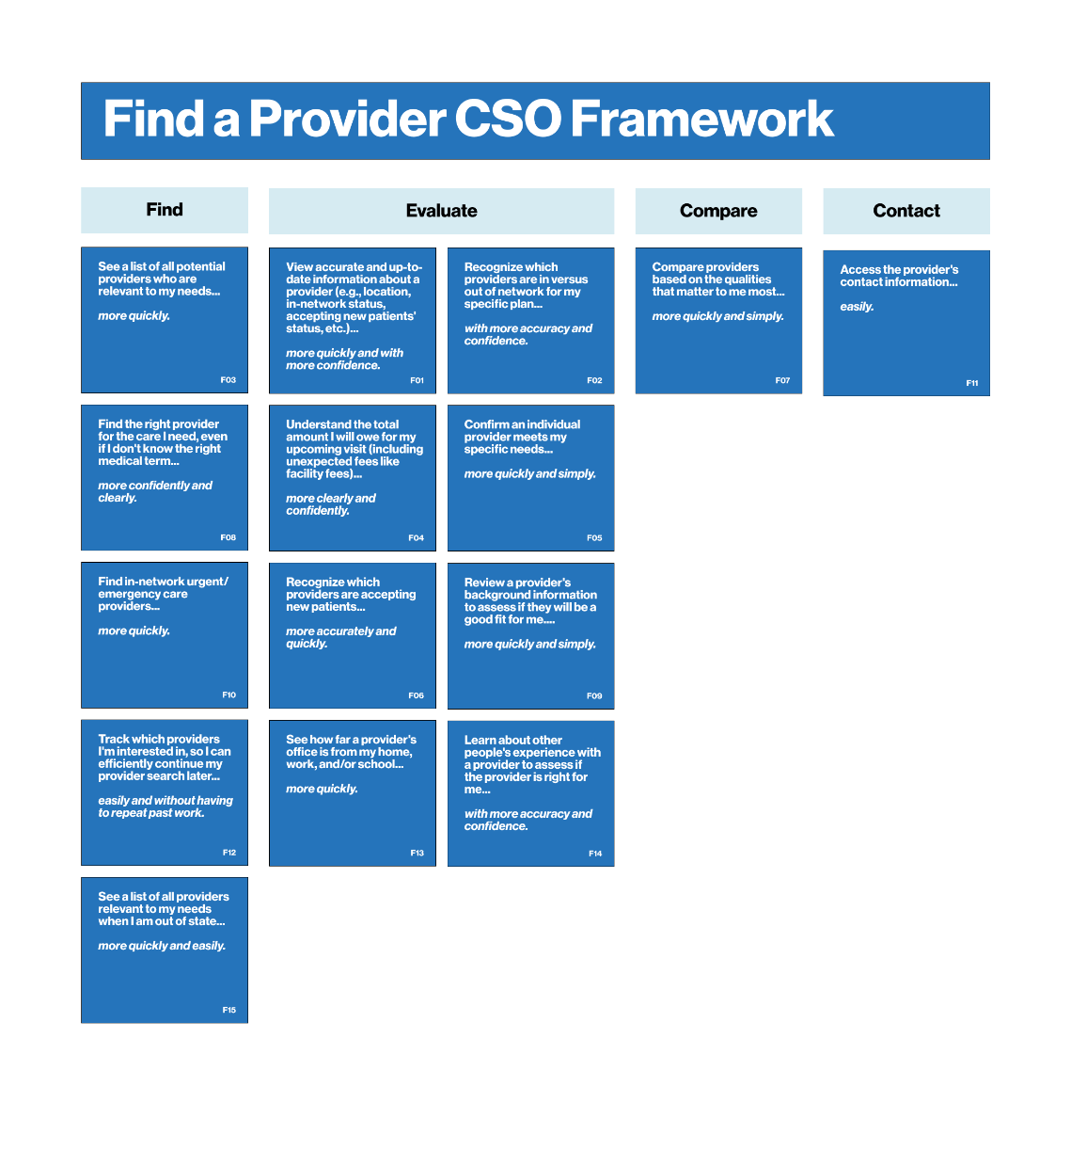
Find a Provider Survey
Find a Provider Journey – All CSOs

Slide 53
Find a Provider Survey
Find a Provider Audience
All survey respondents completed at least one of the following tasks on their insurance provider’s website or app in the past year:
Looked for a new healthcare provider/doctor
This data reflects their general experience with the Find a Provider process, regardless if their interaction went well or not. A few things to keep in mind while reviewing the data:
The current process of finding a new provider involves many platforms
The main job for insurance is confirming the provider is in network
Information is often accurate, but not always

Slide 54
Find a Provider Survey
What are the most important outcomes for members?

Slide 55
Find a Provider Survey
Seeing accurate provider info is critical for members
CSO #
RANK
CUSTOMER SUCCESS OUTCOMES (CSOs)
RELATIVE IMPORTANCE FOR FIND A PROVIDER
For Find a Provider, the top CSO really stood out as most important relative to other CSOs. It is for members to view accurate/updated information about a provider.
Other important CSOs include:
Identifying which doctors are in vs. out of network
Seeing a list of providers relevant to needs
F06 | 1 | View accurate/updated info about a provider
F07 | 2 | Identify which doctors are in vs. out of network
F01 | 3 | See a list of providers relevant to needs
F13 | 4 | Understand my total cost for an upcoming visit
F09 | 5 | Confirm a provider meets my specific needs
F08 | 6 | Identify which providers are accepting new patients
F14 | 7 | Compare providers on qualities that matter most
F02 | 8 | Find the right provider
F10 | 9 | Review provider's background to determine fit
F03 | 10 | Find in-network urgent care/ER providers
F15 | 11 | Access provider's contact info
F05 | 12 | Denote the providers I am interested in to find later
F12 | 13 | See distance of provider's office from home/office
F11 | 14 | Review others' experiences with the provider
F04 | 15 | See a list of providers when out of state
The younger generation puts more importance on understand my total cost for an upcoming visit than those 55 and older (#4 overall, #2 for those ages 18-34, #3 for those 35-54, and #8 for those 55 and older).
FINDAPROVIDERMAXDIFF. Presented with 4/15 statements and asked: Please select one statement that would be “most important” for you when finding a provider through your health insurance company. Then repeated 9 times. All respondent in Find a Provider track, n=467, comprising of BCBSMA n=67, Anthem n=166, United n=234
Notes:
Relative Importance Utility Scores: Showing MaxDiff utility output where users rated “most” and “least” of each group and then are ranked relative to one another.

Slide 56
Find a Provider Survey
How well is BCBSMA currently fulfilling member needs?

Slide 57
BCBSMA’s Find a Provider CSOs are also mostly falling left of the average satisfaction line, indicating lower satisfaction than competitors.
Find a Provider Survey
Most BCBSMA CSOs fall below avg. satisfaction
UNMET NEEDS
TABLE STAKES
IMPORTANCE OF FIND A PROVIDER CSOs VS. SATISFACTION WITH CURRENT SOLUTIONS
HIGH IMPORTANCE
LOW SATISFACTION
HIGH IMPORTANCE
HIGH SATISFACTION
BCBSMA Unmet Needs
F13 Understand my total cost for an upcoming visit
F09 Confirm a provider meets my specific needs
F08 Identify which providers are accepting new patients F14 Compare providers on qualities that matter most
IMPORTANCE
BCBSMA Table Stakes
F06 View accurate/updated info about a provider
F07 Identify which doctors are in vs. out of network
F01 See a list of providers relevant to needs
RIPE FOR DISRUPTION
OVERSERVED AREAS
BCBSMA Ripe for Disruption
F07 Find the right provider
F10 Review provider's background to determine fit
F03 Find in-network urgent care/ER providers
F05 Denote the providers I am interested in to find later
F12 See distance of provider's office from home/office
F11 Review others' experiences with the provider
F04 See a list of providers when out of state
BCBSMA Overserved Areas
F15 Access provider's contact info
LOW IMPORTANCE
LOW SATISFACTION
LOW IMPORTANCE
HIGH SATISFACTION
SATISFACTION
FINDAPROVIDERMAXDIFF. Please select one statement that would be “most important” for you when checking your benefits through your health insurance provider. Base: Those in Find a Provider track , n=467 (comprising of BCBSMA n=67, Anthem n=166, United n=234)
FINDAPROVIDERSAT. How satisfied are you with your current ability to accomplish each task on <insurer’s> <app or website> today?
Base: Those in Find a Provider track, BCBSMA n=67
Notes:
Relative Importance Utility Scores: Showing MaxDiff utility output where users rated “most” and “least” of each group and then are ranked relative to one another.
Satisfaction Scores: Based on top two box scores from satisfaction question, charted regardless of channel

Slide 58
To help members Find a Provider for their care, BCBSMA needs to better arm members with key information to make a decision, including relevant providers, which providers meet needs, and how much that visit would cost them.
Find a Provider Survey
Start with solidifying the top 5 CSOs
IMPORTANCE OF FIND A PROVIDER CSOs VS. SATISFACTION WITH CURRENT SOLUTIONS
HIGH IMPORTANCE
LOW SATISFACTION
HIGH IMPORTANCE
HIGH SATISFACTION
IMPORTANCE
BCBSMA Unmet Needs
F13 Understand my total cost for an upcoming visit
F09 Confirm a provider meets my specific needs
F08 Identify which providers are accepting new patients F14 Compare providers on qualities that matter most
UNMET NEEDS
TABLE STAKES
BCBSMA Table Stakes
F06 View accurate/updated info about a provider
F07 Identify which doctors are in vs. out of network
F01 See a list of providers relevant to needs
SATISFACTION
FINDAPROVIDERMAXDIFF. Please select one statement that would be “most important” for you when checking your benefits through your health insurance provider. Base: Those in Find a Provider track , n=467 (comprising of BCBSMA n=67, Anthem n=166, United n=234)
FINDAPROVIDERSAT. How satisfied are you with your current ability to accomplish each task on <insurer’s> <app or website> today?
Base: Those in Find a Provider track, BCBSMA n=67
Notes:
Relative Importance Utility Scores: Showing MaxDiff utility output where users rated “most” and “least” of each group and then are ranked relative to one another.
Satisfaction Scores: Based on top two box scores from satisfaction question, charted regardless of channel

Slide 59
Find a Provider Survey
Supporting insights from member interviews
01
Members are using the insurance company to confirm the provider is in network.
Members use many platforms and services to find the right provider. They often start with recommendations from their community, then research them through various sites online, and finish by using the insurance company to confirm the provider is in the network. Though it would be nice to have all the information in one place, they are used to that not being the case.
02
More detail is needed to accommodate members’ end-to-end journey.
To rely on the insurance website or app for the whole process of finding a new provider, members need to be able to search and filter by things like subspecialties, see bio with information on the provider’s background and values, and see a number of reviews to understand others’ experiences with that provider.
03
Information is often accurate, but not always.
However, many have experienced times when a provider shows up as in network or accepting new patients, but they learn that is no longer the case when they call to make an appointment. This can cause the member to start the search over again and makes saving alternative options more important.
“It would be less overwhelming if you put more information up there, like the reviews and background information, because then I won't have to bounce between websites.” —Research Participant

Slide 60
Find a Provider Survey
How does BCBSMA stack up to key competitors?

Slide 61
For most Find a Provider CSOs, Anthem received the highest satisfaction scores, especially within the table stakes quadrant. BCBSMA should look to Anthem as an example here.
Find a Provider Survey
Anthem outperforms on Find a Provider CSOs
UNMET NEEDS
TABLE STAKES
IMPORTANCE OF FIND A PROVIDER CSOs VS. SATISFACTION WITH CURRENT SOLUTIONS
HIGH IMPORTANCE
LOW SATISFACTION
HIGH IMPORTANCE
HIGH SATISFACTION
BCBSMA Anthem United
F06 View accurate/updated info about a provider
F07 Identify which doctors are in vs. out of network
F01 See a list of providers relevant to needs
F13 Understand my total cost for an upcoming visit
F09 Confirm a provider meets my specific needs
F08 Identify which providers are accepting new patients
F14 Compare providers on qualities that matter most
F02 Find the right provider
F10 Review provider's background to determine fit
F03 Find in-network urgent care/ER providers
P15 Access provider's contact info
F05 Denote the providers I am interested in to find later
F12 See distance of provider's office from home/office
F11 Review others' experiences with the provider
F04 See a list of providers when out of state
IMPORTANCE
RIPE FOR DISRUPTION
OVERSERVED AREAS
LOW IMPORTANCE
LOW SATISFACTION
LOW IMPORTANCE
HIGH SATISFACTION
SATISFACTION
FINDAPROVIDERMAXDIFF. Please select one statement that would be “most important” for you when checking your benefits through your health insurance provider. Base: Those in Find a Provider track , n=467 (comprising of BCBSMA n=67, Anthem n=166, United n=234)
FINDAPROVIDERSAT. How satisfied are you with your current ability to accomplish each task on <insurer’s> <app or website> today?
Base: Those in Find a Provider track by insurer, BCBSMA n=67, Anthem n=166, United n=234
Notes:
Relative Importance Utility Scores: Showing MaxDiff utility output where users rated “most” and “least” of each group and then are ranked relative to one another.
Satisfaction Scores: Based on top two box scores from satisfaction question, charted regardless of channel

Slide 62
Find a Provider Survey
Anthem stands out as the strongest for Find a Provider
Anthem shines as the strongest competitor for Find a Provider CSOs, followed by United and then BCBSMA.
BCBSMA is performing strongest in identifying which doctors are in vs. out of network, accessing provider’s contact information, and viewing accurate/updated information about a provider.
Satisfaction for BCBSMA in Find a Provider CSOs drops below 50% for four CSOs:
Understanding my total cost for an upcoming visit
See a list of providers when out of state
Denote the providers I am interested in finding later
Review others’ experiences with the provider
FIND A PROVIDER SATISFACTION (CHANNEL AGNOSTIC)
STATEMENT | BCBSMA | ANTHEM | UNITED | IMPORTANCE RANKING
Identify which doctors are in vs. out of network | 78% | 84% | 83% | #2
Access provider's contact info | 78% | 89% | 86% | #11
View accurate/updated info about a provider | 75% | 81% | 80% | #1
See a list of providers relevant to needs | 72% | 87% | 81% | #3
Confirm a provider meets my specific needs | 69% | 78% | 74% | #5
Identify which providers are accepting new patients | 69% | 78% | 77% | #6
See distance of provider's office from home/office | 66% | 78% | 83% | #13
Find in-network urgent care/ER providers | 63% | 75% | 77% | #10
Review provider's background to determine fit | 61% | 73% | 68% | #9
Compare providers on qualities that matter most | 58% | 70% | 72% | #7
Find the right provider | 57% | 77% | 70% | #8
Understand my total cost for an upcoming visit | 49% | 65% | 62% | #4
See a list of providers when out of state | 46% | 61% | 53% | #15
Denote the providers I am interested in to find later | 45% | 68% | 59% | #12
Review others' experiences with the provider | 45% | 60% | 52% | #14
▼
▼
▼
▼
▼
Groups more likely to be satisfied with BCBSMA Find a Provider CSOs:
Those ages 18-34 on see a list of providers when out of state (62% vs. 20% ages 65+)
Those ages 18-34 on find in-network urgent care/ER providers (62% vs. 20% ages 65+)
▼▼
▼
▼
▼▼
▼
Note: Respondents were forced to answer each question (there was no n/a option)
▲▼- Arrows indicate statistically significant differences between two groups. The direction of the arrow indicates that stat is above/below the stat of the insurer whose color is reflected in the arrow.
FINDAPROVIDERSAT. How satisfied are you with your current ability to accomplish each task on <insurer’s> <app or website> today? Base those in Find a Provider track: BCBSMA n=67, Anthem n=166, United n=234
Notes:
Satisfaction Scores: Based on top two box scores from satisfaction question, charted regardless of channel

Slide 63
Find a Provider Survey
What are the high-value areas to prioritize for CX improvements?

Slide 64
Benefits Survey
Recommendations
01
Focus on improving experiences that arm members with the information needed to make confident decisions about their care
F01^ - See a list of providers relevant to needs
F06 - View accurate/updated info about a provider
F09 - Confirm a provider meets my specific needs
F13^ - Understand my total cost for an upcoming visit
02
Prioritize speed of completing tasks
Speed of access is a key criteria of success for members when finding a provider. Most key drivers included the word “quickly” in their CSO statements.
^CSO also appears as a key driver of NPS (see key drivers' analysis in appendix)

Slide 65
Channel Comparisons
07

Slide 66
Channel Comparisons
How does BCBSMA stack up to key competitors?

Slide 67
Use of customer support via the phone and the mobile app are similar across carriers.
App usage and customer chat support online is lower for BCBSMA members than Anthem members.
Only 32% of BCBSMA members have used customer chat support online.
Channel Comparisons
All respondents engage with the website more than other support channels
CHANNELS USED TO ENGAGE WITH INSURER
▼
▼
▲▼ - Arrows indicate statistically significant differences between two groups. The direction of the arrow indicates that stat is above/below the stat of the insurer whose color is reflected in the arrow.
QWAYSENGAGE. How do you engage with your health insurance company? Select all that apply. Base: All respondents from all three tracks (BCBSMA n=425, Anthem n=625, United n=738)

Slide 68
Both Anthem and United’s website experiences scored significantly better than BCBSMA’s for overall satisfaction, the ability to find information, and the ability to understand the information on the site.
Channel Comparisons
BCBSMA trails competitors with website satisfaction metrics
OVERALL SATISFACTION WITH INSURER’S WEBSITE Reporting Top 2 Box Scores
▼▼
▼▼
▼▼
▼
▲▼ - Arrows indicate statistically significant differences between two groups. The direction of the arrow indicates that stat is above/below the stat of the insurer whose color is reflected in the arrow.
QOVSATSITE. Overall, how satisfied are you with the information provided to you about your health insurance on <insurer’s> website? Base: All respondents who used their health company’s website from all three tracks (BCBSMA n=370, Anthem n=519, United n=616)
Notes:
Satisfaction Scores: Based on top two box scores from satisfaction question, by channel

Slide 69
Overall satisfaction for BCBSMA’s app is lower than Anthem and United’s, specifically in the ability to find information category.
BCBSMA’s app is more on par with competitors with members’ ability to understand the information.
Channel Comparisons
BCBSMA members struggle most with finding information on the app
OVERALL SATISFACTION WITH INSURER’S APP Reporting Top 2 Box Scores
▼▼
▼▼
▼
▲▼ - Arrows indicate statistically significant differences between two groups. The direction of the arrow indicates that stat is above/below the stat of the insurer whose color is reflected in the arrow.
QOVSATAPP. Overall, how satisfied are you with the information provided to you about your health insurance on <insurer’s> mobile app? Base: All respondents who used their health company’s app from all three tracks (BCBSMA n=218, Anthem n=367, United n=418)
Notes:
Satisfaction Scores: Based on top two box scores from satisfaction question, by channel

Slide 70
The website experience returned similar NPS scores for both Anthem and United, but BCBSMA’s NPS is significantly lower, due mostly to fewer promoters for BCBSMA’s website than the competition.
Channel Comparisons
BCBSMA’s website NPS trails competitors by ~20 points
Groups more likely to be BCBSMA promoters:
65+ group (50% vs. 27% ages 18-34)
Medicare users (56% vs. 29% with comm/ind insurance
Groups more likely to be BCBSMA passives:
Those under 65 (48-51% ages 18-54 vs. 30% ages 65+)
Comm/ind insurance users (29% vs. 50% w/ Medicare)
NET PROMOTER SCORE FOR INSURER’S WEBSITE
NPS 11 31 30
▲
▲
▼▼
▲▼ - Arrows indicate statistically significant differences between two groups. The direction of the arrow indicates that stat is above/below the stat of the insurer whose color is reflected in the arrow.
QNPSWEB. Based on your recent website visit, how likely are you to recommend <insurer> to a friend or colleague? Scale ranges from 0-10, with 0-6 classified as “detractors,” 7-8 as “passives,” and 9-10 as “promoters.” Base: All respondents who used their health company’s website from all three tracks (BCBSMA n=370, Anthem n=519, United n=616)

Slide 71
BCBSMA’s NPS score based on the app experience trails the national leader, United, by 20 points. BCBSMA’s app has a similar percentage of promoters as Anthem’s app, but more detractors.
Channel Comparisons
United’s app stands out with significantly more promoters than the others
NET PROMOTER SCORE FOR INSURER’S APP
NPS 18 29 38
▲▲
▼
▲
▼
▲▼ - Arrows indicate statistically significant differences between two groups. The direction of the arrow indicates that stat is above/below the stat of the insurer whose color is reflected in the arrow.
QNPSAPP. Based on your recent app visit, how likely are you to recommend <insurer> to a friend or colleague? Scale ranges from 0-10, with 0-6 classified as “detractors,” 7-8 as “passives,” and 9-10 as “promoters.” Base: All respondents who used their health company’s app from all three tracks (BCBSMA n=218, Anthem n=367, United n=418)

Slide 72
Next steps
08

Slide 73
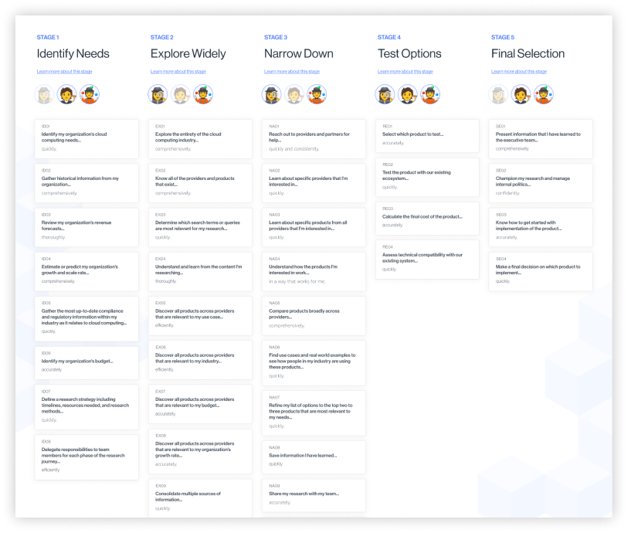
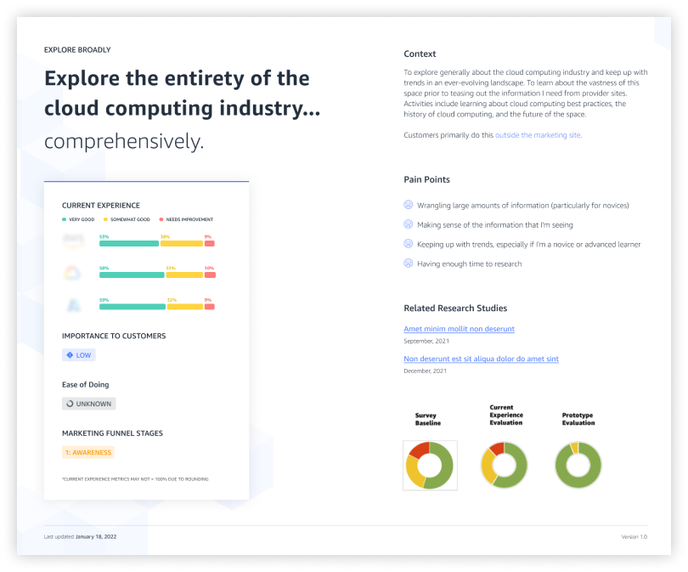
Next steps
Develop a dashboard of CSO performance
Blink will take data gathered from both quantitative and qualitative member research to develop a CSO dashboard. This is a tool designed to align the organization around member needs for each journey, as well as corresponding performance metrics, associated pain points, and contextual details of each CSO.
This grounds teams in a customer-centered approach to designing new features.

Slide 74
Next steps
Continue collecting data after the MyBlue app launch
01
Adjust journey-based feedback mechanism
Integrate questions into the Medallia feedback survey to continuously assess key pain points:
Understanding the content/information presented clearly
Ability to find the information members were seeking quickly
Confidence in decision-making based on the information presented
02
Benchmark annually
Conduct an annual survey to measure changes in member satisfaction with CSOs for each journey over time.
Repeat the full MaxDiff survey every 3-5 years to identify shifts in CSO importance.
03
Evaluate designs often
Identify how well proposed feature ideas, product changes, and concepts meet members’ needs early in the design process with actual members.

Slide 75


Thank You!

Slide 76
Appendix
09

Slide 77
Appendix:
Demographic Distributions

Slide 78
Demographic Distributions
Showing age, gender, race, and income
TRACK | BENEFITS |  |  |  | CLAIMS |  |  |  | FIND A PROVIDER |  |  |  | ALL TRACKS
n-sizes | 226 | 251 | 274 | 751 | 132 | 208 | 230 | 570 | 67 | 166 | 234 | 467 | 425 | 625 | 738 | 1788
AGE | BCBSMA | Anthem | United | Total | BCBSMA | Anthem | United | Total | BCBSMA | Anthem | United | Total | BCBSMA | Anthem | United | Total
18-24 | 5% | 4% | 5% | 5% | 2% | 2% | 3% | 3% | 8% | 4% | 1% | 3% | 5% | 4% | 3% | 4%
25-34 | 21% | 23% | 16% | 20% | 19% | 13% | 12% | 14% | 24% | 28% | 14% | 20% | 21% | 21% | 14% | 18%
35-44 | 24% | 23% | 22% | 23% | 21% | 29% | 24% | 25% | 24% | 25% | 20% | 23% | 23% | 26% | 22% | 24%
45-54 | 20% | 24% | 17% | 20% | 17% | 18% | 15% | 17% | 13% | 19% | 25% | 21% | 18% | 21% | 19% | 19%
55-64 | 14% | 16% | 18% | 16% | 20% | 20% | 19% | 20% | 16% | 14% | 16% | 15% | 16% | 17% | 18% | 17%
65-74 | 14% | 9% | 18% | 14% | 17% | 16% | 18% | 17% | 12% | 9% | 21% | 15% | 14% | 12% | 19% | 15%
75-84 | 3% | 1% | 4% | 3% | 5% | 1% | 9% | 5% | 3% | 0% | 4% | 2% | 3% | 1% | 5% | 3%
85 or older | 0% | 0% | 0% | 1% | 1% | 1% | 0% | 0% | 0% | 0% | 0% | 0% | 0% | 0% | 0% | 0%
GENDER
Woman | 58% | 53% | 56% | 55% | 51% | 51% | 50% | 51% | 60% | 57% | 54% | 56% | 56% | 53% | 54% | 54%
Man | 42% | 46% | 44% | 44% | 46% | 48% | 49% | 48% | 39% | 43% | 45% | 44% | 43% | 46% | 46% | 45%
Other | 0% | 0% | 0% | 1% | 3% | 1% | 0% | 1% | 2% | 0% | 0% | 0% | 1% | 1% | 0% | 1%
RACE
American Indian or Alaska Native | 1% | 1% | 2% | 2% | 0% | 1% | 2% | 1% | 2% | 1% | 2% | 2% | 1% | 1% | 2% | 2%
Asian | 5% | 5% | 6% | 6% | 2% | 7% | 6% | 5% | 5% | 9% | 8% | 8% | 4% | 7% | 7% | 6%
Black or African American | 6% | 12% | 13% | 11% | 3% | 10% | 12% | 9% | 8% | 14% | 6% | 9% | 6% | 12% | 10% | 10%
Hispanic, Latino, or Spanish origin | 10% | 12% | 12% | 11% | 10% | 6% | 6% | 7% | 6% | 11% | 12% | 11% | 9% | 10% | 10% | 10%
Middle Eastern or North African | 0% | 0% | 0% | 0% | 2% | 0% | 0% | 1% | 0% | 2% | 0% | 1% | 1% | 1% | 0% | 1%
Native Hawaiian/Pacific Islander | 0% | 1% | 1% | 1% | 0% | 0% | 0% | 0% | 0% | 1% | 0% | 0% | 0% | 1% | 0% | 0%
White | 83% | 77% | 73% | 77% | 89% | 83% | 79% | 83% | 82% | 73% | 78% | 77% | 85% | 78% | 77% | 79%
Another race or ethnicity | 1% | 0% | 0% | 0% | 2% | 1% | 0% | 1% | 2% | 0% | 1% | 1% | 2% | 0% | 0% | 1%
INCOME
Less than $30,000 | 2% | 6% | 10% | 6% | 4% | 8% | 10% | 8% | 5% | 2% | 10% | 7% | 3% | 6% | 10% | 7%
$30,000 to $49,999 | 14% | 16% | 14% | 15% | 10% | 15% | 19% | 15% | 10% | 16% | 12% | 13% | 12% | 16% | 15% | 15%
$50,000 to $74,999 | 23% | 29% | 22% | 24% | 16% | 24% | 21% | 21% | 19% | 25% | 18% | 21% | 20% | 26% | 21% | 22%
$75,000 to $99,999 | 21% | 19% | 20% | 20% | 14% | 19% | 15% | 16% | 19% | 20% | 17% | 18% | 19% | 19% | 18% | 18%
$100,000 to $124,999 | 12% | 14% | 11% | 12% | 11% | 11% | 9% | 10% | 19% | 12% | 12% | 13% | 13% | 12% | 11% | 12%
$125,000 to $149,999 | 11% | 8% | 10% | 9% | 14% | 9% | 7% | 9% | 9% | 6% | 10% | 8% | 11% | 8% | 9% | 9%
$150,000 to $199,999 | 8% | 4% | 9% | 7% | 17% | 10% | 12% | 13% | 9% | 10% | 10% | 10% | 11% | 8% | 10% | 10%
$200,000 or more | 8% | 4% | 5% | 5% | 11% | 4% | 6% | 7% | 9% | 7% | 9% | 8% | 9% | 5% | 7% | 7%
Prefer not to answer | 3% | 0% | 0% | 1% | 3% | 1% | 0% | 1% | 0% | 1% | 2% | 1% | 2% | 1% | 1% | 1%

Slide 79
Demographic Distributions
Showing residential area, who manages healthcare, decision-makers, plan type, and high deductibles
TRACK | BENEFITS |  |  |  | CLAIMS |  |  |  | FIND A PROVIDER |  |  |  | ALL TRACKS
n-sizes | 226 | 251 | 274 | 751 | 132 | 208 | 230 | 570 | 67 | 166 | 234 | 467 | 425 | 625 | 738 | 1788
 | BCBSMA | Anthem | United | Total | BCBSMA | Anthem | United | Total | BCBSMA | Anthem | United | Total | BCBSMA | Anthem | United | Total
RESIDENTIAL AREA
Large or medium size city (more than 50,000 people) | 31% | 43% | 47% | 41% | 36% | 50% | 53% | 48% | 42% | 63% | 50% | 53% | 34% | 51% | 50% | 46%
Small city or large town (roughly 5,000 to 50,000 people) | 57% | 35% | 35% | 42% | 54% | 29% | 31% | 35% | 46% | 20% | 35% | 31% | 54% | 29% | 34% | 37%
Small town (less than 5,000 people) | 9% | 6% | 7% | 7% | 5% | 4% | 8% | 6% | 9% | 5% | 6% | 6% | 8% | 5% | 7% | 7%
Rural area (outside of urban/suburban areas) | 3% | 15% | 11% | 10% | 5% | 17% | 9% | 11% | 3% | 12% | 9% | 9% | 4% | 15% | 10% | 10%
MANAGE HEALTHCARE
I manage my own healthcare | 65% | 65% | 77% | 69% | 68% | 70% | 76% | 72% | 78% | 72% | 77% | 75% | 68% | 69% | 77% | 72%
I manage my own and someone else’s healthcare | 35% | 35% | 23% | 31% | 32% | 30% | 24% | 28% | 22% | 28% | 23% | 25% | 32% | 31% | 23% | 28%
DECISION MAKER
I am the primary decision maker | 79% | 79% | 82% | 80% | 74% | 80% | 81% | 79% | 78% | 86% | 84% | 84% | 77% | 81% | 83% | 81%
I share the responsibility in making these decisions | 21% | 21% | 18% | 20% | 26% | 20% | 19% | 21% | 22% | 15% | 16% | 16% | 23% | 19% | 18% | 19%
TYPE OF PLAN
PPO | 61% | 68% | 63% | 64% | 66% | 70% | 65% | 67% | 67% | 61% | 65% | 64% | 63% | 67% | 65% | 65%
HMO | 35% | 29% | 33% | 32% | 27% | 27% | 31% | 29% | 28% | 37% | 31% | 33% | 32% | 30% | 32% | 31%
Something else, please specify: | 0% | 1% | 1% | 1% | 3% | 1% | 2% | 2% | 2% | 0% | 1% | 1% | 1% | 1% | 1% | 1%
Not sure | 4% | 2% | 3% | 3% | 4% | 1% | 2% | 2% | 3% | 2% | 3% | 2% | 4% | 2% | 3% | 3%
HIGH DEDUCTIBLE?
Yes | 50% | 65% | 58% | 58% | 52% | 64% | 59% | 59% | 52% | 76% | 63% | 66% | 51% | 68% | 60% | 61%
No | 43% | 30% | 35% | 36% | 46% | 33% | 37% | 37% | 40% | 19% | 32% | 29% | 43% | 28% | 35% | 34%
Don’t know | 7% | 5% | 7% | 6% | 3% | 3% | 4% | 4% | 8% | 5% | 5% | 5% | 6% | 4% | 5% | 5%

Slide 80
Demographic Distributions
Showing how members receive insurance and type of Medicare plans
TRACK | BENEFITS |  |  |  | CLAIMS |  |  |  | FIND A PROVIDER |  |  |  | ALL TRACKS
n-sizes | 226 | 251 | 274 | 751 | 132 | 208 | 230 | 570 | 67 | 166 | 234 | 467 | 425 | 625 | 738 | 1788
 | BCBSMA | Anthem | United | Total | BCBSMA | Anthem | United | Total | BCBSMA | Anthem | United | Total | BCBSMA | Anthem | United | Total
HOW RECEIVE INSURANCE
A policy offered through your employer | 60% | 63% | 52% | 58% | 59% | 53% | 42% | 50% | 57% | 60% | 48% | 54% | 59% | 59% | 48% | 54%
A policy offered through the employer of a family member | 16% | 18% | 10% | 14% | 13% | 14% | 10% | 12% | 18% | 13% | 8% | 11% | 16% | 15% | 9% | 13%
Original Medicare, Medicare Advantage, Medicare Supplement, or other Medicare plan | 16% | 10% | 25% | 17% | 21% | 19% | 36% | 26% | 13% | 11% | 30% | 21% | 17% | 13% | 30% | 21%
A non-Medicare policy purchased directly from a health insurance company | 5% | 3% | 4% | 4% | 2% | 4% | 6% | 5% | 2% | 5% | 2% | 3% | 4% | 4% | 4% | 4%
A policy purchased through a health insurance Marketplace or Public Exchange | 3% | 6% | 10% | 7% | 3% | 10% | 6% | 7% | 6% | 10% | 11% | 10% | 4% | 9% | 9% | 8%
A policy offered through your university | 0% | 0% | 0% | 0% | 2% | 0% | 0% | 1% | 5% | 1% | 0% | 1% | 1% | 0% | 0% | 1%
TYPE OF MEDICARE PLAN n-sizes | 35 | 25 | 67 | 127 | 27 | 39 | 82 | 148 | 9 | 19 | 71 | 99 | 71 | 83 | 220 | 374
A Medicare Advantage plan with prescription drugs | 54% | 72% | 82% | 72% | 52% | 62% | 79% | 70% | 100% | 79% | 86% | 86% | 59% | 69% | 82% | 75%
A Medicare Advantage plan without prescription drugs | 6% | 8% | 2% | 4% | 7% | 3% | 1% | 3% | 0% | 11% | 1% | 3% | 6% | 6% | 1% | 3%
A Medicare Supplement or Medigap Plan | 40% | 20% | 16% | 24% | 41% | 36% | 20% | 28% | 0% | 11% | 13% | 11% | 35% | 25% | 16% | 22%

Slide 81
Appendix:
Channel Comparisons

Slide 82
Online resources are primarily used for checking benefits
Channel Comparisons
ACTIONS TAKEN WITH INSURANCE COMPANY’S APP OR WEBSITE
Participating in a Benefits, Claims, or Find a Provider action were required to participate in our survey, but ultimately, we still learned that members are using online resources to check their benefits more than any other actions (69% of BCBSMA members reviewed their coverage of benefits online).
BCBSMA members reported going online for eight actions less frequently than members of other health insurance companies.
Only 25% of all BCBSMA members surveyed recall submitting a claim in the past year.
▼▼
▼▼
▼▼
▼▼
▼▼
▼▼
▼
▼
▲▼ - Arrows indicate statistically significant differences between two groups. The direction of the arrow indicates that stat is above/below the stat of the insurer whose color is reflected in the arrow.
QHIACTIONS. In the past year, which of the following have you done on your insurance company’s mobile app or website? Select all that apply. Base: All respondents from all three tracks (BCBSMA n=425, Anthem n=625, United n=738)

Slide 83
Channel Comparisons
App usage to refer to benefits is lowest for BCBSMA
BENEFIT-RELATED ACTIONS AND CHANNELS USED TO ENGAGE WITH INSURER
When looking at specific actions or ways to engage with their insurer, the majority of BCBSMA members choose to go to the website on their computers.
If having to decide whether to use the website or their app on their phones, for Benefits tasks, BCBSMA members tend to prefer the app.
Reviewed health insurance coverage or benefits
▲▲
▼▼
Used an ancillary health insurance benefit
▲
Reviewed coverage for prescriptions
Researched the cost of a visit, procedure, or treatment
Managed prescriptions through health insurance provider
▼▼
▲▼ - Arrows indicate statistically significant differences between two groups. The direction of the arrow indicates that stat is above/below the stat of the insurer whose color is reflected in the arrow.
QPRIMARYENGAGE. For each of the activities you’ve done with your insurance provider in the past year, please indicate how you primarily engaged with your insurance provider to complete each action? Please select one for each action. Base: Those who indicated taking each action in QHIACTIONS (ns vary)

Slide 84
BCBSMA are less likely to look for a provider on the app
Channel Comparisons
PROVIDER & PLAN-RELATED ACTIONS AND CHANNELS USED TO ENGAGE WITH INSURER
When looking for a provider, United members are more likely to look for providers on their United app (33%) than BCBSMA members (22%).
BCBSMA website usage is mostly on par with competitors for provider and plan-related actions, except for engaging in the prior authorization process for the healthcare company, where BCBSMA leans on the website more than competitors.
Researched or chose a health insurance plan
Designated a specific primary care provider
Looked for a new healthcare provider/doctor
▼
Engaged in the prior authorization process for the health insurance company
▲
▼
▲▼ - Arrows indicate statistically significant differences between two groups. The direction of the arrow indicates that stat is above/below the stat of the insurer whose color is reflected in the arrow.
QPRIMARYENGAGE. For each of the activities you’ve done with your insurance provider in the past year, please indicate how you primarily engaged with your insurance provider to complete each action? Please select one for each action. Base: Those who indicated taking each action in QHIACTIONS (ns vary)

Slide 85
Channel Comparisons
For claims, BCBSMA members stick to the website
CLAIMS-RELATED ACTIONS AND CHANNELS USED TO ENGAGE WITH INSURER
Especially when submitting a claim, BCBSMA members are a lot more comfortable doing so on their insurer’s website on a computer than they are on their app. Both Anthem and United members are more likely to choose to submit claims on their insurer’s respective apps.
BCBSMA members are most likely to use their insurer’s website on their phones to track the status of claims.
▲▲
▼▼
▼
Submitted a claim
Reviewed claim or EOB information
▲
▼
Tracked the status of a claim
▲▼ - Arrows indicate statistically significant differences between two groups. The direction of the arrow indicates that stat is above/below the stat of the insurer whose color is reflected in the arrow.
QPRIMARYENGAGE. For each of the activities you’ve done with your insurance provider in the past year, please indicate how you primarily engaged with your insurance provider to complete each action? Please select one for each action. Base: Those who indicated taking each action in QHIACTIONS (ns vary)

Slide 86
Appendix:
Benefits

Slide 87
Benefits Survey
Truncated and Full Benefits CSO statements
CSO # | Importance Ranking | Truncated Statement (used in this report) | Full Statement (shown to respondents in the survey)
B15 | 1 | Understand total cost associated with upcoming care | Easily understand the total amount I will owe for an upcoming visit or procedure (including unexpected fees like facility fees).
B06 | 2 | Understand plan overview info (deductibles, etc.) | Easily understand my plan overview information (e.g., deductibles, out-of-pocket maximums, etc.).
B04 | 3 | Find accurate cost info for procedures, treatments, and meds | Quickly find accurate healthcare cost information for procedures, treatments, and medications.
B07 | 4 | Understand coverage for a specific issue/care | Clearly understand my health insurance coverage for a specific issue/care.
B21 | 5 | Understand how changes to coverage will impact annual usage | Clearly understand how changes to my coverage will impact the total amount I will owe for the type of care I typically use.
B01 | 6 | Find plan overview info (deductibles, etc.) | Quickly navigate to my plan overview information (e.g., deductibles, out-of-pocket maximums, etc.).
B20 | 7 | Be informed when coverage changes | Clearly be informed when my coverage changes, annually or during the year.
B08 | 8 | Understand services covered based on age/circumstances | Clearly understand the services I have covered based on my age and unique health circumstances.
B02 | 9 | Find relevant coverage for emergency/urgent care | Quickly find relevant healthcare coverage information for emergency or urgent care treatment.
B03 | 10 | Find coverage information for a specific issue/care | Easily find coverage information for my specific issues/care, even if I don't know the right medical term.
B05 | 11 | Access expert support to understand coverage/costs | Quickly access expert support to understand my coverage or cost when needed.
B16 | 12 | Understand total cost for new prescription medications | Easily understand the total amount I will owe for a new prescription medication I am considering.
B10 | 13 | Understand factors impacting coverage eligibility | Easily understand what factors impact my eligibility for insurance coverage (e.g., time window, limits on number of visits, PCP referral, age, etc.).
B11 | 14 | Understand number of covered visits or products remaining | Easily understand how many visits or products I have remaining for the year with my insurance plan (e.g., physical therapy visits, contact lenses, etc.).
B17 | 15 | Understand cost differences between similar options | Clearly understand cost differences between similar options (provider or medication) that address the same concern.
B09 | 16 | Understand coverage differences for in- vs. out-of-network providers | Easily understand the difference in my coverage for in-network vs. out-of-network providers.
B13 | 17 | Access medications while awaiting approval | Easily access the medications I need while waiting for approval (prior authorization) from my insurance company for that medication.
B22 | 18 | Be informed when the cost of my meds change | Quickly be informed when the cost of any of my medications has changed.
B18 | 19 | Understand trade-offs for lower cost options | Clearly understand potential quality trade-offs associated with a lower cost option (e.g., provider, medication).
B19 | 20 | Be aware of pharmacies that sell meds for a lower price | Easily become aware of alternative pharmacies that sell my same medication for a lower price.
B12 | 21 | Understand technical terms and language | Confidently understand technical terms and language related to my healthcare coverage.
B14 | 22 | Be notified when prescription refills are available | Easily become aware when I have a prescription refill available.

Slide 88
Benefits Survey
Overall, Anthem’s website performed the best
BENEFITS SATISFACTION (WEBSITE ONLY)
STATEMENT | BCBSMA WEBSITE | ANTHEM WEBSITE | UNITED WEBSITE | IMPORTANCE RANKING
Understand plan overview info (deductibles, etc.) | 79% | 81% | 80% | #2
Find plan overview info (deductibles, etc.) | 78% | 84% | 82% | #6
Understand coverage for a specific issue/care | 77% | 76% | 75% | #4
Access expert support to understand coverage/costs | 69% | 72% | 66% | #11
Understand total cost associated with upcoming care | 69% | 70% | 70% | #1
Understand coverage differences for in- vs. out-of-network providers | 68% | 82% | 74% | #16
Be informed when coverage changes | 67% | 70% | 75% | #7
Understand services covered based on age/circumstances | 66% | 71% | 71% | #8
Find accurate cost info for procedures, treatments, and meds | 65% | 68% | 73% | #3
Find coverage information for a specific issue/care | 64% | 68% | 63% | #10
Be notified when prescription refills are available | 63% | 60% | 68% | #22
Understand number of covered visits or products remaining | 63% | 61% | 62% | #14
Find relevant coverage for emergency/urgent care | 62% | 74% | 68% | #9
Understand how changes to coverage will impact annual usage | 62% | 70% | 68% | #5
Understand total cost for new prescription medications | 61% | 68% | 70% | #12
Understand factors impacting coverage eligibility | 58% | 66% | 66% | #13
Understand technical terms and language | 58% | 66% | 70% | #21
Access medications while awaiting approval | 55% | 55% | 48% | #17
Be informed when the cost of my meds change | 52% | 49% | 54% | #18
Understand cost differences between similar options | 51% | 64% | 52% | #15
Understand trade-offs for lower cost options | 50% | 57% | 46% | #19
Be aware of pharmacies that sell meds for a lower price | 40% | 48% | 45% | #20
BCBSMA’s website shows much lower satisfaction than competitors’, especially for members to:
Understand coverage differences for in- vs. out- of-network providers (-14%)
Understand cost differences between similar options (-13%)
Find relevant coverage for emergency/urgent care (-12%)
Understand technical terms and language (-12%)
▼
▼
Groups more likely to be satisfied with BCBSMA benefits CSOs:
Those ages 18-34 on access medications while awaiting approval (66% vs. 40% ages 65+)
Those ages 18-34 on be aware of pharmacies that sell meds for a lower price (55% vs. 27% ages 65+)
Medicare subscribers on understand services covered based on age/circumstances (82% vs. 63% of comm/ind subscribers)
The age group 34-44 had significantly lower satisfaction than other ages groups for 15/22 BCBSMA benefits CSOs on the website.
▼
▼
Note: Respondents were forced to answer each question
▲▼- Arrows indicate statistically significant differences between two groups. The direction of the arrow indicates that stat is above/below the stat of the insurer whose color is reflected in the arrow.
BENEFITSSAT. How satisfied are you with your current ability to accomplish each task on <insurer’s> <app or website> today? Base: Those in Benefits track who evaluated satisfaction on the website for BCBSMA n= 151, Anthem n=148 , United n=166
Notes:
Satisfaction Scores: Based on top two box scores from satisfaction question

Slide 89
BCBSMA also falls behind on CSO satisfaction on the app
Benefits Survey
BENEFITS SATISFACTION (APP ONLY)
STATEMENT | BCBSMA APP | ANTHEM APP | UNITED APP | IMPORTANCE RANKING
Understand plan overview info (deductibles, etc.) | 85% | 87% | 92% | #2
Understand coverage for a specific issue/care | 84% | 79% | 79% | #4
Find plan overview info (deductibles, etc.) | 81% | 86% | 81% | #6
Access expert support to understand coverage/costs | 80% | 82% | 74% | #11
Understand coverage differences for in- vs. out-of-network providers | 77% | 79% | 74% | #16
Be notified when prescription refills are available | 77% | 75% | 79% | #22
Find relevant coverage for emergency/urgent care | 77% | 74% | 80% | #9
Find accurate cost info for procedures, treatments, and meds | 76% | 76% | 75% | #3
Find coverage information for a specific issue/care | 74% | 74% | 74% | #10
Understand how changes to coverage will impact annual usage | 70% | 79% | 74% | #5
Understand factors impacting coverage eligibility | 70% | 72% | 74% | #13
Be informed when coverage changes | 69% | 78% | 73% | #7
Understand services covered based on age/circumstances | 69% | 80% | 79% | #8
Understand total cost for new prescription medications | 69% | 87% | 79% | #12
Understand total cost associated with upcoming care | 68% | 70% | 78% | #1
Understand technical terms and language | 68% | 71% | 63% | #21
Understand number of covered visits or products remaining | 65% | 72% | 69% | #14
Be informed when the cost of my meds change | 64% | 59% | 65% | #18
Access medications while awaiting approval | 61% | 72% | 67% | #17
Understand cost differences between similar options | 60% | 64% | 64% | #15
Understand trade-offs for lower cost options | 55% | 64% | 65% | #19
Be aware of pharmacies that sell meds for a lower price | 53% | 56% | 54% | #20
BCBSMA did outperform competitors with satisfaction for understanding coverage for a specific issue or healthcare on the app.
However, satisfaction with Benefits CSOs on the BCBSMA app are generally lower than competitors’ apps, especially for:
Understanding total cost for new prescription medications (-18%)
Understanding services covered based on age/circumstances (-11%)
Accessing medications while awaiting approval (-11%)
▼
Groups more likely to be satisfied with BCBSMA benefits CSOs:
Those ages 18-34 on be notified when prescription refills are available (86% vs. 43% ages 65+)
Comm/ind subscribers on be notified when prescription refills are available (81% vs. 43% of Medicare subscribers)
Those ages 18-34 on understand cost differences between similar options (72% vs. 29% ages 65+)
Note: Respondents were forced to answer each question
▲▼- Arrows indicate statistically significant differences between two groups. The direction of the arrow indicates that stat is above/below the stat of the insurer whose color is reflected in the arrow.
BENEFITSSAT. How satisfied are you with your current ability to accomplish each task on <insurer’s> <app or website> today? Base: Those in Benefits track who evaluated satisfaction on the website for BCBSMA n= 74, Anthem n=103 , United n=107
Notes:
Satisfaction Scores: Based on top two box scores from satisfaction question

Slide 90
For most of Anthem’s Benefits CSOs, as importance increases, so does satisfaction, showing a mostly linear pattern with some exceptions (B15 and B04 are noteworthy).
Benefits Survey
Anthem’s CSOs match importance to sat well
UNMET NEEDS
TABLE STAKES
IMPORTANCE OF BENEFITS CSOs VS. SATISFACTION WITH CURRENT SOLUTIONS
HIGH IMPORTANCE
LOW SATISFACTION
HIGH IMPORTANCE
HIGH SATISFACTION
Anthem Unmet Needs
none
Anthem Table Stakes
B15 Understand total cost associated with upcoming care
B06 Understand plan overview info (deductibles, etc.)
B04 Find accurate cost info for procedures, treatments, and meds
B07 Understand coverage for a specific issue/care
B21 Understand how changes to coverage will impact annual usage
B01 Find plan overview info (deductibles, etc.)
B20 Be informed when coverage changes
B08 Understand services covered based on age/circumstances
B02 Find relevant coverage for emergency/urgent care
B03 Find coverage information for a specific issue/care
IMPORTANCE
RIPE FOR DISRUPTION
OVERSERVED AREAS
Anthem Ripe for Disruption
B11 Understand number of covered visits or products remaining
B17 Understand cost differences between similar options
B13 Access medications while awaiting approval
B22 Be informed when the cost of my meds change
B18 Understand trade-offs for lower cost options
B19 Be aware of pharmacies that sell meds for a lower price
B14 Be notified when prescription refills are available
Anthem Overserved Areas
B05 Access expert support to understand coverage/costs
B16 Understand total cost for new prescription medications
B10 Understand factors impacting coverage eligibility
B09 Understand coverage differences for in- vs. out-of-network providers
B12 Understand technical terms and language
LOW IMPORTANCE
LOW SATISFACTION
LOW IMPORTANCE
HIGH SATISFACTION
SATISFACTION
BENEFITSMAXDIFF. Please select one statement that would be “most important” for you when checking your benefits through your health insurance provider. Base: Those in Benefits track , n=751 (comprising of BCBSMA n=226, Anthem n=251, United n=274)
BENEFITSSAT. How satisfied are you with your current ability to accomplish each task on <insurer’s> <app or website> today?
Base: Those in Benefits track, Anthem n=251
Notes:
Relative Importance Utility Scores: Showing MaxDiff utility output where users rated “most” and “least” of each group and then are ranked relative to one another.
Satisfaction Scores: Based on top two box scores from satisfaction question, charted regardless of channel

Slide 91
Within the Benefits CSOs, United has several that cluster right into (or very near) the table stakes quadrant, showing the appropriate satisfaction levels based on importance of most CSOs.
Benefits Survey
Many of United’s CSOs cluster near table stakes
UNMET NEEDS
TABLE STAKES
IMPORTANCE OF BENEFITS CSOs VS. SATISFACTION WITH CURRENT SOLUTIONS
HIGH IMPORTANCE
LOW SATISFACTION
HIGH IMPORTANCE
HIGH SATISFACTION
IMPORTANCE
United Table Stakes
B15 Understand total cost associated with upcoming care
B06 Understand plan overview info (deductibles, etc.)
B04 Find accurate cost info for procedures, treatments, and meds
B07 Understand coverage for a specific issue/care
B21 Understand how changes to coverage will impact annual usage
B01 Find plan overview info (deductibles, etc.)
B20 Be informed when coverage changes
B08 Understand services covered based on age/circumstances
B02 Find relevant coverage for emergency/urgent care
B03 Find coverage information for a specific issue/care
United Unmet Needs
none
RIPE FOR DISRUPTION
OVERSERVED AREAS
United Ripe for Disruption
B11 Understand number of covered visits or products remaining
B17 Understand cost differences between similar options
B13 Access medications while awaiting approval
B22 Be informed when the cost of my meds change
B18 Understand trade-offs for lower cost options
B19 Be aware of pharmacies that sell meds for a lower price
B12 Understand technical terms and language
United Overserved Areas
B05 Access expert support to understand coverage/costs
B16 Understand total cost for new prescription medications
B10 Understand factors impacting coverage eligibility
B09 Understand coverage differences for in- vs. out-of-network providers
B14 Be notified when prescription refills are available
LOW IMPORTANCE
LOW SATISFACTION
LOW IMPORTANCE
HIGH SATISFACTION
SATISFACTION
BENEFITSMAXDIFF. Please select one statement that would be “most important” for you when checking your benefits through your health insurance provider. Base: Those in Benefits track , n=751 (comprising of BCBSMA n=226, Anthem n=251, United n=274)
BENEFITSSAT. How satisfied are you with your current ability to accomplish each task on <insurer’s> <app or website> today?
Base: Those in Benefits track, United n=274
Notes:
Relative Importance Utility Scores: Showing MaxDiff utility output where users rated “most” and “least” of each group and then are ranked relative to one another.
Satisfaction Scores: Based on top two box scores from satisfaction question, charted regardless of channel

Slide 92
Nearly 60% of NPS variance for an insurer’s website can be predicted based on how satisfied members are with six key Benefits CSOs. Focusing on just improving a tool to help members understand expected costs could greatly increase NPS overall.
Benefits Survey
Helping members understand expected costs will greatly increase website NPS
Key drivers analysis is performed with a stepwise multiple regression procedure to identify the attributes most closely associated with overall NPS for claims CSOs. This procedure identifies how much variation in overall NPS each of the identified attributes explains. As satisfaction of these key CSOs increases, NPS should increase as well.
Total Variance Explained: 41% 51% 55%^ 57% 58% 59%
^CSO is also a key driver on the app
BENEFITSSAT. How satisfied are you with your current ability to accomplish each task on <insurer’s> <app or website> today? Base: Those answer Benefits track for website n=465 made up of BCBSMA n=151, Anthem n=148, United n=166
QNPSWEB. Based on your recent website visit, how likely are you to recommend <insurer> to a friend or colleague? Scale ranges from 0-10, with 0-6 classified as “detractors,” 7-8 as “passives,” and 9-10 as “promoters.” Base: All respondents who used their health company’s website from Benefits track n=465 (BCBSMA n=151, Anthem n=148, United n=166)

Slide 93
An insurer’s app NPS scores are heavily influenced by their satisfaction with understanding the total amount for new prescription medications, what factors impact their eligibility for coverage, their coverage for a specific issue, and services that are covered based on age and unique circumstances.
Benefits Survey
Increasing members’ understanding of their unique coverage would boost app NPS
Key drivers analysis is performed with a stepwise multiple regression procedure to identify the attributes most closely associated with overall NPS for claims CSOs. This procedure identifies how much variation in overall NPS each of the identified attributes explains. As satisfaction of these key CSOs increases, NPS should increase as well.
Total Variance Explained: 33% 45% 49% 51% 52%^
^CSO is also a key driver on the website
BENEFITSSAT. How satisfied are you with your current ability to accomplish each task on <insurer’s> <app or website> today? Base: Those answer Benefits track for app n=284 made up of BCBSMA n=74, Anthem n=103, United n=107
QNPSAPP. Based on your recent app visit, how likely are you to recommend <insurer> to a friend or colleague? Scale ranges from 0-10, with 0-6 classified as “detractors,” 7-8 as “passives,” and 9-10 as “promoters.” Base: All respondents who used their health company’s app from Benefits track n=284 (BCBSMA n=74, Anthem n=103, United n=107)

Slide 94
Appendix:
Claims

Slide 95
Claims Survey
Truncated and Full Claims CSO statements
CSO # | Importance Ranking | Truncated Statement (used in this report) | Full Statement (shown to respondents in the survey)
C10 | 1 | Be confident the claim was processed correctly | Be confident my insurance provider correctly processed the claim based on my coverage.
C11 | 2 | Be confident I was billed correctly for the care received | Be confident the provider billed me correctly for the care I received.
C12 | 3 | Find how much is owed and why it is owed for a claim | Quickly find how much I owe and why I owe that amount for the claim.
C16 | 4 | Understand next steps based on outcome of a claim | Clearly understand the next steps based on whether my claim was fully covered, partially covered, or denied.
C06 | 5 | Be confident a claim was successfully submitted | Be confident my claim was successfully submitted.
C02 | 6 | Understand the steps and responsibilities in the claims process | Clearly understand the steps involved in the claims process, including my and the insurance providers' responsibilities.
C19 | 7 | Correct denials of coverage due to errors | Quickly correct denials of coverage due to errors by the doctor or insurance company.
C01 | 8 | Understand info needed to submit/justify a claim | Clearly understand what information is needed to submit and justify my claim.
C09 | 9 | Understand the impact a pending claim will have on plan usage | Clearly understand the impact pending claims might have on my out-of-pocket max, deductible, and remaining benefits.
C20 | 10 | Understand what is needed to appeal denied claim | Clearly understand what information is needed to appeal my denied claim and then provide that information.
C13 | 11 | Understand why a claim was denied | Clearly understand why my claim was denied.
C14 | 12 | Access relevant details to understand a claim | Easily access the relevant details I need to understand a given claim.
C18 | 13 | Access expert support when needed | Quickly access expert support or ask a clarifying question when needed.
C21 | 14 | Understand the steps and responsibilities in the appeals process | Clearly understand the steps involved in the appeal process, including my and the insurance providers' responsibilities.
C23 | 15 | Understand options to ease burden of my portion | Easily understand what options I have to ease the burden of paying for care that was not covered by my insurance.
C22 | 16 | See current outstanding payments owed to a provider | Easily see if I have any outstanding payments to providers for my claims.
C08 | 17 | Understand the current status of a claim | Easily understand what stage of the claims process my claims are in at any time.
C07 | 18 | Find a specific claim | Quickly locate the claim I am looking for.
C15 | 19 | Understand technical terms when reviewing claims | Confidently understand technical terms and language related to health insurance when reviewing my claims.
C24 | 20 | Predict how much I might spend this year based on last year's usage | Quickly help me predict how much I should expect to spend on medical expenses this year based on my healthcare usage last year.
C05 | 21 | Start filling out a claim and finish it later without repeating work | The ability to start filling out a claim and return to it later without repeating past work.
C04 | 22 | Find where to start a claim | Quickly find where to go to start my claim.
C17 | 23 | Save/share EOB document for a claim | Easily save or share my explanation of benefits (EOB) document for a claim.
C03 | 24 | Understand how long the claims process takes | Clearly understand how long it takes for a claim to be processed.

Slide 96
Claims Survey
The Claim’s web experience on BCBSMA is subpar to competitors
CLAIMS SATISFACTION (WEBSITE ONLY)
STATEMENT | BCBSMA WEBSITE | ANTHEM WEBSITE | UNITED WEBSITE | IMPORTANCE RANKING
Be confident a claim was successfully submitted | 77% | 85% | 87% | #5
Find a specific claim | 74% | 84% | 93% | #18
See current outstanding payments owed to a provider | 73% | 78% | 78% | #16
Find how much is owed and why it is owed for a claim | 70% | 82% | 76% | #3
Access relevant details to understand a claim | 70% | 76% | 83% | #12
Be confident the claim was processed correctly | 69% | 74% | 79% | #1
Understand info needed to submit/justify a claim | 68% | 73% | 74% | #8
Find where to start a claim | 67% | 69% | 72% | #22
Understand next steps based on outcome of a claim | 67% | 72% | 70% | #4
Understand the steps and responsibilities in the claims process | 66% | 67% | 82% | #6
Be confident I was billed correctly for the care received | 63% | 76% | 77% | #2
Start filling out a claim and finish it later without repeating work | 60% | 49% | 57% | #21
Save/share EOB document for a claim | 60% | 76% | 77% | #23
Access expert support when needed | 59% | 70% | 71% | #13
Understand technical terms when reviewing claims | 57% | 67% | 65% | #19
Understand the current status of a claim | 55% | 66% | 74% | #17
Understand the impact a pending claim will have on plan usage | 55% | 66% | 67% | #9
Understand the steps and responsibilities in the appeals process | 52% | 51% | 61% | #14
Understand what is needed to appeal denied claim | 52% | 53% | 61% | #10
Understand options to ease burden of my portion | 52% | 52% | 57% | #15
Understand how long the claims process takes | 48% | 58% | 59% | #24
Predict how much I might spend this year based on last year's usage | 48% | 58% | 56% | #20
Understand why a claim was denied | 47% | 54% | 56% | #11
Correct denials of coverage due to errors | 38% | 45% | 53% | #7
BCBSMA’s website shows much lower satisfaction than competitors’, especially for members to:
Find a specific claim (-19%)
Understand the current status of a claim (-19%)
Save/share EOB documents (-17%)
Understand steps and responsibilities in the claims process (-16%)
▼
▼
▼
▼
▼
▼
▼
▼▼
▼▼
Groups more likely to be satisfied with BCBSMA claims CSOs:
Those ages 65+ on be confident the claim was processed correctly (88% vs. 50% ages 18-34)
Medicare subscribers on correct denials of coverage due to errors (60% vs. 32% of comm/ind subscribers)
▼
▼
Note: Respondents were forced to answer each question
▲▼- Arrows indicate statistically significant differences between two groups. The direction of the arrow indicates that stat is above/below the stat of the insurer whose color is reflected in the arrow.
CLAIMSSAT. How satisfied are you with your current ability to accomplish each task on <insurer’s> <app or website> today? Base: Those in Claims track who evaluated satisfaction on the website for BCBSMA n=96, Anthem n=144, United n=151
Notes:
Satisfaction Scores: Based on top two box scores from satisfaction question

Slide 97
Claims Survey
CLAIMS SATISFACTION (APP ONLY)
United’s app leads performance among Claims CSOs
STATEMENT | BCBSMA APP* | ANTHEM APP | UNITED APP | IMPORTANCE RANKING
Be confident a claim was successfully submitted | 90% | 86% | 94% | #5
Find how much is owed and why it is owed for a claim | 84% | 81% | 88% | #3
Understand the steps and responsibilities in the claims process | 74% | 74% | 80% | #6
See current outstanding payments owed to a provider | 74% | 83% | 85% | #16
Find where to start a claim | 74% | 75% | 85% | #22
Find a specific claim | 71% | 84% | 88% | #18
Start filling out a claim and finish it later without repeating work | 71% | 63% | 83% | #21
Save/share EOB document for a claim | 71% | 81% | 70% | #23
Be confident I was billed correctly for the care received | 68% | 75% | 76% | #2
Understand next steps based on outcome of a claim | 68% | 75% | 81% | #4
Understand info needed to submit/justify a claim | 68% | 83% | 80% | #8
Access relevant details to understand a claim | 68% | 79% | 76% | #12
Understand the current status of a claim | 68% | 77% | 81% | #17
Understand how long the claims process takes | 68% | 74% | 76% | #24
Understand what is needed to appeal denied claim | 65% | 77% | 68% | #10
Understand technical terms when reviewing claims | 65% | 72% | 66% | #19
Be confident the claim was processed correctly | 61% | 79% | 82% | #1
Understand the impact a pending claim will have on plan usage | 61% | 70% | 70% | #9
Access expert support when needed | 61% | 74% | 79% | #13
Understand why a claim was denied | 58% | 70% | 58% | #11
Understand the steps and responsibilities in the appeals process | 58% | 72% | 74% | #14
Predict how much I might spend this year based on last year's usage | 58% | 68% | 67% | #20
Correct denials of coverage due to errors | 55% | 63% | 64% | #7
Understand options to ease burden of my portion | 52% | 65% | 76% | #15
Satisfaction with BCBSMA’s app falls well below satisfaction with United’s app for some key CSOs:
Be confident a claim was processed correctly (#1 importance, -21% from United)
Understand next steps based on outcome of a claim (#3 importance, -13% from United)
▼
▼
Groups more likely to be satisfied with BCBSMA benefits CSOs:
Comm/ind subscribers on access relevant details to understand a claim (76% vs. 33% of Medicare subscribers)
Comm/ind subscribers on understand why a claim was denied (68% vs. 17% of Medicare subscribers)
Comm/ind subscribers understand next steps based on outcome of a claim (76% vs. 33% of Medicare subscribers)
Comm/ind subscribers on understand the steps and responsibilities in the claims process (68% vs. 17% of Medicare subscribers)
▼
▼
Note: Respondents were forced to answer each question
*Interpret results as directional only, as the n-size is below 50 (BCBSMA n=31)
▲▼- Arrows indicate statistically significant differences between two groups. The direction of the arrow indicates that stat is above/below the stat of the insurer whose color is reflected in the arrow.
CLAIMSSAT. How satisfied are you with your current ability to accomplish each task on <insurer’s> <app or website> today? Base: Those in Claims track who evaluated satisfaction on the app for BCBSMA n=31*, Anthem n=57, United n=66
Notes:
Satisfaction Scores: Based on top two box scores from satisfaction question

Slide 98
Anthem members expressed higher satisfaction with many of the key claims CSOs than BCBSMA members, starting with confidence the claim was processed correctly.
Claims Survey
Anthem has 10 claims CSOs in table stakes
UNMET NEEDS
TABLE STAKES
IMPORTANCE OF CLAIMS CSOs VS. SATISFACTION WITH CURRENT SOLUTIONS
HIGH IMPORTANCE
LOW SATISFACTION
HIGH IMPORTANCE
HIGH SATISFACTION
Anthem Unmet Needs
C19 Correct denials of coverage due to errors
C20 Understand what is needed to appeal denied claim
C13 Understand why a claim was denied
Anthem Table Stakes
C10 Be confident the claim was processed correctly
C11 Be confident I was billed correctly for the care received
C12 Find how much is owed and why it is owed for a claim
C16 Understand next steps based on outcome of a claim
C06 Be confident a claim was successfully submitted
C02 Understand the steps and responsibilities in the claims process
C01 Understand info needed to submit/justify a claim
C09 Understand the impact a pending claim will have on plan usage
C14 Access relevant details to understand a claim
C18 Access expert support when needed
IMPORTANCE
RIPE FOR DISRUPTION
OVERSERVED AREAS
Anthem Ripe for Disruption
C21 Understand the steps and responsibilities in the appeals process
C23 Understand options to ease burden of my portion
C24 Predict how much I might spend this year based on last year's usage
C05 Start filling out a claim and finish it later without repeating work
C03 Understand how long the claims process takes
Anthem Overserved Areas
C22 See current outstanding payments owed to a provider
C08 Understand the current status of a claim
C07 Find a specific claim
C15 Understand technical terms when reviewing claims
C04 Find where to start a claim
C17 Save/share EOB document for a claim
LOW IMPORTANCE
LOW SATISFACTION
LOW IMPORTANCE
HIGH SATISFACTION
SATISFACTION
CLAIMSMAXDIFF. Please select one statement that would be “most important” for you when checking on a claim through your health insurance provider. Base: Those in Claims track, n=570, comprising of BCBSMA n=132, Anthem n=208, United n=230
CLAIMSSAT. How satisfied are you with your current ability to accomplish each task on <insurer’s> <app or website> today?
Base: Those in Claims track, Anthem n=208
Notes:
Relative Importance Utility Scores: Showing MaxDiff utility output where users rated “most” and “least” of each group and then are ranked relative to one another.
Satisfaction Scores: Based on top two box scores from satisfaction question, charted regardless of channel

Slide 99
Both United’s and Anthem’s claims quadrants ended up with the same CSO statements in each quadrant, though satisfaction with United’s CSOs is generally slightly higher.
Claims Survey
United’s CSO distribution matches Anthem’s
UNMET NEEDS
TABLE STAKES
IMPORTANCE OF CLAIMS CSOs VS. SATISFACTION WITH CURRENT SOLUTIONS
HIGH IMPORTANCE
LOW SATISFACTION
HIGH IMPORTANCE
HIGH SATISFACTION
IMPORTANCE
United Table Stakes
C10 Be confident the claim was processed correctly
C11 Be confident I was billed correctly for the care received
C12 Find how much is owed and why it is owed for a claim
C16 Understand next steps based on outcome of a claim
C06 Be confident a claim was successfully submitted
C02 Understand the steps and responsibilities in the claims process
C01 Understand info needed to submit/justify a claim
C09 Understand the impact a pending claim will have on plan usage
C14 Access relevant details to understand a claim
C18 Access expert support when needed
United Unmet Needs
C19 Correct denials of coverage due to errors
C20 Understand what is needed to appeal denied claim
C13 Understand why a claim was denied
RIPE FOR DISRUPTION
OVERSERVED AREAS
United Ripe for Disruption
C21 Understand the steps and responsibilities in the appeals process
C23 Understand options to ease burden of my portion
C15 Understand technical terms when reviewing claims
C24 Predict how much I might spend this year based on last year's usage
C05 Start filling out a claim and finish it later without repeating work
C03 Understand how long the claims process takes
United Overserved Areas
C22 See current outstanding payments owed to a provider
C08 Understand the current status of a claim
C07 Find a specific claim
C04 Find where to start a claim
C17 Save/share EOB document for a claim
LOW IMPORTANCE
LOW SATISFACTION
LOW IMPORTANCE
HIGH SATISFACTION
SATISFACTION
CLAIMSMAXDIFF. Please select one statement that would be “most important” for you when checking on a claim through your health insurance provider. Base: Those in Claims track, n=570, comprising of BCBSMA n=132, Anthem n=208, United n=230
CLAIMSSAT. How satisfied are you with your current ability to accomplish each task on <insurer’s> <app or website> today?
Base: United n=226
Notes:
Relative Importance Utility Scores: Showing MaxDiff utility output where users rated “most” and “least” of each group and then are ranked relative to one another.
Satisfaction Scores: Based on top two box scores from satisfaction question, charted regardless of channel

Slide 100
Being able to understand the next steps based on the outcome of the claim is the key driver to determining 30% of the variance in NPS scores. Improving this and access to expert support and confidence the provider billed them correctly would greatly increase NPS scores.
Claims Survey
Website perceptions can best be improved by explaining next steps for claims
Key drivers analysis is performed with a stepwise multiple regression procedure to identify the attributes most closely associated with overall NPS for claims CSOs. This procedure identifies how much variation in overall NPS each of the identified attributes explains. As satisfaction of these key CSOs increases, NPS should increase as well.
Total Variance Explained: 30%^ 41%^ 46%^ 49% 50%
^CSO is also a key driver on the app
CLAIMSSAT. How satisfied are you with your current ability to accomplish each task on <insurer’s> <app or website> today? Base: Those answer Claims track for website n=393 made up of BCBSMA n=96, Anthem n=114, United n=153
QNPSWEB. Based on your recent website visit, how likely are you to recommend <insurer> to a friend or colleague? Scale ranges from 0-10, with 0-6 classified as “detractors,” 7-8 as “passives,” and 9-10 as “promoters.” Base: All respondents who used their health company’s website from Claims track n=393 (BCBSMA n=96, Anthem n=114, United n=153)

Slide 101
Three of the four key driver CSOs are the same for web and app, a strong indication that these CSOs will help drive higher NPS scores on both channels.
Claims Survey
Confidence in billing and claims processing have the greatest influence on app NPS
Key drivers analysis is performed with a stepwise multiple regression procedure to identify the attributes most closely associated with overall NPS for claims CSOs. This procedure identifies how much variation in overall NPS each of the identified attributes explains. As satisfaction of these key CSOs increases, NPS should increase as well.
Total Variance Explained: 30%^ 37% 42%^ 45%^
^CSO is also a key driver on the website
CLAIMSSAT. How satisfied are you with your current ability to accomplish each task on <insurer’s> <app or website> today? Base: Those answer Claims track for app n=155 made up of BCBSMA n=33, Anthem n=57, United n=67
QNPSAPP. Based on your recent app visit, how likely are you to recommend <insurer> to a friend or colleague? Scale ranges from 0-10, with 0-6 classified as “detractors,” 7-8 as “passives,” and 9-10 as “promoters.” Base: All respondents who used their health company’s app from all three tracks n=155 (BCBSMA n=33, Anthem n=57, United n=67)

Slide 102
Appendix:
Find a Provider

Slide 103
Find a Provider Survey
Truncated and Full Find a Provider CSO statements
CSO # | Importance Ranking | Truncated Statement (used in this report) | Full Statement (shown to respondents in the survey)
F06 | 1 | View accurate/updated info about a provider | View accurate and up-to-date information about a provider (e.g., location, in-network status, accepting new patients' status, etc.).
F07 | 2 | Identify which doctors are in vs out of network | Quickly recognize which doctors are in versus out of network for my specific plan.
F01 | 3 | See a list of providers relevant to needs | Quickly see a list of all potential providers who are relevant to my needs.
F13 | 4 | Understand my total cost for an upcoming visit | Confidently understand the total amount I will owe for my upcoming visit (including unexpected fees like facility fees).
F09 | 5 | Confirm a provider meets my specific needs | Quickly confirm an individual provider meets my specific needs.
F08 | 6 | Identify which providers are accepting new patients | Quickly recognize which providers are accepting new patients.
F14 | 7 | Compare providers on qualities that matter most | Quickly compare providers based on the qualities that matter to me most.
F02 | 8 | Find the right provider | Confidently find the right provider for the care I need, even if I don't know the right medical term.
F10 | 9 | Review provider's background to determine fit | Review a provider's background information to assess if they will be a good fit for me.
F03 | 10 | Find in-network urgent care/ER providers | Quickly find in-network urgent/emergency care providers.
F15 | 11 | Access provider's contact info | Easily access the provider's contact information.
F05 | 12 | Denote the providers I am interested in to find later | Easily track which providers I'm interested in, so I can efficiently continue my provider search later.
F12 | 13 | See distance of provider's office from home/office | Quickly see how far a provider's office is from my home, work, and/or school.
F11 | 14 | Review others' experiences with the provider | Learn about other people's experience with a provider to assess if the provider is right for me.
F04 | 15 | See a list of providers when out of state | Quickly see a list of all providers relevant to my needs when I am out of state.

Slide 104
Find a Provider Survey
There is still room for improvement on ways to Find a Provider on all insurer’s websites
FIND A PROVIDER SATISFACTION (WEBSITE ONLY)
BCBSMA’s website shows much lower satisfaction than competitors,’ especially for members to:
Denote the providers I am interested in finding later (-17%)
Find the right provider (-16%)
Understand my total cost for an upcoming visit (-15%)
Compare providers on qualities that matter most (-15%)
See a list of providers relevant to my needs (-14%)
STATEMENT | BCBSMA WEBSITE | ANTHEM WEBSITE | UNITED WEBSITE | IMPORTANCE RANKING
Identify which doctors are in vs out of network | 80% | 83% | 81% | #2
Access provider's contact info | 80% | 91% | 86% | #11
View accurate/updated info about a provider | 76% | 80% | 78% | #1
See a list of providers relevant to needs | 72% | 86% | 80% | #3
See distance of provider's office from home/office | 72% | 76% | 82% | #13
Confirm a provider meets my specific needs | 68% | 75% | 71% | #5
Identify which providers are accepting new patients | 66% | 76% | 73% | #6
Find in-network urgent care/ER providers | 64% | 74% | 72% | #10
Review provider's background to determine fit | 64% | 69% | 63% | #9
Compare providers on qualities that matter most | 58% | 64% | 73% | #7
Find the right provider | 58% | 74% | 66% | #8
Review others' experiences with the provider | 46% | 55% | 45% | #14
Understand my total cost for an upcoming visit | 44% | 58% | 59% | #4
Denote the providers I am interested in to find later | 44% | 61% | 53% | #12
See a list of providers when out of state | 42% | 55% | 45% | #15
▼
▼
▼
*Sample sizes are too small to do BCBSMA analysis by groups (age 65+ n=6)
▼
Note: Respondents were forced to answer each question
*Interpret results as directional only, as the n-size is below 50 (BCBSMA n=31)
▲▼- Arrows indicate statistically significant differences between two groups. The direction of the arrow indicates that stat is above/below the stat of the insurer whose color is reflected in the arrow.
FINDAPROVIDERSAT. How satisfied are you with your current ability to accomplish each task on <insurer’s> <app or website> today? Base: Those in Find a Provider track who evaluated satisfaction on the website for BCBSMA n=50 , Anthem n=115 , United n=139
Notes:
Satisfaction Scores: Based on top two box scores from satisfaction question

Slide 105
Find a Provider Survey
BCBSMA falls far behind Anthem on app performance
FIND A PROVIDER SATISFACTION (APP ONLY)
Anthem’s app performed much better than BCBSMA’s app for Find a Provider CSOs, with gaps as high as 31 percentage points between Anthem and BCBSMA’s satisfaction scores.
To compete with others on Find a Provider CSOs, BCBSMA needs to improve satisfaction for members to:
Review others’ experiences with the provider (-31%)
See distance of provider’s office from home/office (-31%)
Denote the providers I am interested in finding later (-27%)
Find the right provider (-25%)
STATEMENT | BCBSMA APP* | ANTHEM APP* | UNITED APP | IMPORTANCE RANKING
See a list of providers relevant to needs | 79% | 88% | 83% | #3
Identify which doctors are in vs out of network | 79% | 88% | 85% | #2
Identify which providers are accepting new patients | 79% | 84% | 84% | #6
Access provider's contact info | 71% | 94% | 87% | #11
Confirm a provider meets my specific needs | 71% | 88% | 80% | #5
View accurate/updated info about a provider | 71% | 86% | 83% | #1
Understand my total cost for an upcoming visit | 71% | 82% | 67% | #4
Find in-network urgent care/ER providers | 71% | 78% | 85% | #10
Compare providers on qualities that matter most | 64% | 84% | 71% | #7
Review provider's background to determine fit | 64% | 84% | 74% | #9
See a list of providers when out of state | 64% | 74% | 67% | #15
Denote the providers I am interested in to find later | 57% | 84% | 69% | #12
Find the right provider | 57% | 82% | 76% | #8
See distance of provider's office from home/office | 57% | 82% | 88% | #13
Review others' experiences with the provider | 43% | 74% | 65% | #14
▼
*Sample sizes are too small to do BCBSMA analysis by groups (age 65+ n=1)
▼
▼
Note: Respondents were forced to answer each question
*Interpret results as directional only, as the n-size is below 50 (BCBSMA n=14, Anthem n=49)
▲▼- Arrows indicate statistically significant differences between two groups. The direction of the arrow indicates that stat is above/below the stat of the insurer whose color is reflected in the arrow.
FINDAPROVIDERSAT. How satisfied are you with your current ability to accomplish each task on <insurer’s> <app or website> today? Base: Those in Find a Provider track who evaluated satisfaction on the website for BCBSMA n= 14, Anthem n= 49, United n=89
Notes:
Satisfaction Scores: Based on top two box scores from satisfaction question

Slide 106
Anthem shows the highest satisfaction of competitor’s evaluated for the Find a Provider track, though there is still room for improvement in showing total expected costs with Anthem as well.
Find a Provider Survey
Anthem performs well with Provider CSOs
UNMET NEEDS
TABLE STAKES
IMPORTANCE OF FIND A PROVIDER CSOs VS. SATISFACTION WITH CURRENT SOLUTIONS
HIGH IMPORTANCE
LOW SATISFACTION
HIGH IMPORTANCE
HIGH SATISFACTION
Anthem Table Stakes
F06 View accurate/updated info about a provider
F07 Identify which doctors are in vs out of network
F01 See a list of providers relevant to needs
F09 Confirm a provider meets my specific needs
F08 Identify which providers are accepting new patients
F14 Compare providers on qualities that matter most
IMPORTANCE
Anthem Unmet Needs
F13 Understand my total cost for an upcoming visit
RIPE FOR DISRUPTION
OVERSERVED AREAS
Anthem Ripe for Disruption
F05 Denote the providers I am interested in to find later
F11 Review others' experiences with the provider
F04 See a list of providers when out of state
Anthem Overserved Areas
F02 Find the right provider
F10 Review provider's background to determine fit
F03 Find in-network urgent care/ER providers
F15 Access provider's contact info
F12 See distance of provider's office from home/office
LOW IMPORTANCE
LOW SATISFACTION
LOW IMPORTANCE
HIGH SATISFACTION
SATISFACTION
FINDAPROVIDERMAXDIFF. Please select one statement that would be “most important” for you when checking your benefits through your health insurance provider. Base: Those in Find a Provider track , n=467 (comprising of BCBSMA n=67, Anthem n=166, United n=234)
FINDAPROVIDERSAT. How satisfied are you with your current ability to accomplish each task on <insurer’s> <app or website> today?
Base: Those in Find a Provider track, Anthem n=166
Notes:
Relative Importance Utility Scores: Showing MaxDiff utility output where users rated “most” and “least” of each group and then are ranked relative to one another.
Satisfaction Scores: Based on top two box scores from satisfaction question, charted regardless of channel

Slide 107
United’s Find a Provider CSOs are generally somewhere between Anthem and BCBSMA, with slightly better performance in comparing providers on qualities that matter most.
Find a Provider Survey
United also struggles to show total costs upfront
UNMET NEEDS
TABLE STAKES
IMPORTANCE OF FIND A PROVIDER CSOs VS. SATISFACTION WITH CURRENT SOLUTIONS
HIGH IMPORTANCE
LOW SATISFACTION
HIGH IMPORTANCE
HIGH SATISFACTION
IMPORTANCE
United Table Stakes
F06 View accurate/updated info about a provider
F07 Identify which doctors are in vs out of network
F01 See a list of providers relevant to needs
F09 Confirm a provider meets my specific needs
F08 Identify which providers are accepting new patients
F14 Compare providers on qualities that matter most
United Unmet Needs
F13 Understand my total cost for an upcoming visit
RIPE FOR DISRUPTION
OVERSERVED AREAS
United Ripe for Disruption
F10 Review provider's background to determine fit
F13 Denote the providers I am interested in to find later
F11 Review others' experiences with the provider
F04 See a list of providers when out of state
United Overserved Areas
F02 Find the right provider
F03 Find in-network urgent care/ER providers
F15 Access provider's contact info
F12 See distance of provider's office from home/office
LOW IMPORTANCE
LOW SATISFACTION
LOW IMPORTANCE
HIGH SATISFACTION
SATISFACTION
FINDAPROVIDERMAXDIFF. Please select one statement that would be “most important” for you when checking your benefits through your health insurance provider. Base: Those in Find a Provider track , n=467 (comprising of BCBSMA n=67, Anthem n=166, United n=234)
FINDAPROVIDERSAT. How satisfied are you with your current ability to accomplish each task on <insurer’s> <app or website> today?
Base: Those in Find a Provider track, United n=234
Notes:
Relative Importance Utility Scores: Showing MaxDiff utility output where users rated “most” and “least” of each group and then are ranked relative to one another.
Satisfaction Scores: Based on top two box scores from satisfaction question, charted regardless of channel

Slide 108
Half of an insurer’s website NPS variance can be explained by how satisfied members are with five key factors — most related to being able to *quickly* compare providers, see a list of potential providers, recognize which are accepting new patients, see options when out of state, and understand the total amount owed for a pending visit.
Find a Provider Survey
Quickly accessing and assessing providers on the website is important for NPS
Key drivers analysis is performed with a stepwise multiple regression procedure to identify the attributes most closely associated with overall NPS for claims CSOs. This procedure identifies how much variation in overall NPS each of the identified attributes explains. As satisfaction of these key CSOs increases, NPS should increase as well.
Total Variance Explained: 32% 42% 47% 49%^ 50%^
^CSO is also a key driver on the app
FINDAPROVIDERSAT. How satisfied are you with your current ability to accomplish each task on <insurer’s> <app or website> today? Base: Those answer Find a Provider track for website n=304 made up of BCBSMA n=50, Anthem n=115, United n=139
QNPSWEB. Based on your recent website visit, how likely are you to recommend <insurer> to a friend or colleague? Scale ranges from 0-10, with 0-6 classified as “detractors,” 7-8 as “passives,” and 9-10 as “promoters.” Base: All respondents who used their health company’s website from Find a Provider track n=304 (BCBSMA n=50, Anthem n=115, United n=139)

Slide 109
Whether or not members have good experiences when trying to *quickly* find providers in emergency situations or even out of state can have a big impact on their overall app NPS for their insurer.
Find a Provider Survey
Ease of access to emergent or out-of-state care when on the go is critical for app NPS
Key drivers analysis is performed with a stepwise multiple regression procedure to identify the attributes most closely associated with overall NPS for claims CSOs. This procedure identifies how much variation in overall NPS each of the identified attributes explains. As satisfaction of these key CSOs increases, NPS should increase as well.
Total Variance Explained: 35% 47%^ 50% 53%^ 54%
^CSO is also a key driver on the website
FINDAPROVIDERSSAT. How satisfied are you with your current ability to accomplish each task on <insurer’s> <app or website> today? Base: Those answer Find a Provider track for app n=152 made up of BCBSMA n=14, Anthem n=49, United n=89
QNPSAPP. Based on your recent app visit, how likely are you to recommend <insurer> to a friend or colleague? Scale ranges from 0-10, with 0-6 classified as “detractors,” 7-8 as “passives,” and 9-10 as “promoters.” Base: All respondents who used their health company’s app from Find a Provider track n=152 (BCBSMA n=14, Anthem n=49, United n=89)

