Slide 1
AI STRATEGY discussion
EMT
Prem Somasundaram, Sophie Clarke, Minita Shah-Mara
October 21, 2025

Slide 2
Context: The AI revolution is likely to reshape our industry & impact every facet of our business – and we must prepare accordingly
AI has the potential to create faster and more disruptive changes to our society & economy – including the healthcare sector – than ever before seen in human history
Given this, BCBSMA must take an AI-first lens to our business, not only proactively harnessing the power of AI for our own processes & performance, but also adapting our near and long-term strategies to prepare for the ways AI will transform our market
Specifically, BCBSMA must…
HARNESS THE POTENTIAL POWER OF AI
to optimize our performance, sustain our competitive advantage, and transform our business (For example, how can we leverage AI to re-imagine our current manual methods of reviewing, understanding, and sharing benefit determinations?)
Our “AI Strategy”
ANTICIPATE MARKET IMPACTS; RAPIDLY REACT AND EVOLVE
in response to AI-driven changes in our macro economic and regulatory landscape, consumer expectations, and stakeholders’ ways of working (For example, how can we anticipate, prepare for, and respond to the ways providers will be using AI to optimize reimbursement in the future?)
Lenses to integrate into our regular business processes & strategic planning
STRATEGICALLY POSITION OURSELVES TO THRIVE
balancing the realities & imperatives of today’s challenging healthcare landscape with the potentially societal and industry-transformative nature of an AI revolution (For example, how will our current differentiators or weaknesses be impacted in the long term by an AI revolution? Will we be disproportionately advantaged or disadvantaged vs competitors? What actions should we take today to protect our positioning?

Slide 3













Our Vision: What “Harnessing the potential power of AI” could look like & mean for our business
FROM
TO
A more simple, flexible, and powerful AI-enabled technology foundation
dozens of core platforms form a rigid and complex technology architecture, limiting our ability to re-shaping our work to meet our business needs
a dynamic AI orchestration layer will surround traditional platforms, rendering them more data repositories than core platforms enabling workflows
…will reshape our workflows & the value we create across every area of our business
individuals execute defined workflows, initiating engagement with applications and relevant data stores
intelligence layer will enable orchestration of agents and initiation of tasks to generate new insights, amplify creativity, automate processes, eliminate waste, and improve decisioning
…allowing us guide our people to the exceptional health care they deserve. Affordably. Equitably. Seamlessly.
we push relentlessly towards are mission, while challenged with an affordability crisis, increased consumer expectations, and urgency to do more with limited admin funding
we will reduce administrative friction for our providers, offer journeys that empower consumers, support delivery of higher quality, more affordable, and more personalized care by our healthcare ecosystem

Slide 4




Our Strategy: We will take a 4-pronged approach to harness the potential power of AI
ARCHITECTURE STRATEGY
What data & technology foundation do we require to optimally leverage AI at scale? Where must we build vs buy vs partner?
Maintain critical enabling data & infrastructure while intentionally build/buy/partnering to create a flexible, AI-centric technology ecosystem that protects our core business differentiators & competitiveness
AI-ROADMAP
Where across our business should we use AI to improve outcomes? On what timeline? How will we resource?
Establish ambitious but achievable AI-roadmap; requires collaborative business & ET ideation, process redesign, and use case prioritization with focus on scaled implementations
GOVERNANCE STRUCTURE
How will we drive & measure progress? What roles and responsibilities will ET & the business play? How will we ensure our AI use is ethical, compliant, and aligned with our values?
Deploy an AI governance and oversight structure that advances & oversees the AI roadmap & policies to drive value & responsible, compliant AI use
WORKFORCE TRANSFORMATION
How will we build a workforce that is equipped to lead and work with an AI-first mindset?
Accellerate AI-literacy and adoption across all levels of the organization not only to capture workforce efficiencies, but to power future AI-enabled business transformation

Slide 5
Our AI roadmap will include solutions that vary in terms of transformative scope, functional scope, IT approach, and value generated
Transformative scope
Includes opportunities to leverage AI solutions for a range of purposes…
Functional scope
…Across all functions and business units…
IT approach
…While aligning with our overall architecture strategy & principles…
Value generated
…To drive measurable value and further our Enterprise strategy…
Associate Productivity
Raise productivity of each associate by putting general purpose agents at their fingertips
Product, Sales, & Marketing
Build
Improve productivity
Enrollment & Billing
Buy/Vend
Establish AI fluency
Business Unit Innovation
Solve key business challenges by integrating innovative AI-enabled solutions into workflows
Network & Provider Operations
Partner
Reduce admin costs
Clinical Operations
Reduce medical costs
Claims
Increase revenue
Enterprise Core Business Reimagined
Marry bold AI plays together to reimagine the core business
Member & Provider Service
Improve experiences
Corporate & Enabling Functions

Slide 6

GOVERNANCE STRUCTURE

Slide 7








We will deploy an AI governance and oversight structure that
strengthens business accountability & accelerates our roadmap
1
AI and Automation Transformation
Value Management (Strategy & Transformation Office)
Partnerships, Strategic Sourcing, & Innovation (Strategy, ET, Innovation)
Strategic Management
Use case/solution feasibility & prioritization
Budget and funding Governance
Track and measure enterprise outcomes
Selection of preferred technology partners and platforms
Evaluation of emerging
GenAI solutions, co-pilots, etc.
Incorporating AI and automation solutions and vendor partnerships
Organization & Change Management (People)
Responsible AI (Risk, Legal, Security, ET)
Organizational and people enablement
Stakeholder Engagement & Communications
Upskilling & Re-skilling
Learning & Development
AI principle and guardrail management
Ethical framework development and controls evaluation
Algorithmically risk assessment and ongoing monitoring
Demand Management
2
3
Functions & BUs
Function & BU
Value Realization Teams
(Business, ET)
Execution & Delivery Teams (ET)
Service Operations
Multiple MVPs / per BU domain
Execution teams
Scaling & Operating teams
Use Case/Solution Identification
Clinical Ops
Architect and Design use cases
Engineering/Agile delivery
Methods and tools
Security and quality
OKRs / KPIs
Business process transformation & UX design
Release management
Change Management
Product New Releases
Job monitoring
Code/application stabilization and management
LLM Operations: Deployment, Case-specific tuning / selection, Ethics & Regulatory
Demand Intake & Tracking
Sales & Marketing
Corp Strategy & Dev
Use Case/Solution Shaping and Validation
Value Analysis & Business Case
IT
4
Demand Backlog Management
Platform Development Team (ET)
HR, Finance, Legal
Platform & Product Build
Platform & Product Operate
Alignment with ongoing IT delivery priorities / roadmaps
Home
AI Enterprise platform
AI / Automation common feature catalogue (e.g., document, voice, workflow)
Benchmark and monitor
Data Science
Security integration
Quality engineering
DevOps (Environment management)
Platform fixes
AI and Data Product enhancements & stabilization
LLMOps, Training, Governance, Infra, Maintenance
AI/LLM performance and costs
OKRs/KPI tracking and realization
PBM/Rx

Slide 8

WORKFORCE TRANSFORMATION

Slide 9
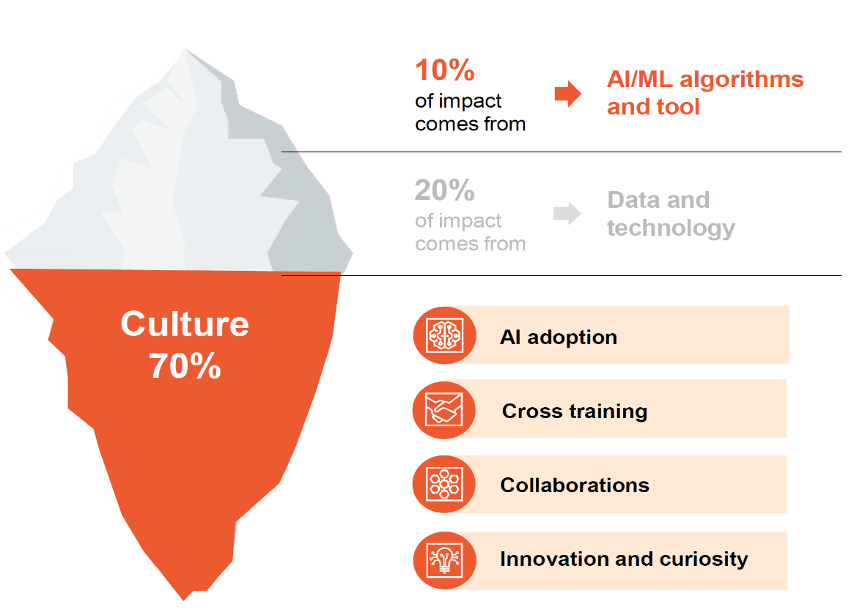
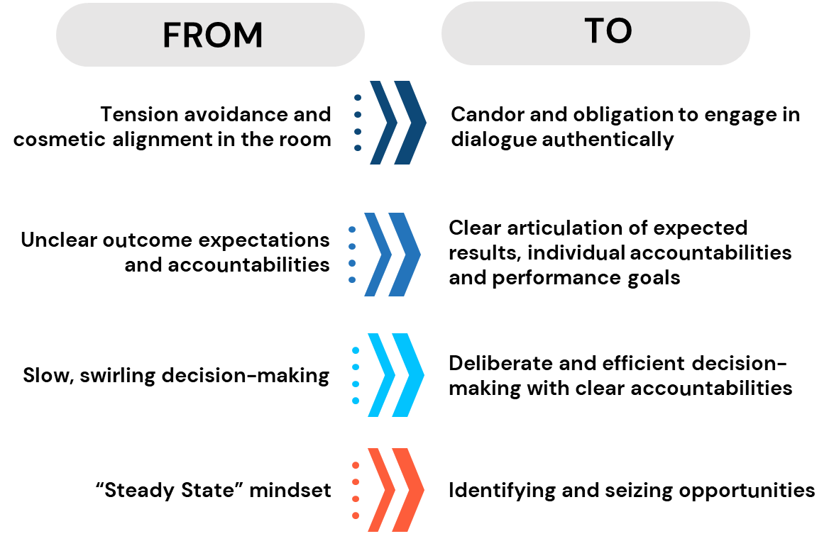

The success, or failure, of an AI adoption will hinge on our ability to role model and demonstrate our core culture shifts.
Implementing AI isn’t just about new technology, it’s a cultural shift.
Adopting “Blue Behaviors” will be key to moving towards an AI-First culture.
Organizations must change the ways they work to embrace AI.
We must be prepared to model curiosity and experimentation mindsets.

Slide 10
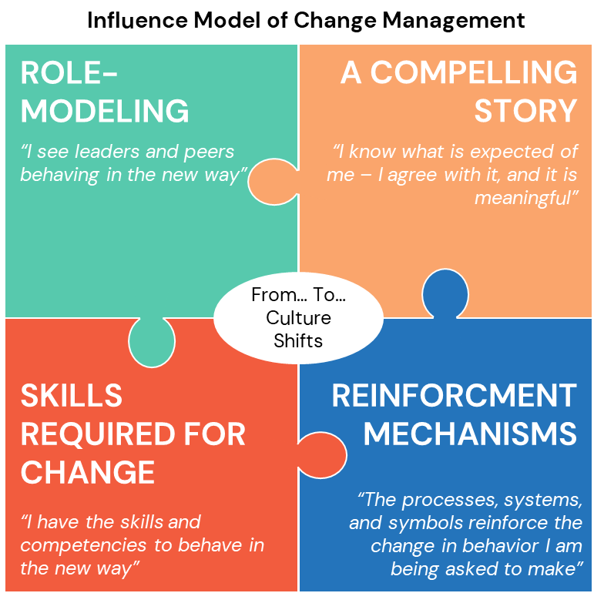
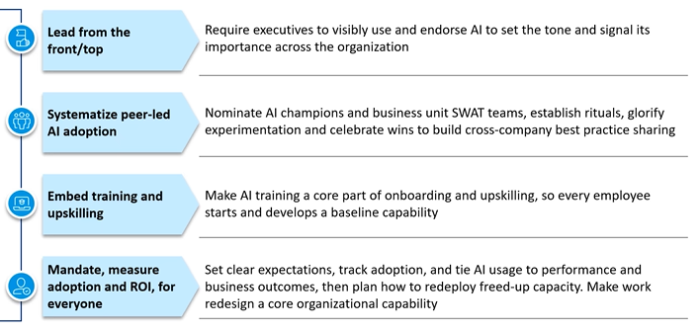
To drive AI adoption, leaders must embody Blue behaviors, moving the organization from a steady-state to an opportunity-seizing mindset.
Throughout our adoption and rollout we will which emphasize the continuous loop of experimentation, feedback, and adaptation – which aligns with our broader culture goals.
Notes:
What is success + Fear (not keeping up with other blues, and external in POV). > Theme: Systemic issues in how we do everything (IT, data, risk, etc)

Slide 11
Our AI workforce transformation aims to drive fluency, shift mindsets, and deliver results across all levels of our organization.
 | Three core goals of our workforce readiness & transformation strategy
 | Equip with fluency to enable practical, day-to day use of new tools | Foster new mindsets through storytelling and role modeling. | Deliver through application with hands-on practice to turn ideas into reality. | Example tactics to support goals
Executive leaders | Become AI fluent for purpose of driving strategy & culture | Foster culture of innovation with compelling narrative and role model visible engagement and AI adoption | Shape Enterprise AI strategy to meet their needs & own functional AI-strategies | Attend today’s ½ Day AI Executive Offsite to activate leaders Adopt leadership roles in AI roadmap creation via broader AI governance structure
Director+ | Become AI fluent for purpose of owning use cases & driving adoption | Foster culture of innovation with compelling narrative and empower teams to drive AI divisional adoption | Understand Enterprise AI strategy and own functional use case development & re-imagining of existing processes | Attend G+ Session to align on leader expectations with AI adoption and experimentation Play key contributor role in AI roadmap creation via broader AI governance structure
AI Champions | Become AI fluent for purpose of championing use and encourage teams to drive adoption | Champion AI adoption and innovation mindset through role modeling & influence | Showcase how tools can be leveraged through hosting use-case experimentation sessions. | Join AI Champion Network (November launch) to obtain access to tools & supports to empower teams & peers
All associates | Become AI fluent to drive day-to-day personal effectiveness | Experiment with available AI tools | Identify use cases for AI-enabled efficiencies in day-to-day work. | Attend introductory tool agnostic AI Fluency Learning Series, including prompting basics (November launch)
Notes:
Reskilling

Slide 12

NEXT STEPS

Slide 13
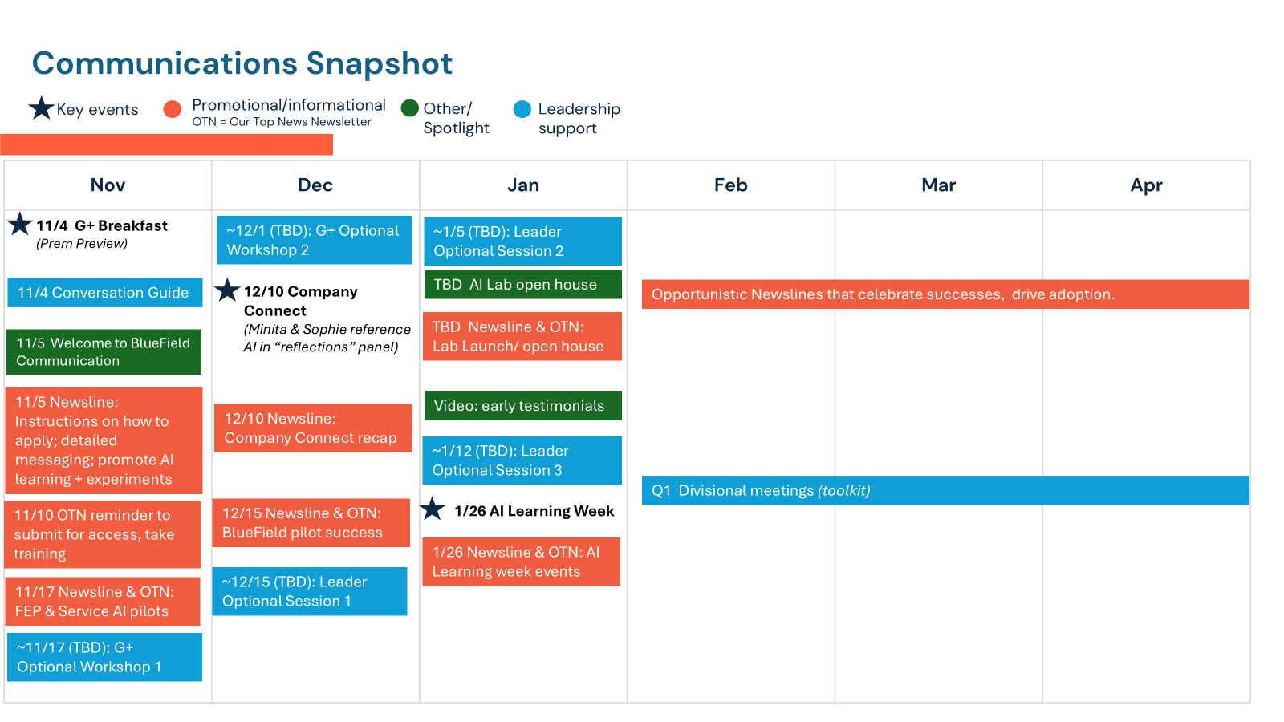
We will use a rolling launch, helping associates understand why AI is important, it’s benefits and, how they can engage and learn.
Next Steps: Bluefield Rollout
11/4: Leader Preparedness at G+ Breakfast
11/5: Enterprise-wide introduction of BlueField
Nov – Jan: AI Experimentation workshops, for users to learn and explore
Ongoing communication and learning events to continue the narrative and share information (e.g. G+ Meeting, Company Connect, etc.)
Next Steps: Business Transformation Opportunities
Ongoing: Identify highest priority functions with greatest value opportunities
Nov – Jan: Divisional AI Roadmap co-creation workshops supported by Deloitte
Nov+: AI Lab operational for rapid prototyping opportunities
Notes:
Other prompts to explore if interested.
Heres an example.

Slide 14
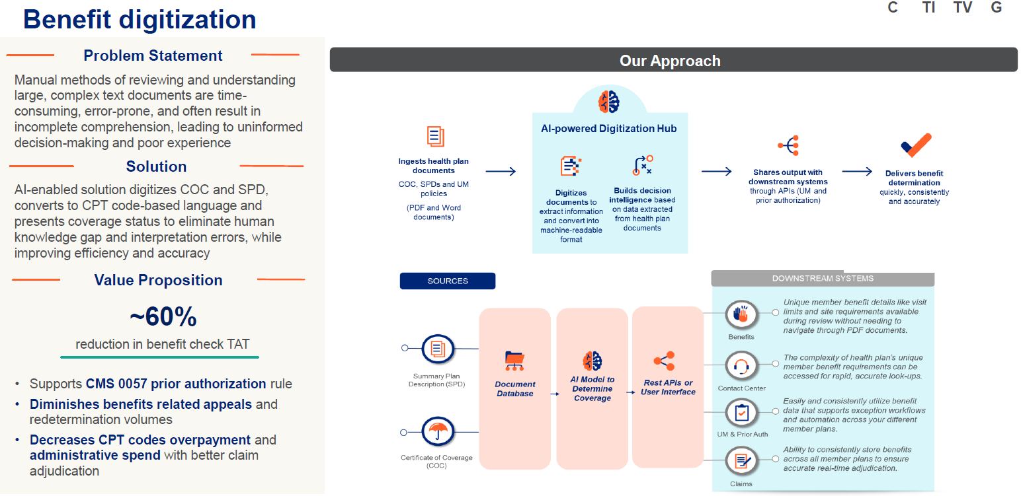
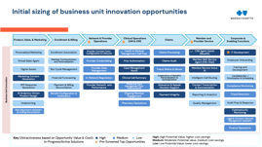
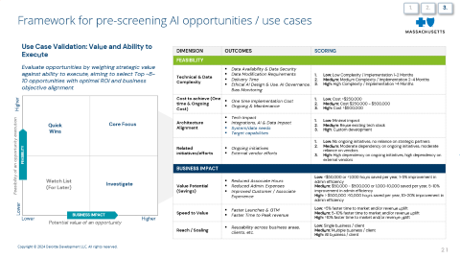
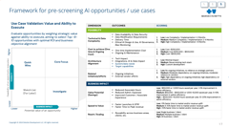
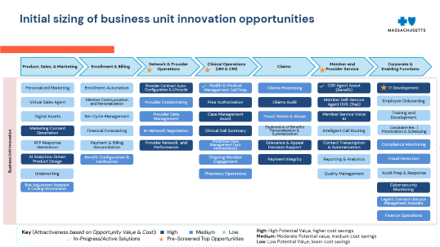
Next steps to create and action our AI roadmap
OPPORTUNITY IDENTIFICATION
BUSINESS/TECH CO-CREATION
SOLUTION PRIORITIZATION & PLANNING
1
Identify highest priority functions with greatest value opportunities
2
Develop use cases for agentic workflows based on the art of the possible
3
Value & prioritize AI use cases and determine approach to action
For each use case, map out current knowledge and data, business reasoning, and actions to inform intelligence layer and AI tools needed
For each use case, map out current knowledge and data, business reasoning, and actions to inform intelligence layer and AI tools needed
For each use case, assess feasibility (technical complexity, cost, architecture alignment) and business impact (value, speed to execution, reach) and determine best build/buy/partner approach to action
While we intend to partner with Deloitte to rapidly launch this process, this must be established as a continuous process that includes piloting, scaling, and outcome tracking, is aligned via governance with the AI risk committee, and is coordinated with strategic and financial business planning and resource allocation

Slide 15
APPENDIX

Slide 16


Initial sizing of business unit innovation opportunities
Product, Sales, & Marketing
Enrollment & Billing
Network & Provider Operations
Clinical Operations (UM & CM)
Claims
Member and Provider Service
Corporate & Enabling Functions
Business Unit Innovation
Personalized Marketing
Enrollment Automation
Provider Contract Auto-Configuration & Lifecycle
Health & Medical Management Call Prep
Claims Processing
CSR Agent Assist (Benefit)
IT Development
Virtual Sales Agent
Member Communication and Personalization
Provider Credentialing
Prior Authorization
Claims Audit
Member Self-Service Agent (IVR, Chat)
Employee Onboarding
Digital Assets
Rev Cycle Management
Provider Data Management
Case Management Assist
Fraud, Waste & Abuse
Member Service Voice AI
Training and Development
Marketing Content Generation
Financial Forecasting
In-Network Negotiation
Clinical Call Summary
Explanation of Benefits Personalization & Summarization
Intelligent Call Routing
Candidate Rec. / Prioritization & Scheduling
RFP Response Generation
Payment & Billing Reconciliation
Provider Network and Performance
Predictive Care Management (incl. interventions)
Grievance & Appeal Decision Support
Contact Transcription & Summarization
Compliance Monitoring
AI Analytics-Driven Product Design
Benefit Configuration & Verification
Ongoing Member Engagement
Payment Integrity
Reporting & Analytics
Fraud Detection
Underwriting
Pharmacy Operations
Quality Management
Audit Prep & Response
Risk Adjustment Assistant & Coding Recommend.
Cybersecurity Monitoring
Legal & Contract Lifecycle Management Assistant
Finance Operations
Key (Attractiveness based on Opportunity Value & Cost):
High
Medium
Low
High: High Potential Value, higher cost savings
Medium: Moderate Potential value, medium cost savings
Low: Low Potential Value; lower cost savings
In-Progress/Active Solutions
Pre-Screened Top Opportunities

Slide 17
Framework for pre-screening AI opportunities / use cases
1.
2.
3.
Use Case Validation: Value and Ability to Execute
DIMENSION | OUTCOMES | SCORING
FEASIBILITY
Technical & Data Complexity | Data Availability & Data Security Data Modification Requirements Delivery Time Ethical AI Design & Use, AI Governance, Bias Monitoring | Low: Low Complexity / Implementation 1-2 Months Medium: Medium Complexity / Implementation 2-4 Months High: High Complexity / Implementation >4 Months
Cost to achieve (One time & Ongoing Cost) | One time Implementation Cost Ongoing & Maintenance | Low: Cost <$250,000 Medium: Cost $250,000 - $500,000 High: Cost >$500,000
Architecture Alignment | Tech Impact Integrations, AI & Data Impact System/data needs Target capabilities | Low: Minimal impact Medium: Reuse existing tech stack High: Custom development
Related initiatives/efforts | Ongoing initiatives External vendor efforts | Low: No ongoing initiatives, no reliance on strategic partners Medium: Moderate dependency on ongoing initiatives, moderate reliance on vendors High: High dependency on ongoing initiatives, high dependency on external vendors
BUSINESS IMPACT
Value Potential (Savings) | Reduced Associate Hours Reduced Admin. Expenses Improved Customer / Associate Experience | Low: <$50,000 or <1,000 hours saved per year, 1-5% improvement in admin efficiency Medium: $50,000 - $500,000 or 1,000-10,000 saved per year, 5-10% improvement in admin efficiency High: > $500,000 >10,000 hours saved per year, 10-20% improvement in admin efficiency
Speed to Value | Faster Launches & GTM Faster Time to Peak revenue | Low: <5% faster time to market and/or revenue uplift Medium: 5-10% faster time to market and/or revenue uplift High: >10% faster time to market and/or revenue uplift
Reach / Scaling | Reusability across business areas, clients, etc. | Low: Single business / client Medium: Multiple business / client High: All business / client
Evaluate opportunities by weighing strategic value against ability to execute, aiming to select Top ~8-10 opportunities with optimal ROI and business objective alignment
Higher
Feasibility of an opportunity execution
FEASIBILITY
Quick Wins
Core Focus
Watch List
(For Later)
Investigate
Lower
BUSINESS IMPACT
Potential value of an opportunity
Lower
Higher

Slide 18

Architecture strategy - Appendix

Slide 19




Context: “AI” solutions are made up of foundational building blocks which define the functionality of the solution
LLM | SLM | RAG | Agents | Agentic AI | Multi-Agent
Large Language Model - A knowledgeable person who can answer general questions but only with information they already know and can't use tools or remember your past requests | Specialized Language Model - A domain expert trained on organization-specific data and context to deliver precise, reliable insights for specialized topics. | Retrieval-Augmented Generation - A knowledgeable person with access to a library so they can look up facts to provide better, more current answers | A personal assistant who not only uses the library but can also plan a project, use the phone (API calls), send emails, and remember your preferences over time to work autonomously. | A self-improving assistant that reasons, plans, and acts independently — learning from outcomes to make better decisions over time. | A team of specialized assistants (e.g., one researcher, one writer, one finance expert), collaborating and communicating to complete a, large, complex project that no single assistant could manage alone
e.g., Clinical Coding SLM
e.g., ChatGPT 5.0
e.g., Sierra
e.g., Bluefield Orchestrator
e.g., ChatGPT1.0
e.g., Actuarial SLM
e.g., Bluefield
e.g., HMM call prep
e.g., Provider Contractor
User interface through which a user interacts with an AI system
Model trained on organization-specific data for purpose-built accuracy
Raw source data & logic to understand and interpret it that augments core LLM
Capability to use external tools, services, & APIs
Autonomous reasoning that learns, plans, and adapts from outcomes
The shared space or context where agents operate and interact.
Enviornment
App
Purpose-Built
Knowledge
Tools
Autonomy
Storage of information from past interactions & learned patters
Core components (additive)
Improved performance for specific purpose over standard LLM
Memory
Advanced form of natural language processing
Architecture retrieve information and appropriately augment internal knowledge
Break down a complex goal into smaller, manageable tasks
Manage dependencies and ensure alignment toward a common goal
Coordiantion
LLM
Performance
RAG
Reasoning/Planning
Perform actions via external APIs, interacting with other UIs
Action

Slide 20
Option 2
Our end state vision: We will build an intelligence layer to bring BCBSMA’s AI capabilities come to life
From
To
Current State:
Individuals execute defined workflows, initiating engagement with applications and relevant data stores.
Future State:
The intelligence layer will orchestrate workflows, activate reusable agents, and continuously learn from outcomes.
Workforce
Workforce
Business Process Workflow
Business Process Workflow
Applications
Applications
ENTERPRISE INTELLIGENCE LAYER
Member Experience
Claims
Provider Network
Payments
Pharmacy
Illustrative Repository of Reusable Intelligent Domain Cross-Functional Agents
Member Experience
Claims
Provider Network
Payments
Pharmacy
Data
Data

Slide 21
Our approach: We must rapidly but strategically assemble the core components of a holistic AI ecosystem while protecting our core business differentiators
BUY
foundations & prebuilt solutions
PARTNER
for acceleration & expertise
BUILD
for differentiation
MAINTAIN + RATIONALIZE
to enable AI future / longevity
Buy components that would either require vast resources (talent, data, compute) to develop in-house and / or do not distinguish the BCBSMA business
Partner to gain access to specific capabilities quickly or specialized expertise and guidance in a complex area
Build proprietary assets that integrate into core operations and enterprise strategy to transform the business and sustain competitive edge
Maintain a flexible data ecosystem that continuously optimizes performance, compliance, and alignment to overall strategy for maximum value creation
LLMs: e.g., CPT, Claude, Gemini
Core Infrastructure: Cloud computing resources (AWS, Azure, GCP)
Specialized Databases: A vector database for RAG (Retrieval-Augmented Generation).
Basic Security Software: Standard firewalls, access management tools, etc.,
AI Model Libraries: prebuilt models (e.g., Change Healthcare, Health Catalyst)
Collaboration with Specialty Vendors: for niche use cases like medication adherence, narrow marketing channels, etc.
Solution Integrations: end to end platforms for data ingestion, cleaning, modeling, etc.
Unified Intelligence Layer: aggregation of data and insights across partners and internally developed sources
Critical Opportunities to Customize: for areas where personalization is key to gaining competitive advantage e.g., member engagement, provider data management, clinical decision support, etc.
Continuous Data Governance and Quality Programs: e.g., enterprise data stewardship council
Embedded AI: to power operational efficiency and scalability e.g., swap, upgrade, etc.
Upskilling Workforce: trainings and certifications to scale talent with ecosystem
Examples

Slide 22

AI ROADMAP

Slide 23
For example, our Bluefield initiative is focused on associate productivity across all functions
Transformative scope
Includes opportunities to leverage AI solutions for a range of purposes…
Functional scope
…Across all functions and business units…
IT approach
…While aligning with our overall architecture strategy & principles…
Value generated
…To drive measurable value and further our Enterprise strategy…
Associate Productivity
Raise productivity of each associate by putting general purpose agents at their fingertips
Product, Sales, & Marketing
Build
Improve productivity
Enrollment & Billing
Buy/Vend
Establish AI fluency
Business Unit Innovation
Solve key business challenges by integrating innovative AI-enabled solutions into workflows
Network & Provider Operations
Partner
Reduce admin costs
Clinical Operations
Reduce medical costs
Claims
Increase revenue
Enterprise Core Business Reimagined
Marry bold AI plays together to reimagine the core business
Member & Provider Service
Improve experiences
Corporate & Enabling Functions

Slide 24
BCBSMA AI roadmap illustrating future opportunity use cases categorized by transformative & functional scope
Key:
Active Solutions Pursued
Pipeline
Future Opportunities
High Value Opportunities
Transformative scope
Functional Scope
Product, Sales, & Marketing
Enrollment & Billing
Network & Provider Operations
Clinical Operations
Claims
Member and Provider Service
Corporate & Enabling Functions
Associate Productivity
Bluefield
Co-Pilots
Secure Browser Access
Business Unit Innovation
Personalized Marketing
Enrollment Automation
Provider Contract Auto-Configuration & Lifecycle
HMM Call Prep
Claims Processing
CSR Agent Assist (Benefit)
Employee Onboarding
Virtual Sales Agent
Member Communication and Personalization
Provider Credentialing
Clinical Review
Claims Audit
Member Self-Service Agent (IVR, Chat)
Training and Development
Digital Assets
Rev Cycle Management
Provider Data Management
Prior Authorization
Fraud, Waste & Abuse
Member Service Voice AI
Compliance Monitoring
Marketing Content Generation
Financial Forecasting
In-Network Negotiation
Case Management Assist
Explanation of Benefits Personalization & Summarization
Intelligent Call Routing
Fraud Detection
RFP Response Generation
Payment & Billing Reconciliation
Provider Network and Performance
Clinical Call Summary
Grievance & Appeal Decision Support
Contact Transcription & Summarization
Cybersecurity Monitoring
AI Analytics-Driven Product Design
Benefit Configuration & Verification
Pharmacy
Payment Integrity
Virtual Member Assist
Audit Prep & Response
Underwriting
Integrated Advocacy
Quality Management
Legal & Contract Lifecycle Management Assistant
Predictive Care Management
Reporting & Analytics
Candidate Rec. / Prioritization & Scheduling
Ongoing Member Engagement
Risk Adjustment Assistant & Coding Recommend.
Enterprise Core Business Reimagined
AI First IT Development
Zero Ticket ITSM
Differentiated, Personalized Omni Channel Experience
Reimagined Workflow / Inquiry / Service Model

Slide 25
Next steps to create and action our AI roadmap
OPPORTUNITY IDENTIFICATION
BUSINESS/TECH CO-CREATION
SOLUTION PRIORITIZATION & PLANNING
1
Identify highest priority functions with greatest value opportunities
2
Develop use cases for agentic workflows based on the art of the possible
3
Value & prioritize AI use cases and determine approach to action
For each use case, map out current knowledge and data, business reasoning, and actions to inform intelligence layer and AI tools needed
For each use case, map out current knowledge and data, business reasoning, and actions to inform intelligence layer and AI tools needed
For each use case, assess feasibility (technical complexity, cost, architecture alignment) and business impact (value, speed to execution, reach) and determine best build/buy/partner approach to action
While we intend to partner with Deloitte to rapidly launch this process, this must be established as a continuous process that includes piloting, scaling, and outcome tracking, is aligned via governance with the AI risk committee, and is coordinated with strategic and financial business planning and resource allocation

