Slide 1
Wayfair rfp playbook
Strategies to succeed, retain & Grow
Blue Cross Blue Shield of Massachusetts is an Independent Licensee of the Blue Cross and Blue Shield Association.

Slide 2
Client profile: Wayfair
Client details
Business Services client since 2019
10.7k medical members
HQ in Boston, MA (31.5% of members in MA)
Next highest membership in TX, NJ, GA & IL
Decrease in enrollment over the last 4 years.
Contract terms
Current
1/1 anniversary date
Rate guarantee expires 1/1/2026
CPC: $30.50
BAP: 1.00%
Credits: $500k per year
OTHER LINES & services
With BCBSMA
Stop Loss (HRMP)
Telehealth
2nd.MD buy-up
Outside of BCBSMA
Pharmacy (CVS w/ Mercer Coalition)
Dental
Vision
Life/Disability
Spring Health (BH)
Progyny (carve out fertility)
WEX (HSA Administration)
Acc & CI (Voya)
KEY PERSONNEL
Wayfair
David Roth, Global Talent Leader (Total Rewards, Talent Acquisition & Employer Branding)
Ben Grabscheid, NA Benefit Manager
Ali Lynch, Head of Talent Operations, People Analytics, and Total Rewards
Mercer
Greg Hendrickson, Senior Principal
Michael Thompson, Principal
Mitch Grenier, Actuarial/Financial Team
Notes:
RI -503, NJ- 376, PA-342, WA- 254
Growth will happen in CA & GA.

Slide 3
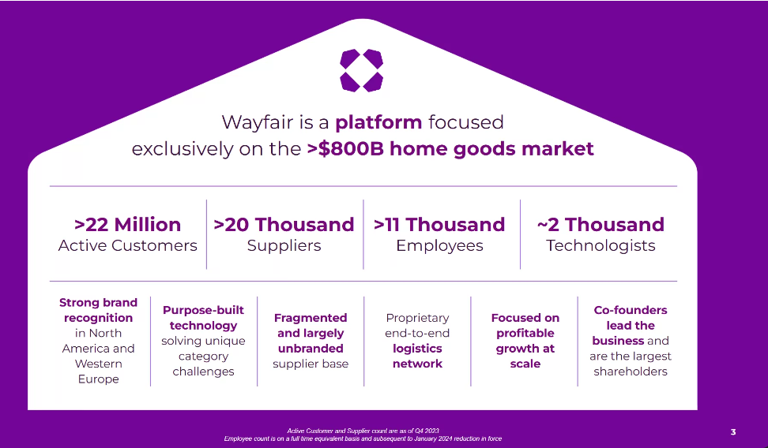

Slide 4
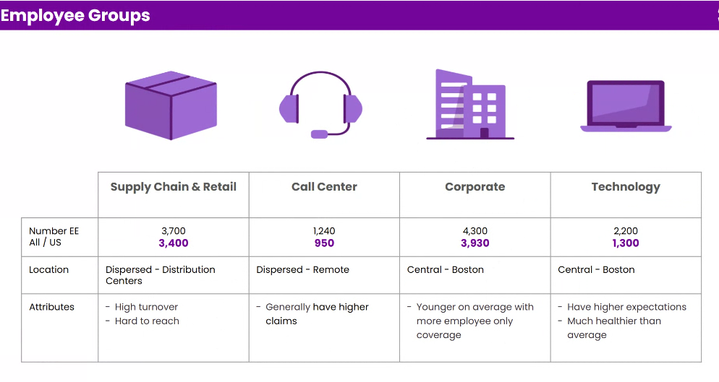

Slide 5
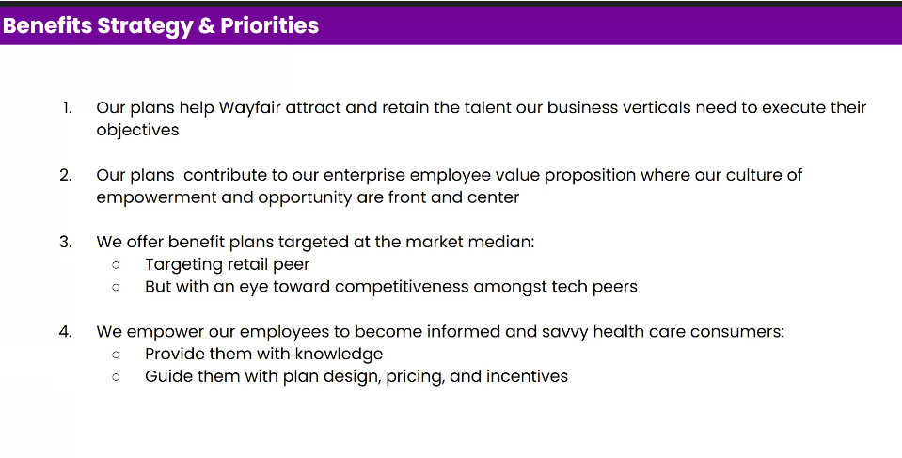

Slide 6
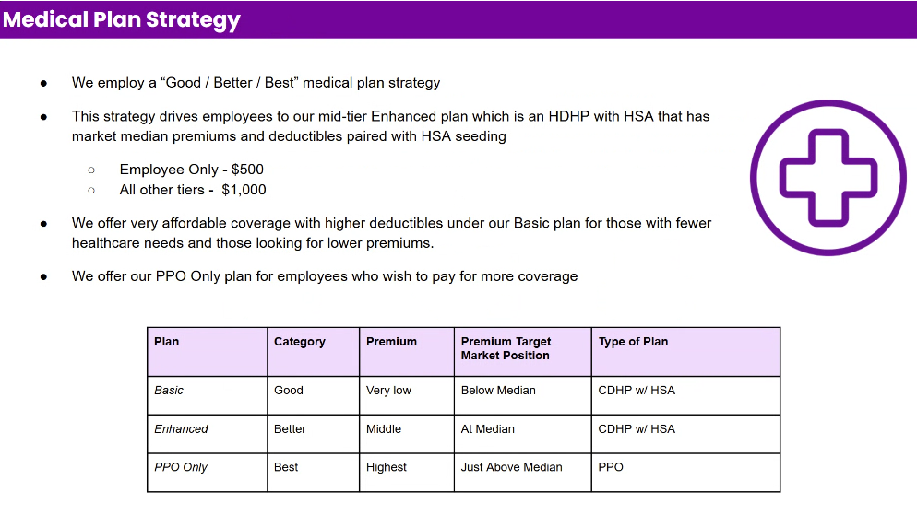

Slide 7
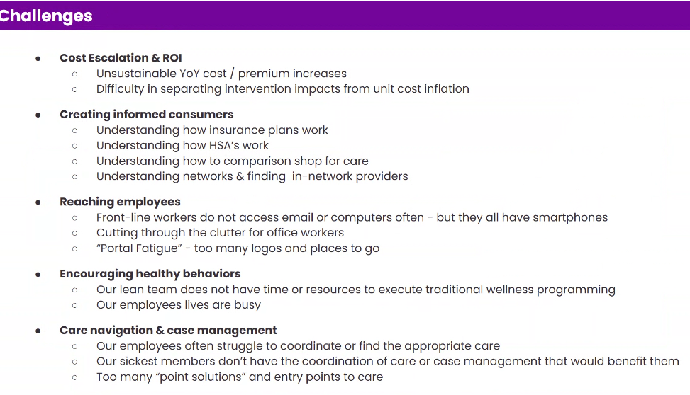

Slide 8
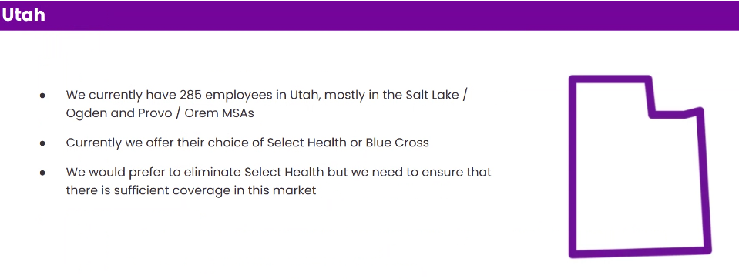

Slide 9
Current medical profile
Benefits
financial
Base fee: $30.50
Telehealth: $0.50
Commission: Net of Commission; N/A
$500k credits
BAP @ 1.00%
OON Shared Savings Cap set at $50K per Claim
$570k at risk for PG’s (Med)
Benefit Design Offering: BlueCard PPO
VPCP
Telehealth
55.7% In-network discount
OON at 150% of Medicare, 2.2% use
No COE, HPN or Select today
HPN was in place, but removed 1/1/2025

Slide 10
Key Threats
Tactics, Strategies to Retain
Leadership Initiative: Risk team has been brought in to create efficiencies within various departments, including HR/Benefits with this RFP.
New HR Team: Existing relationship is not as strong given recent turnover.
Decision Makers: Procurement and Risk are heavily involved in this RFP, making it weigh strongly on financials.
Mercer as new consultant partner will be working to prove their worth to Wayfair and may push for what they perceive to be the best opportunity
Cost: Extremely important and the focus of the RFP. Current CPC is $30.50. We will see aggressive CPC offers from national carriers; total revenue of competitive bids is vital
High name recognition, National’s may look to buy the business with fee holidays, etc..
Perception: It will be important to showcase our ability to service a mostly National Account.
A demonstrated track record of delivery and innovative best-in-class services and solutions with plan management, including excellence in these areas:
Flexible and creative approach to managing cost trends;
Partnering with other Wayfair LLC vendors to provide an integrated and seamless service experience to members; and
Best-in-class claims administration, customer service, and account management to support Wayfair LLC’s employees and expectations.
Administer the plan designs as described and accommodate alternative plan designs in the future.
Provide a designated member service team with a dedicated toll-free number to the member call center.
Provide highly competitive and cost-effective pricing terms and guarantees.
Maintain a highly competitive network of providers providing multiple network solutions to Wayfair LLC to deploy that drive additional savings while increasing quality of care.
Support Wayfair LLC’s data needs including:
Strong reporting capabilities;
Proven capability to turn data into actionable recommendations; and
Willingness to support additional Wayfair LLC initiatives such as wellness, preventive care, etc.
Willingness to coordinate with other vendors as appropriate through data sharing and integration including data warehousing, to support optimal medical outcomes and quality of care for members.
Provide consumer-focused tools and resources, and effectively minimize disruption for Wayfair LLC and their employees.
Capacity to customize services and processes to meet Wayfair LLC’s unique needs.

